Slide 1
One-Cut Magic things you can do with paper
Respect to Martin Gardner
…and my maths teacher Mr Malcolm Quinn
costel.harnasz@gmail.com

Slide 2
One-Cut Magic things you can do with paper
Respect to Martin Gardner
…and my maths teacher Mr Malcolm Quinn
costel.harnasz@gmail.com
^ ^
Mum Romanian Dad Polish

Slide 3
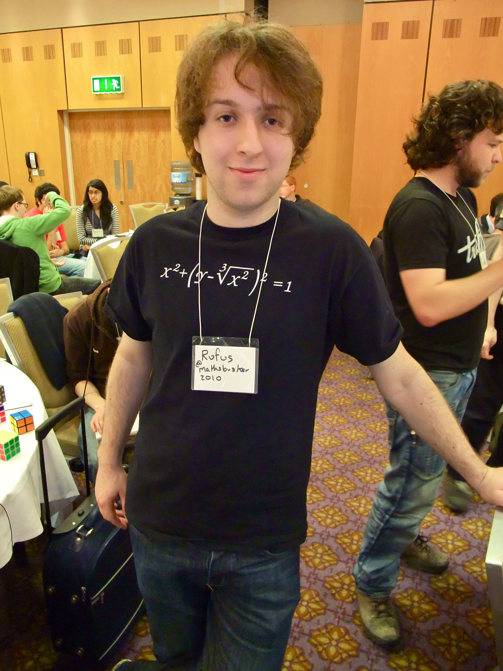

Slide 4
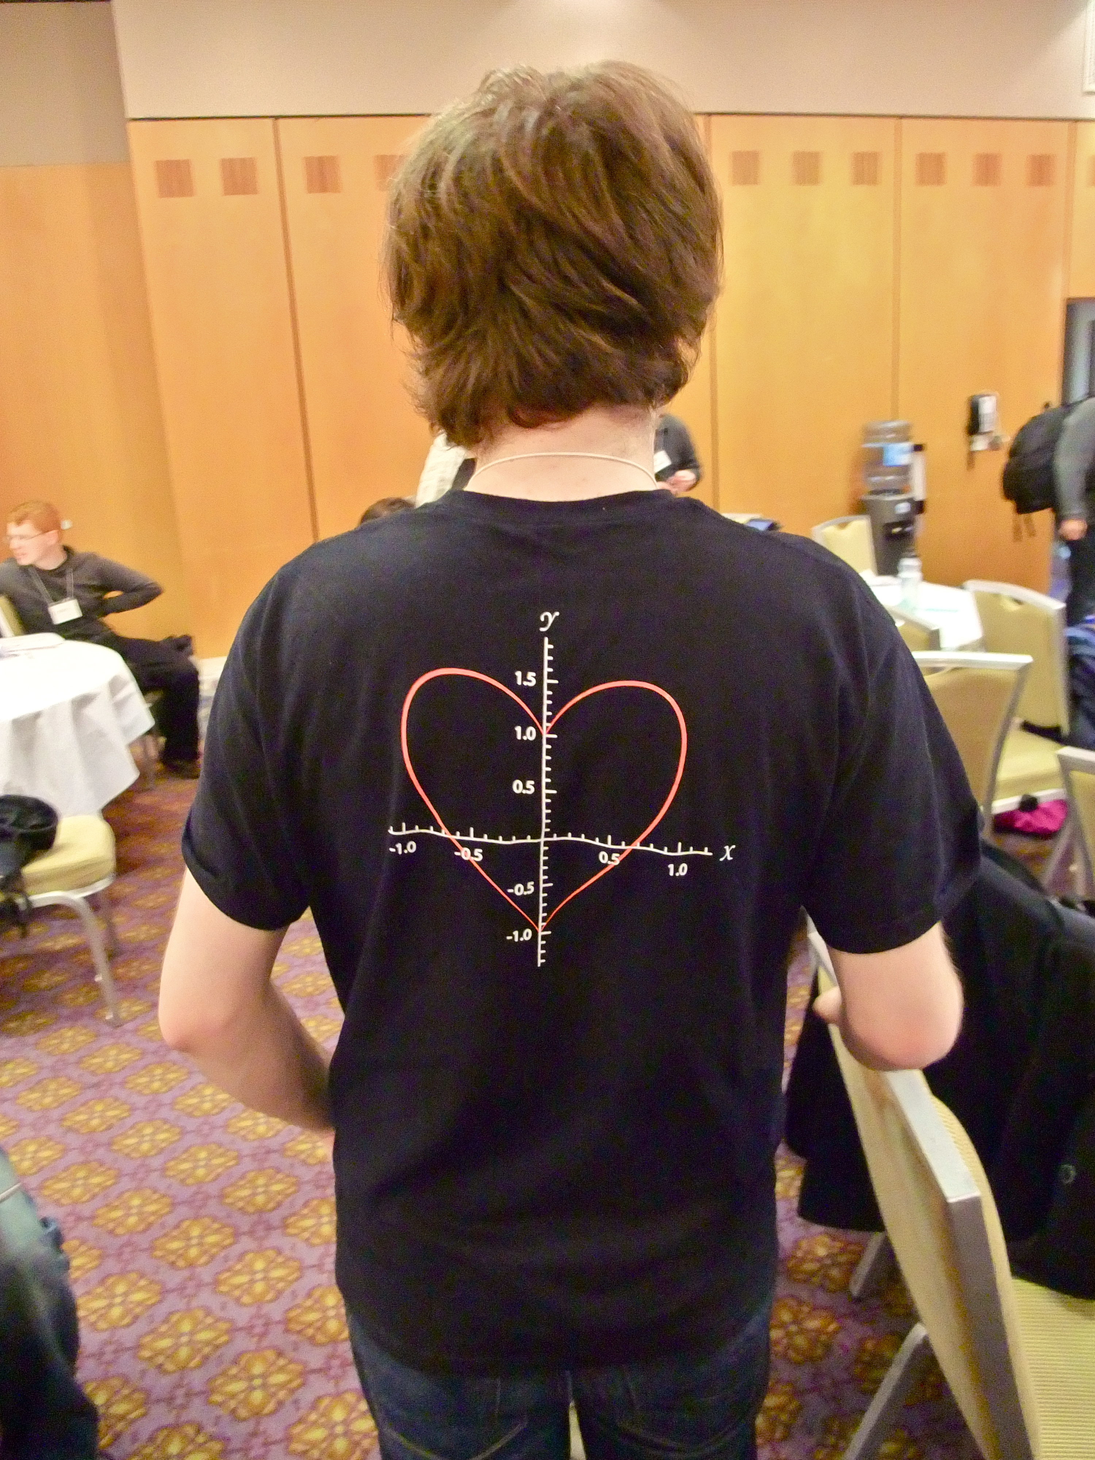

Slide 5
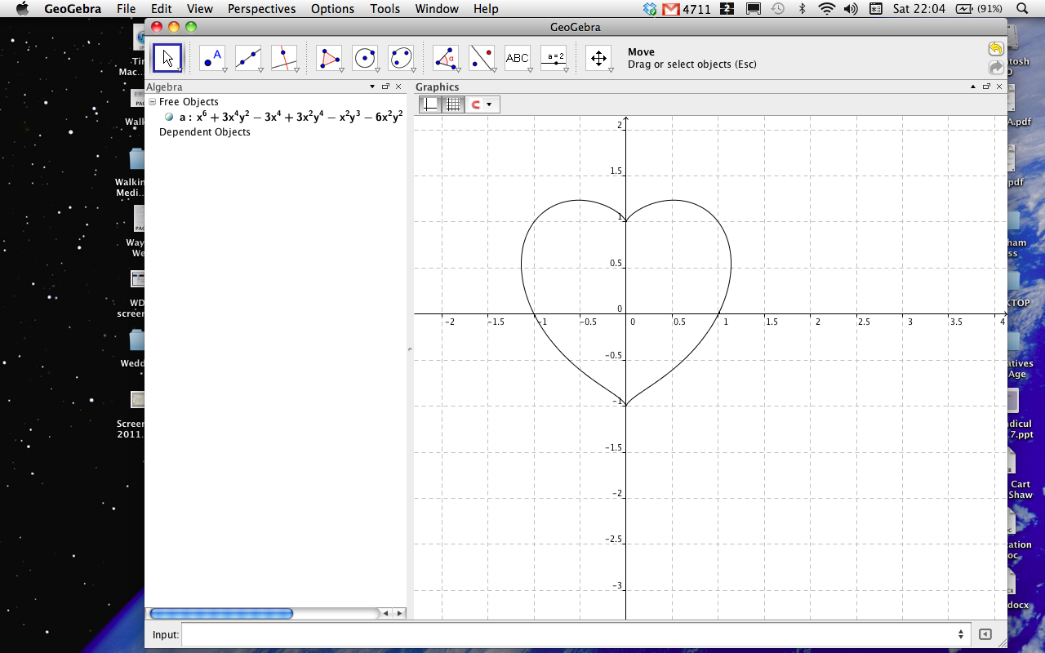

Slide 6
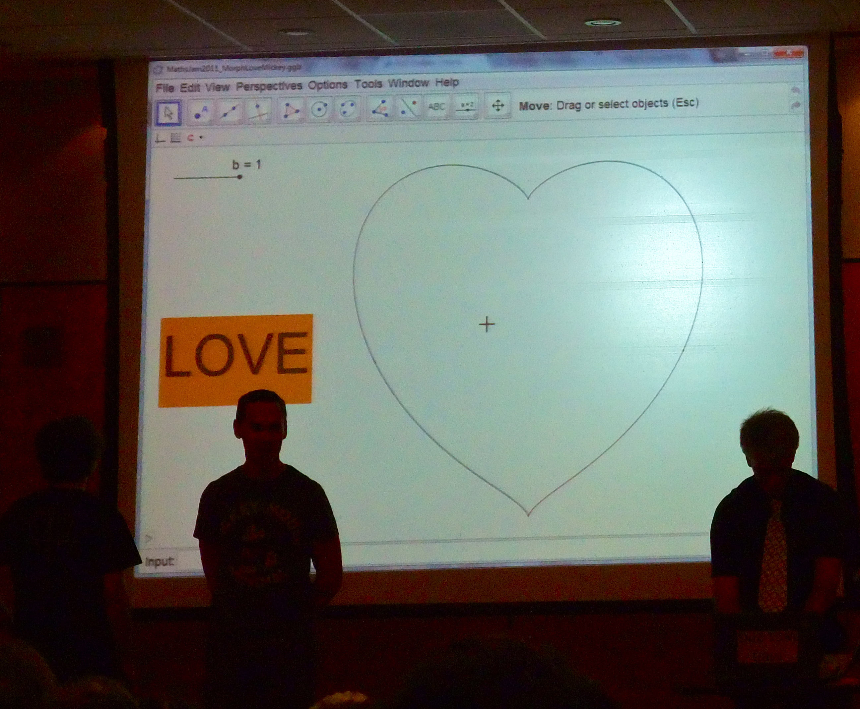

Slide 7
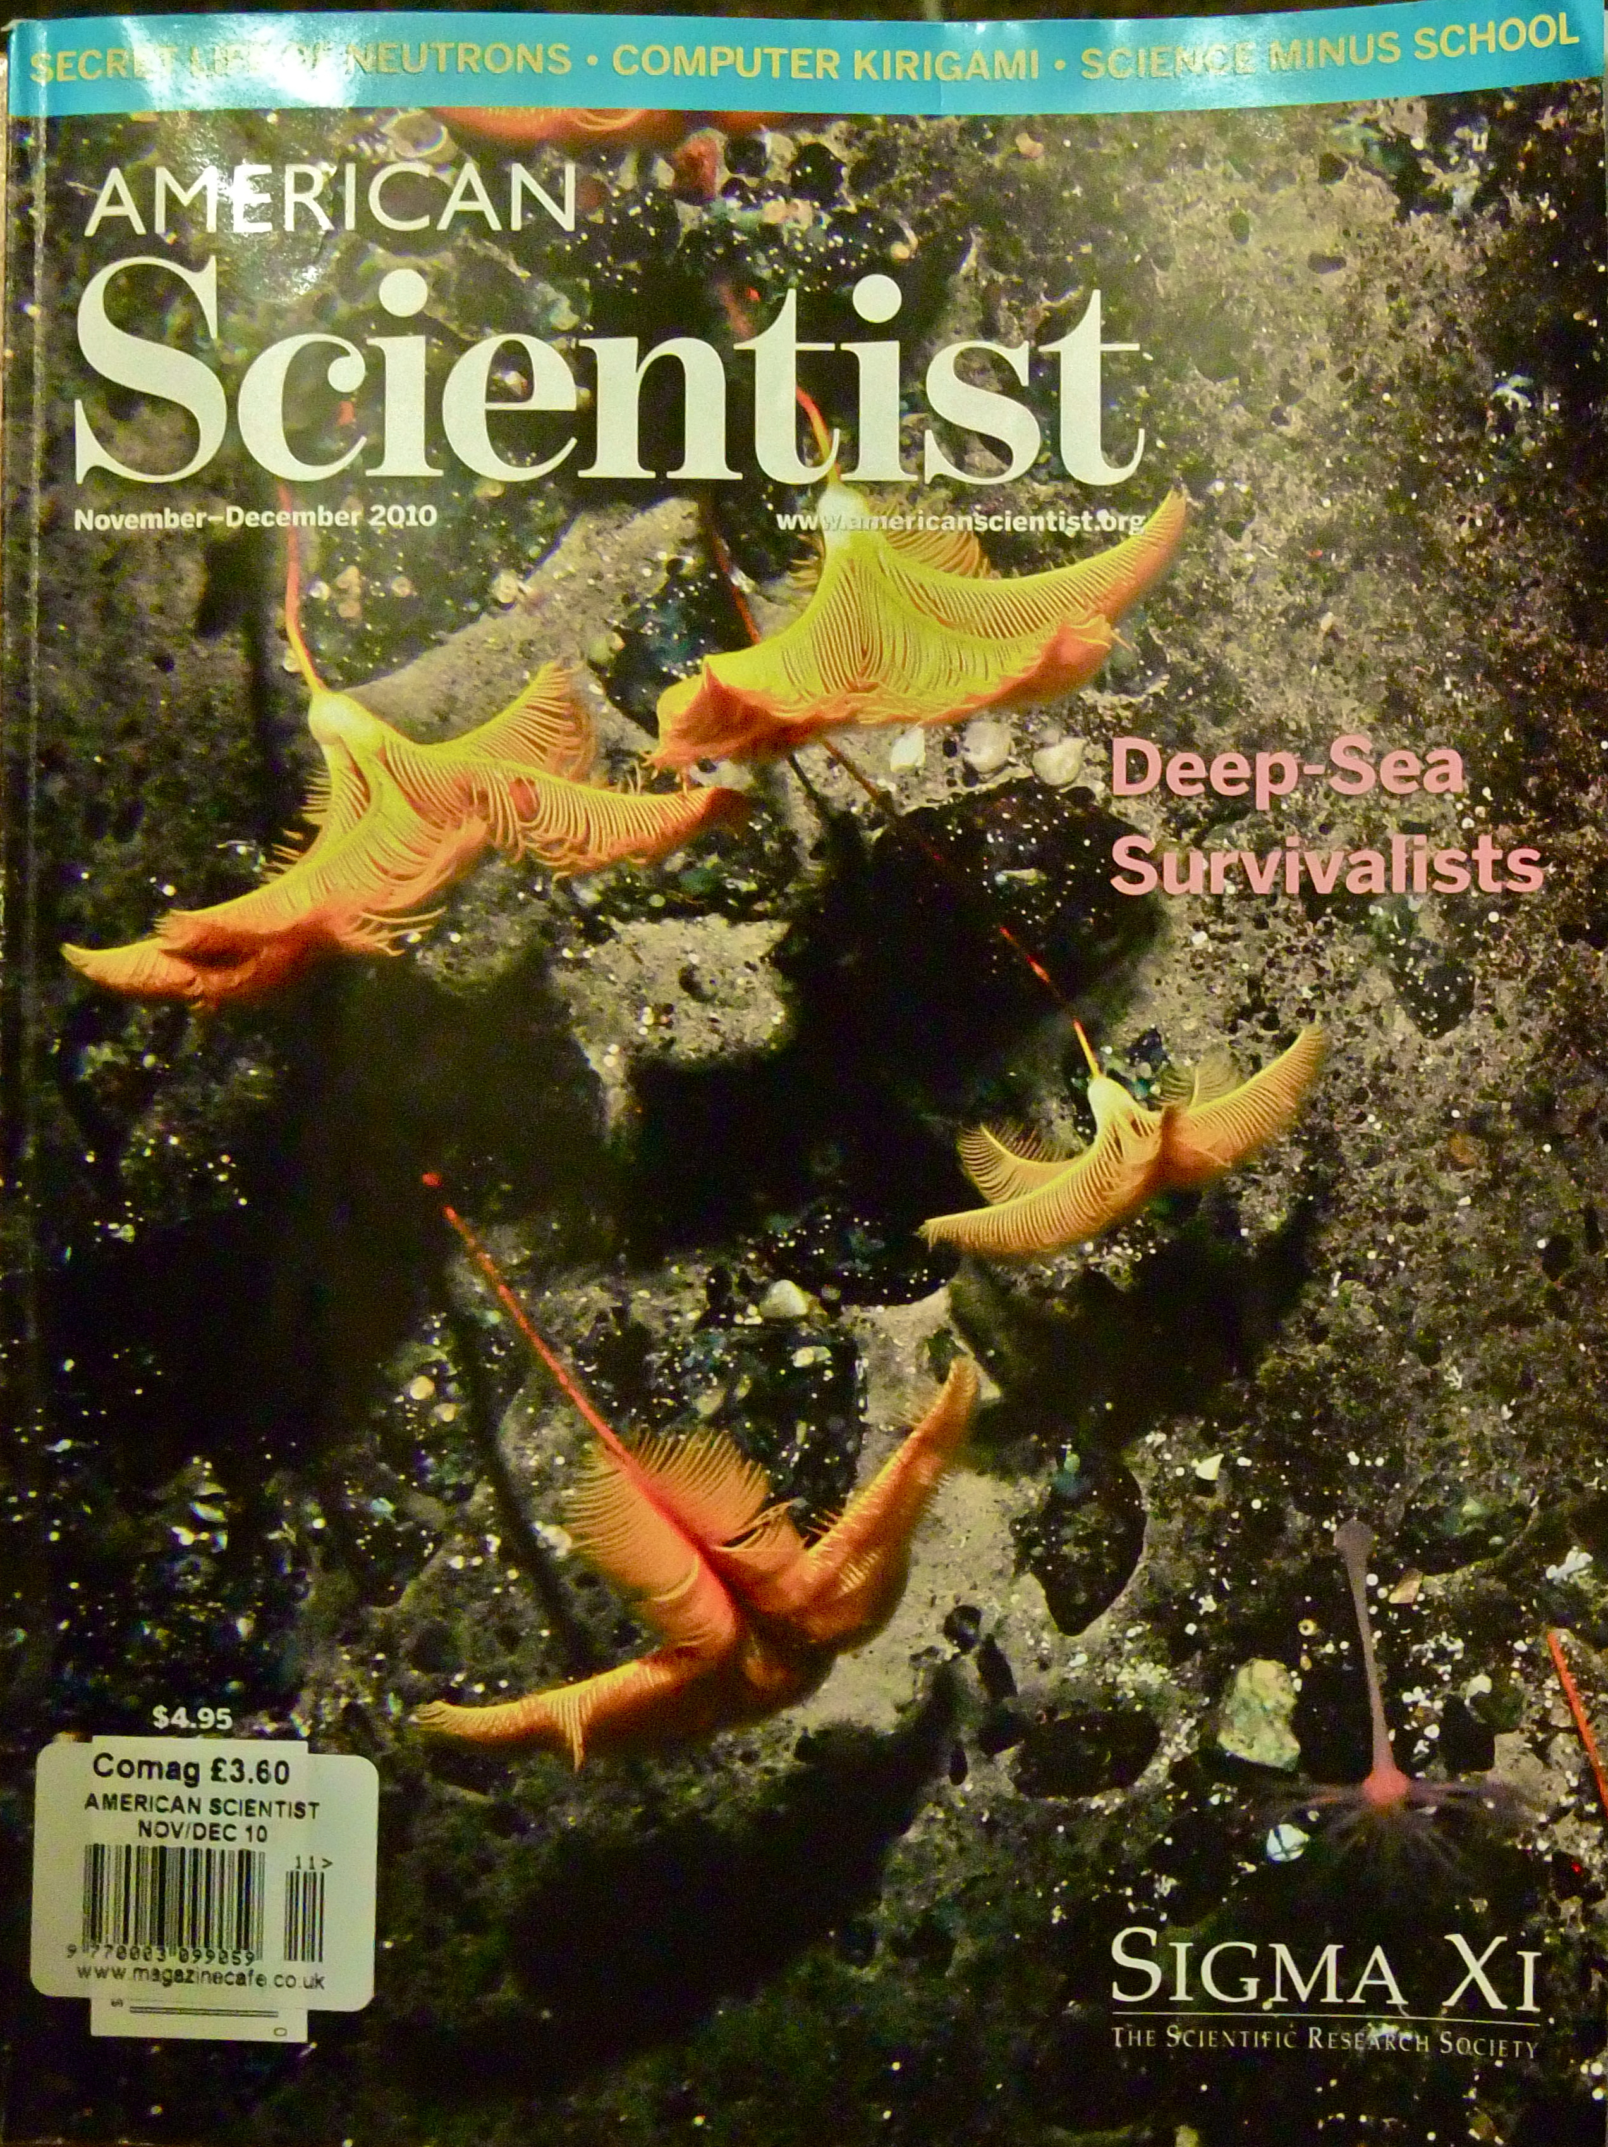

Slide 8
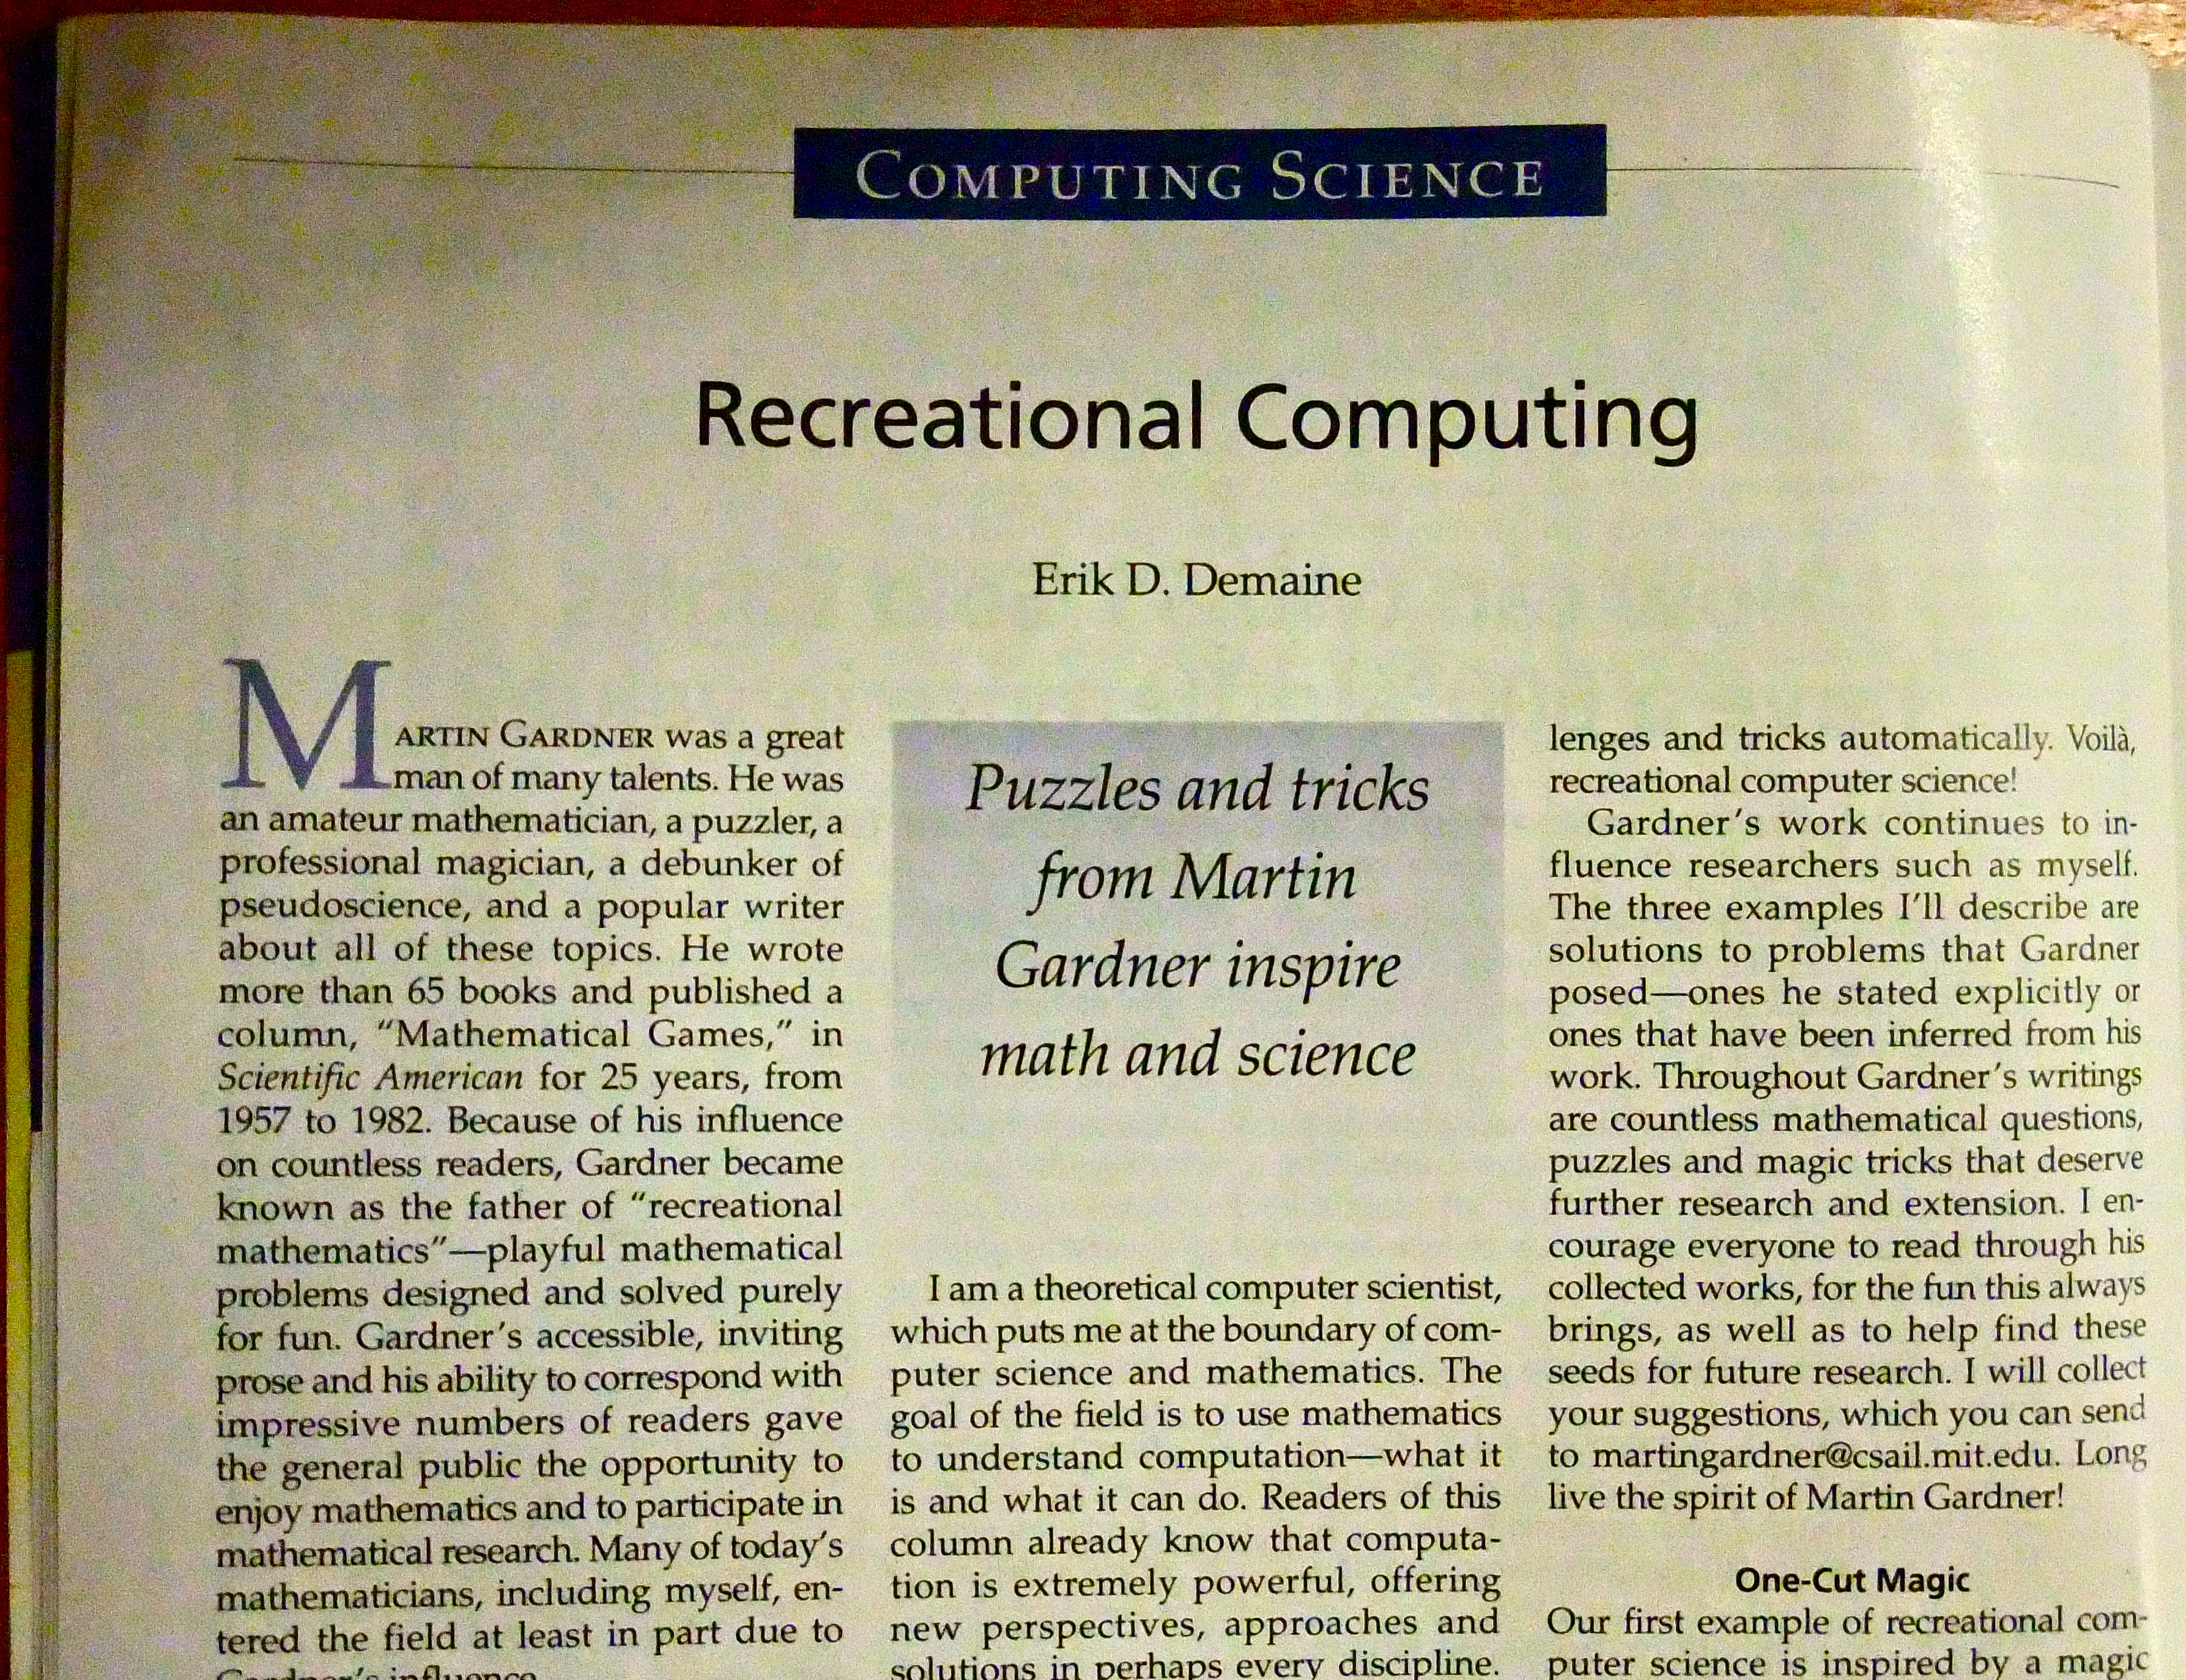

Slide 9
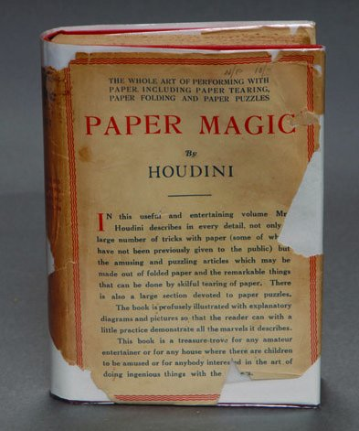

Slide 10
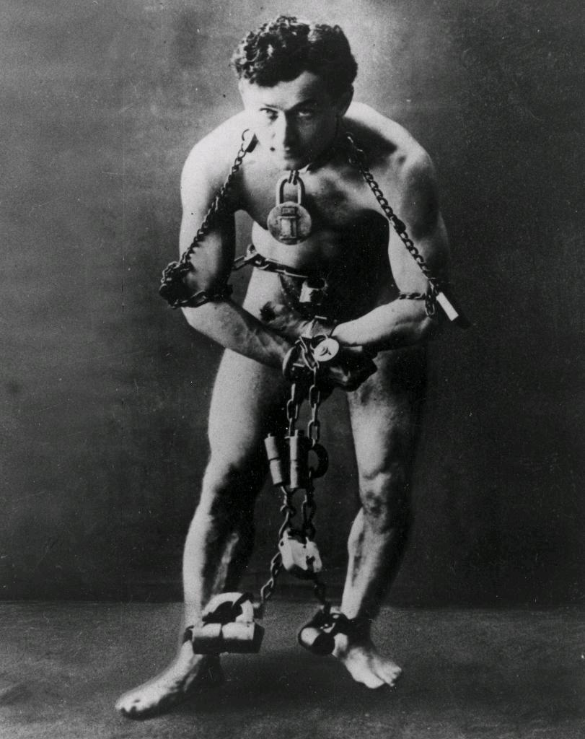

Slide 12
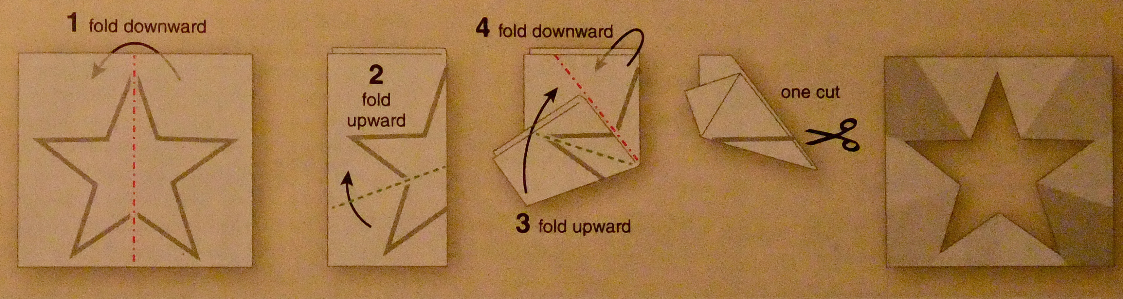

Slide 13
“mormoreemore
“More complicated designs…present formidable problems.”

Slide 14
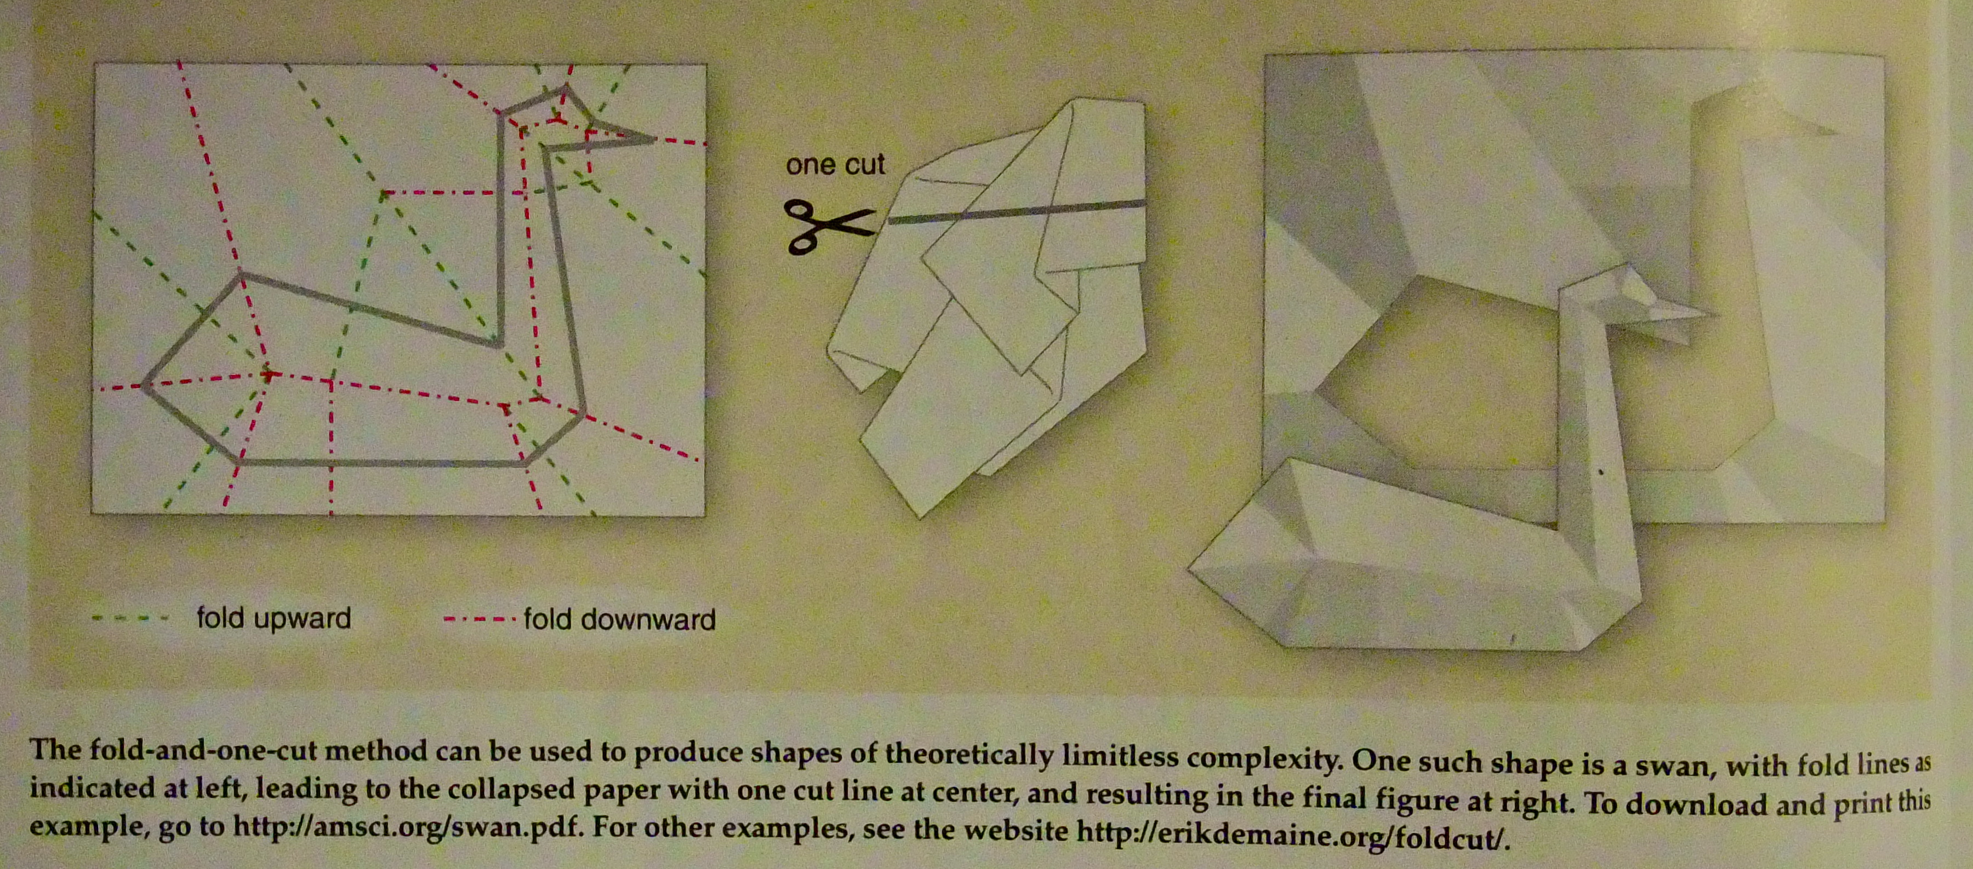

Slide 15
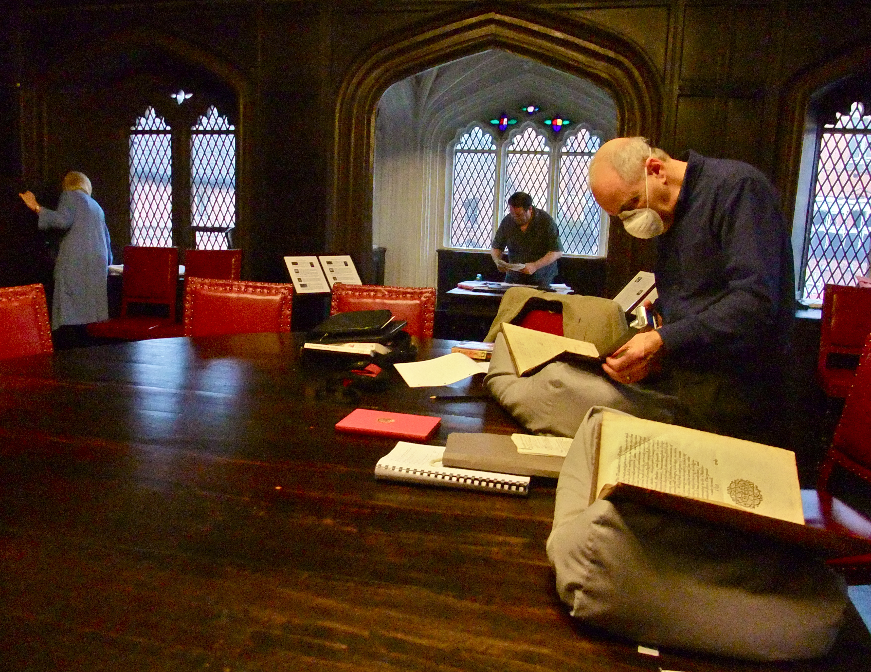

Slide 16
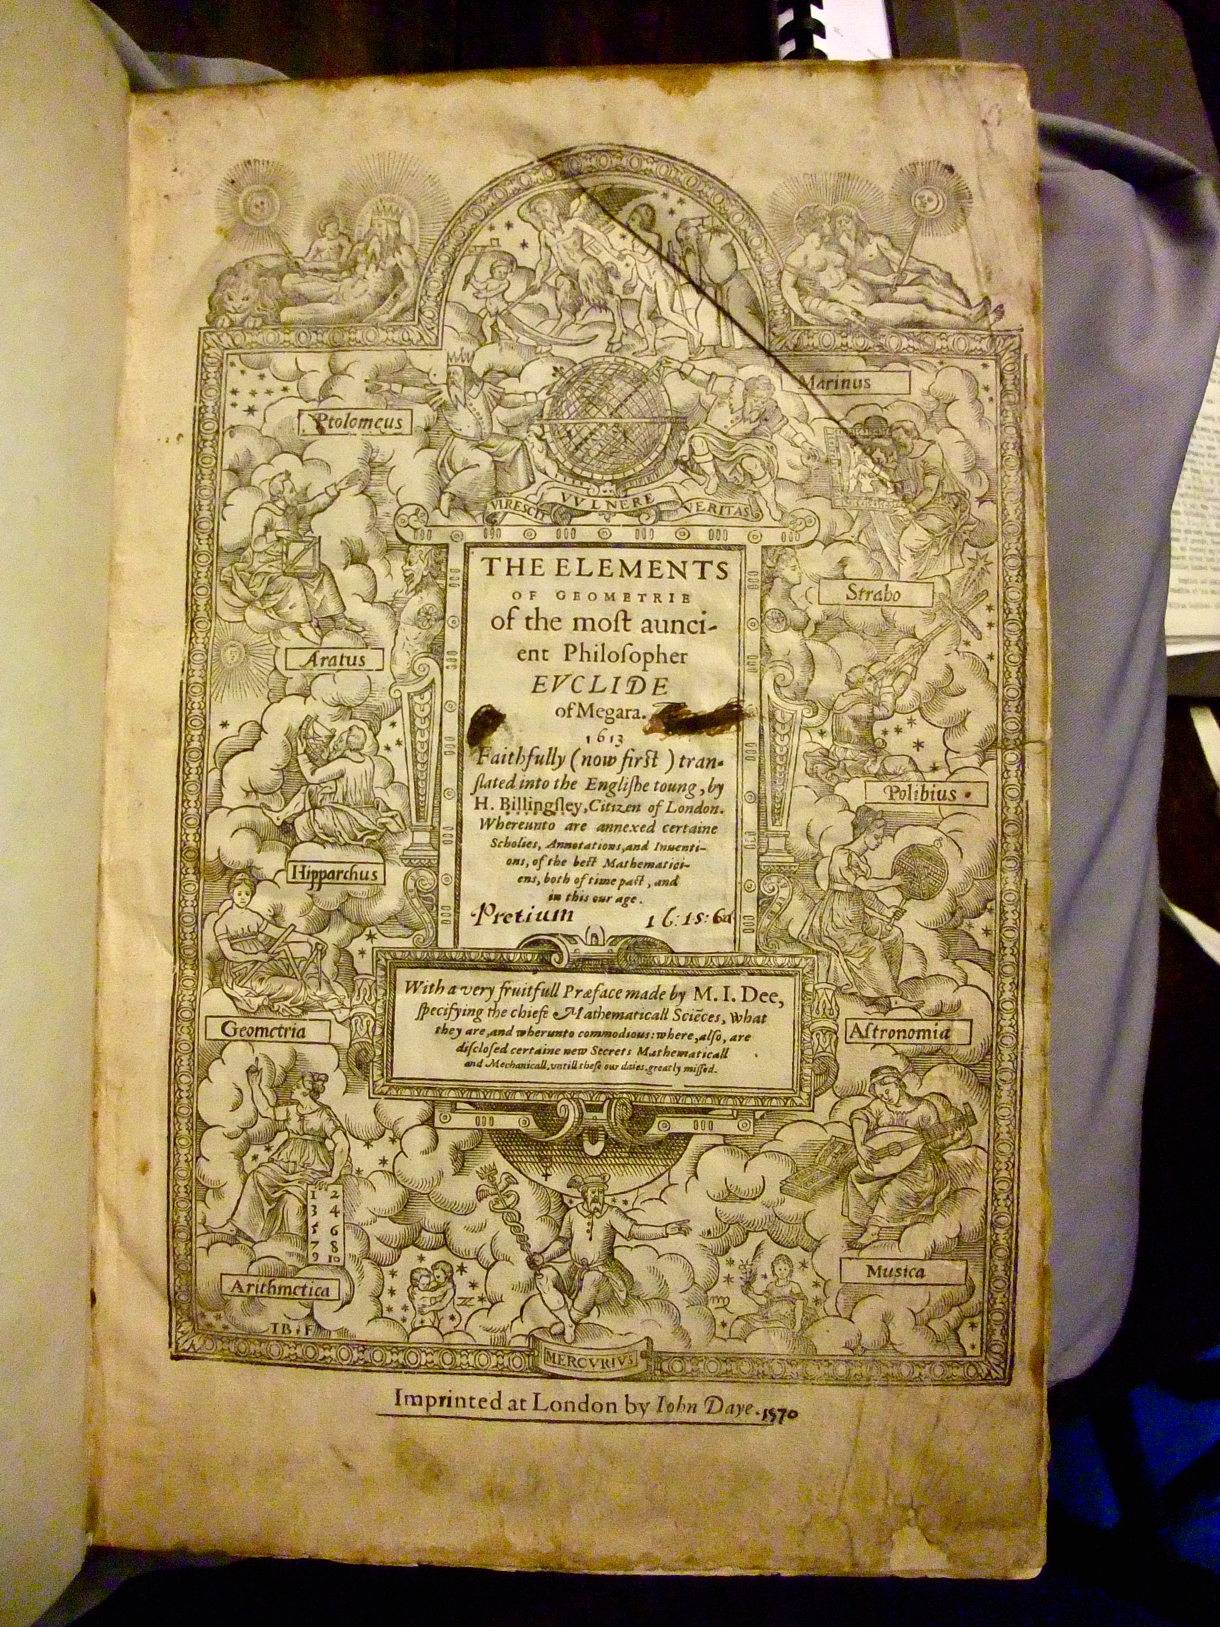

Slide 17
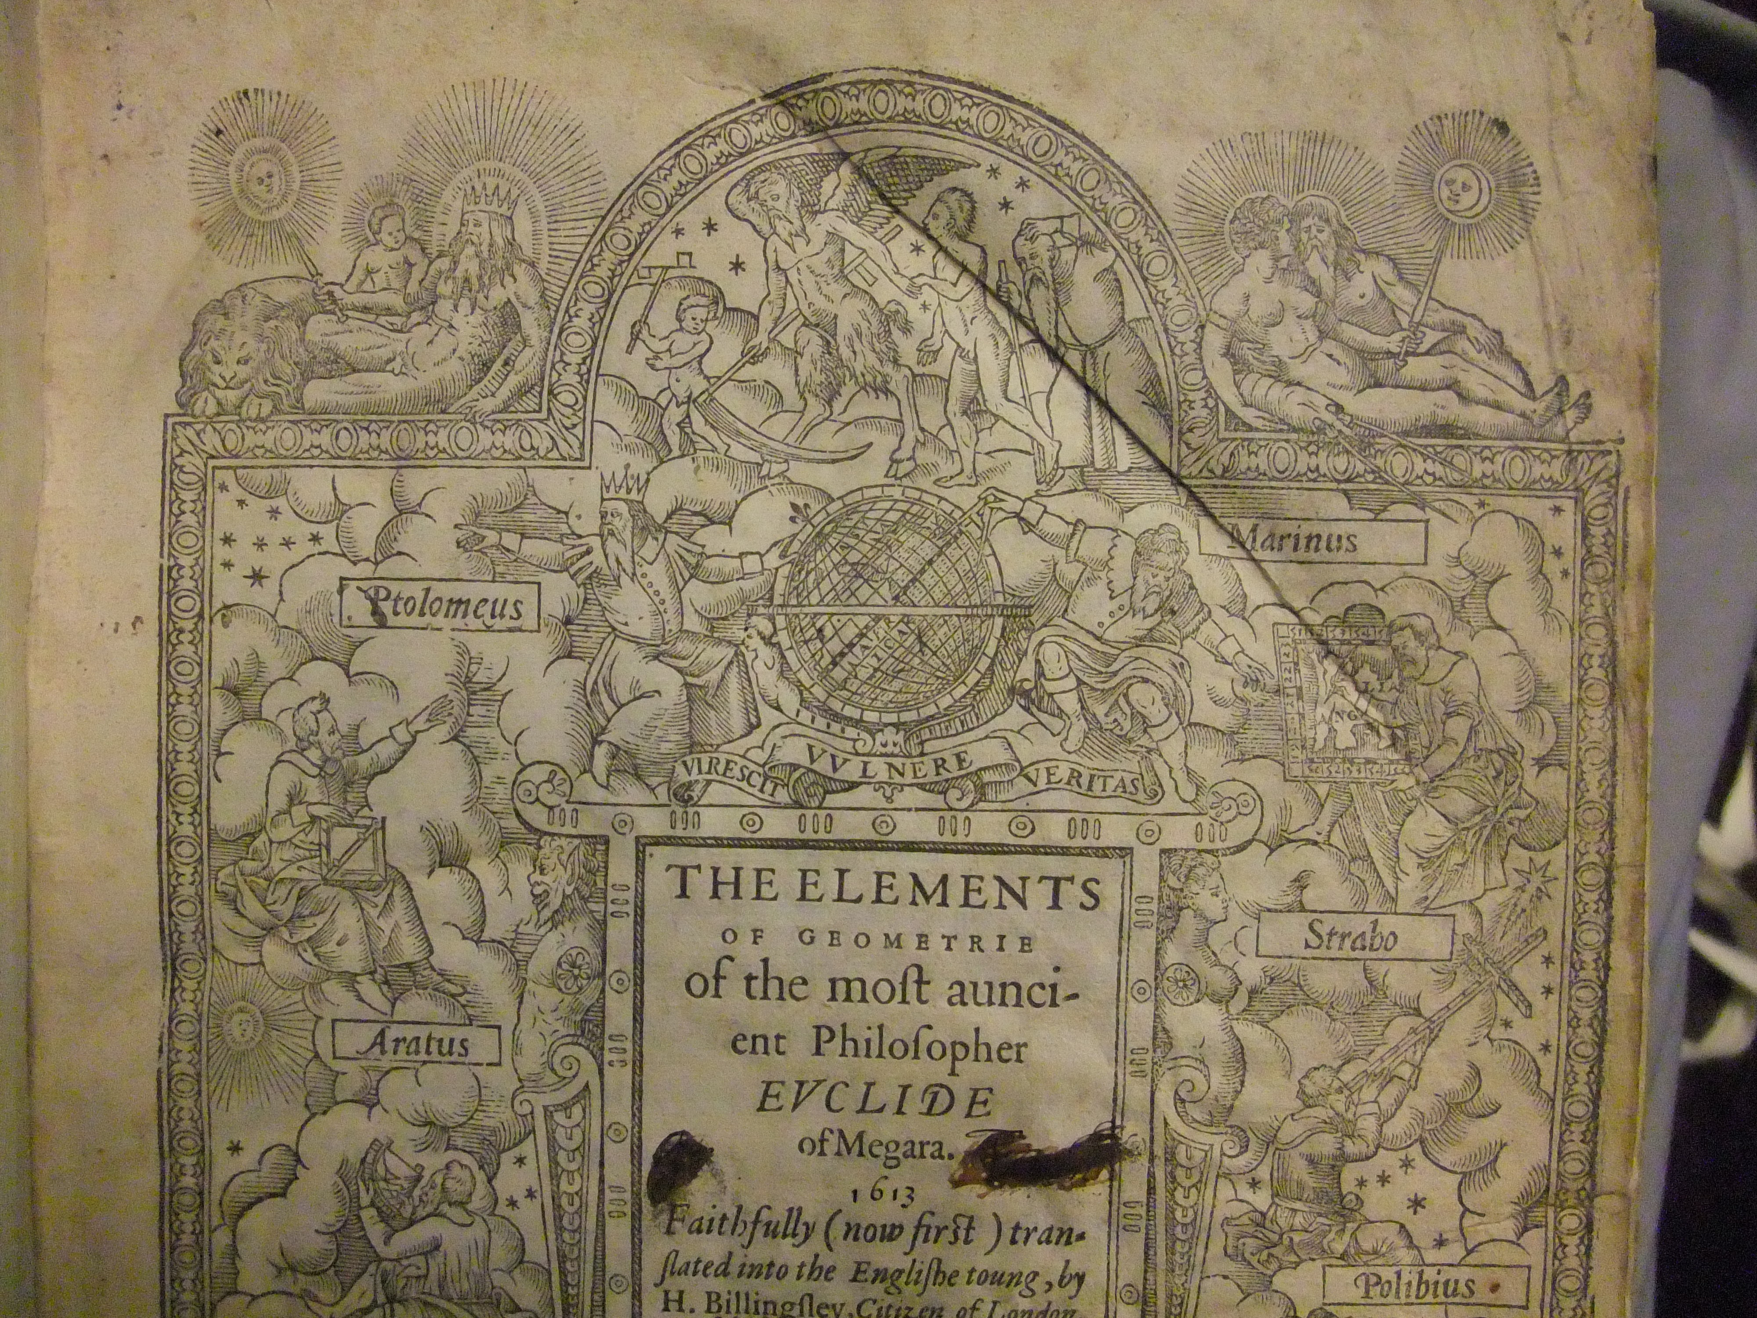

Slide 18
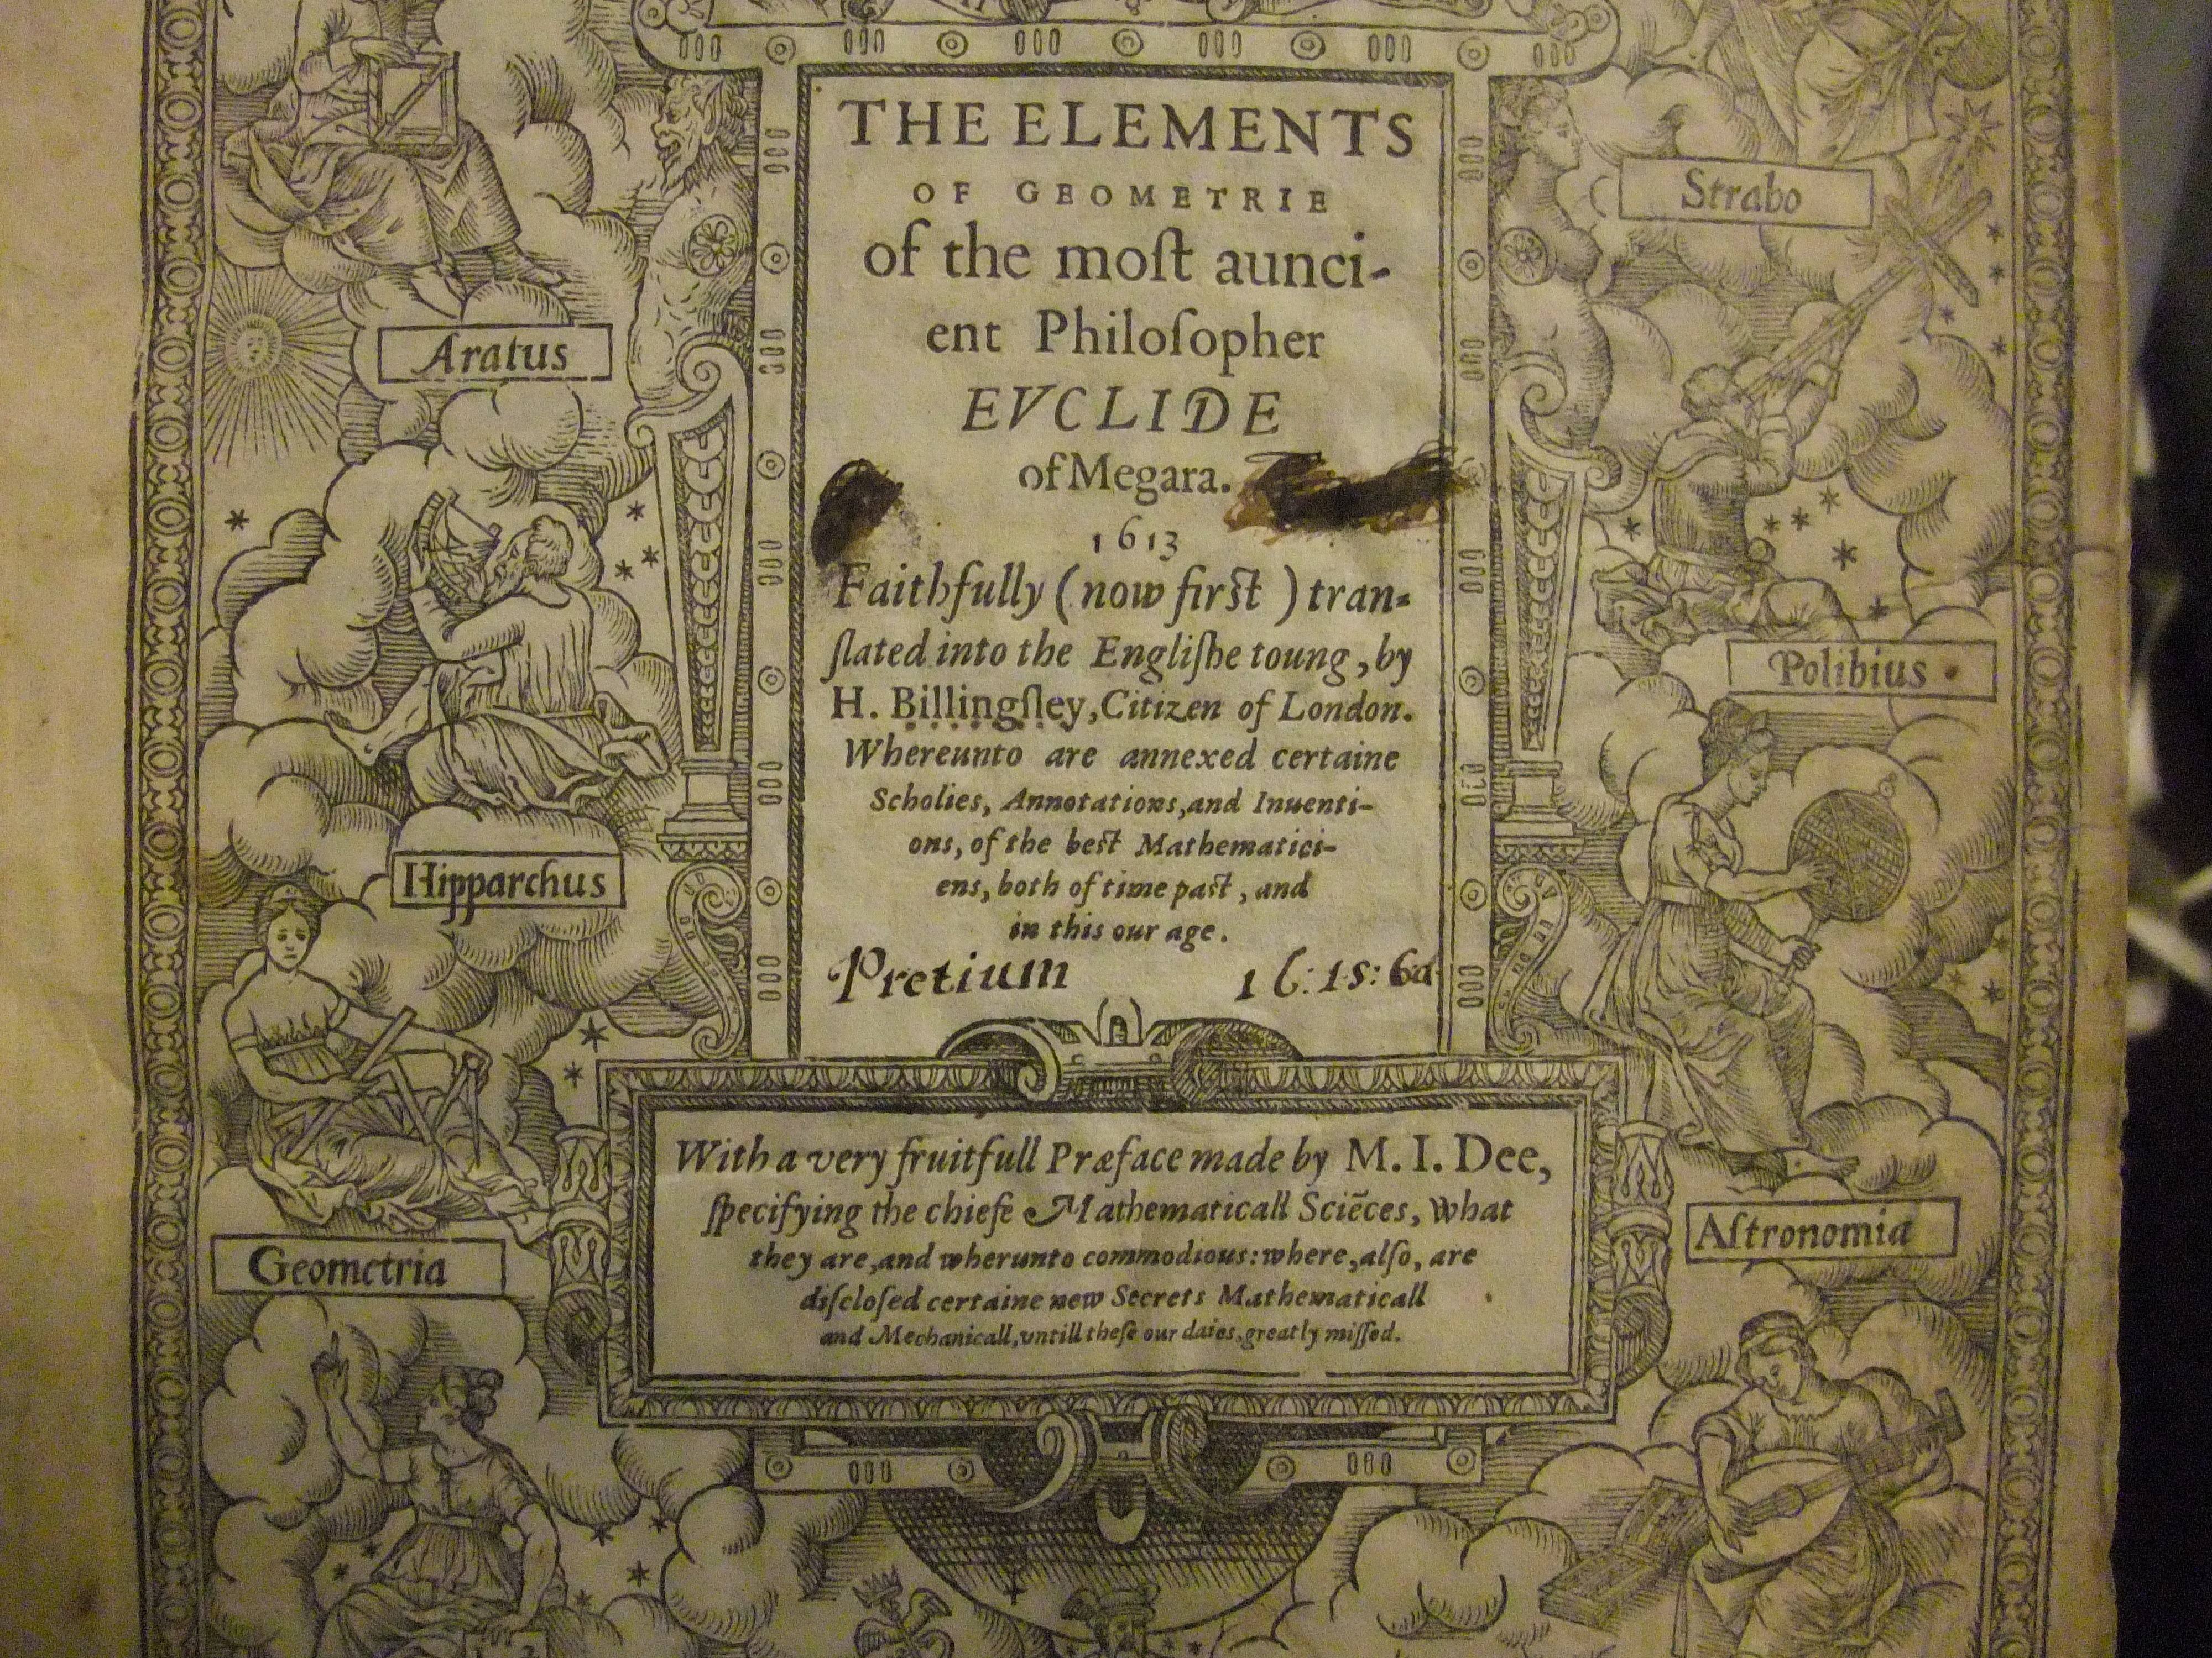

Slide 19
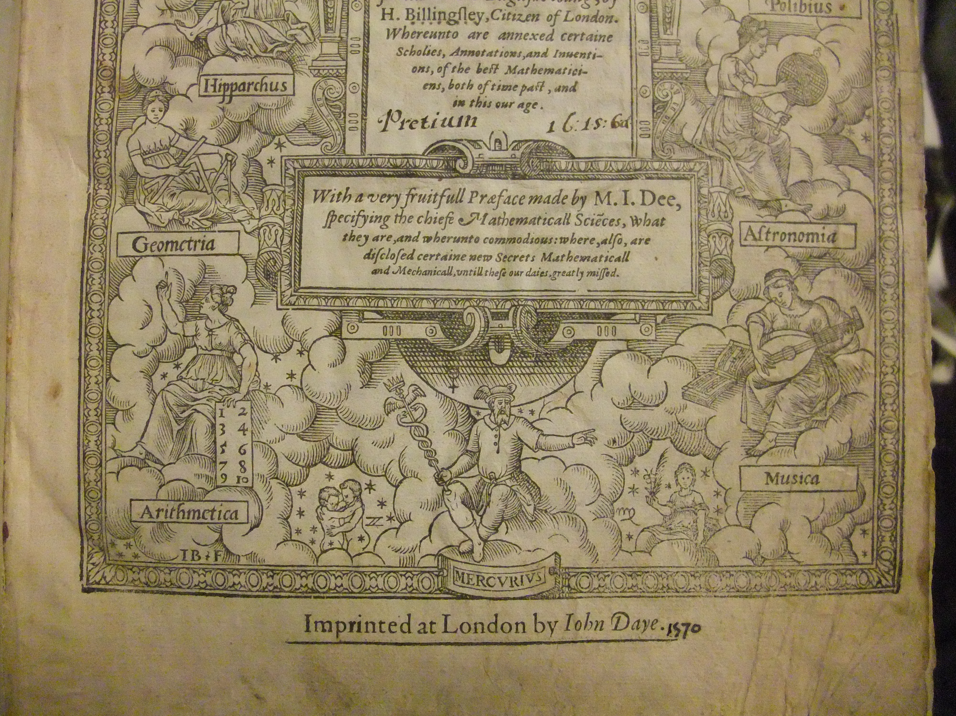

Slide 20
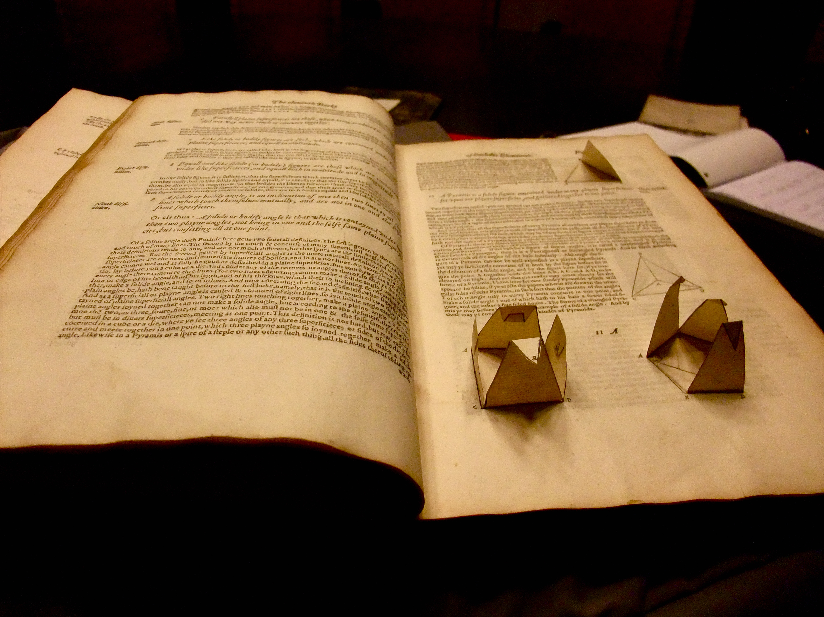
bb

Slide 21
