Slide 1
Ken Wilshire Coulsdon 6th Form College
kenwilshire@gmail.com
MathsJam November 12/13 2011

Slide 2
Early Maths Puzzle Background
Maths puzzle book (age six)
Man and Dog waiting at zebra crossing
Dog calculating speed of approaching car
Bubble thought box with annotated right angled triangle
Henry Ernest Dudeney (Puzzles and Curious Problems)
Sam Loyd’s contemporary
Games and Puzzles magazine (1972 - 1981)
Including David Singmaster’s Column

Slide 3
World Tournaments of the Mind
World Memory Championships – 1991 to date
Mind Sports Olympiad – 1997 to date
World Puzzle Championships – 1990 to date (UK 2000+)
Incorporating World Sudoku Championships – from 2006
Mental Calculations World Cup – 2004 to date (biannual)
Memoriad – 2008 to date (quadrennial)
Combines Memory and Mental Calculations

Slide 4
Mental Calculations World Cup
Organiser: Ralf Laue - Germany
Four “Standard” Sections :
Calendar calculations
Multiplication
Addition
Division
Surprise tasks (were two – now six)
Equal weighting from 2012
Reigning Champion – Priyasnshi Somani (India) aged 11 years
First (and Second) Champion – Robert Fountain (UK)

Slide 5

Calendar Calculations
1 minute
Record – now 93 dates !!!

Slide 6
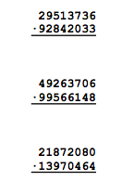
Multiplication
10 = 8 x 8 in 10 minutes
Record – 4 min 29 sec

Slide 7
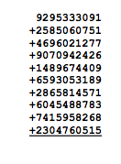
Addition
Adding 10 x 10 digits in 10 minutes
Record 3 min 19 sec

Slide 8
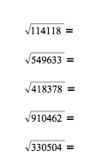
Division
10 sq rt of 6 digit numbers to 8 sig figures in 10 min
Record 6 min 19 sec

Slide 9




Surprise Tasks
Six problems presented immediately before solving

