Slide 1

5 Minutes, 3 Problems, 0 Solutions
David Bedford
d.bedford@keele.ac.uk

Slide 2



Slide 3
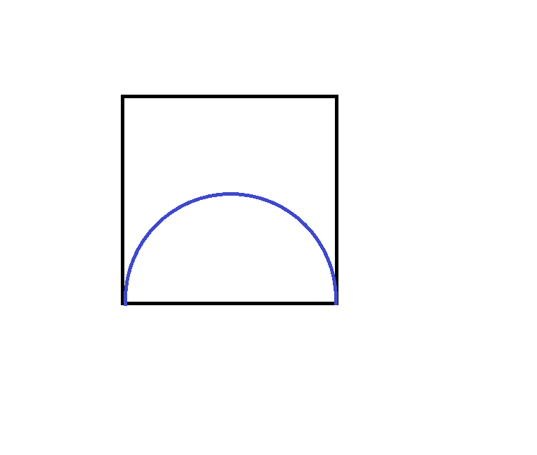

Slide 4
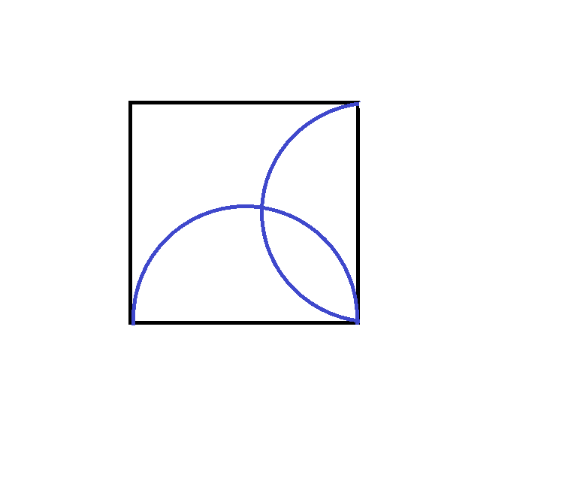

Slide 5
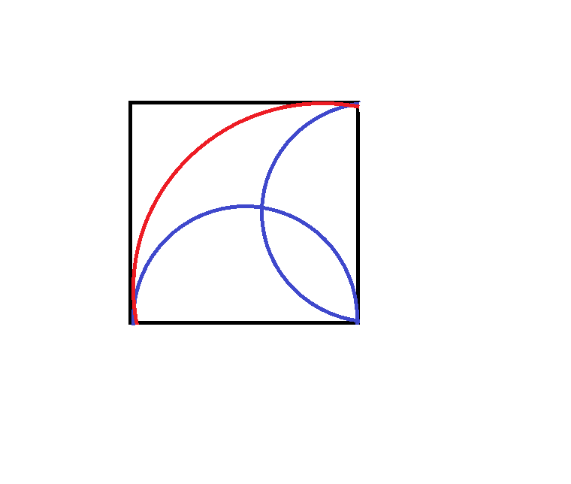

Slide 6


Slide 7
Take n coins and separate them into two piles

Slide 8
Take n coins and separate them into two piles
Now multiply their sizes together
Do the same with the remaining piles
and keep going until all the coins are separated.
Add up all the products formed.

Slide 9
Take n coins and separate them into two piles

Slide 10
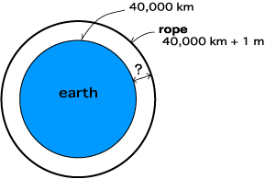
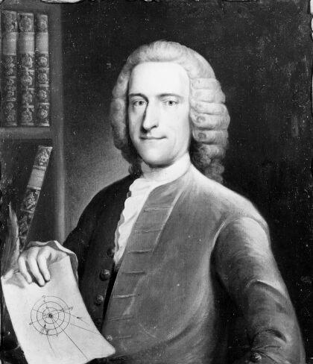
William Whiston, 1667-1752

Slide 11
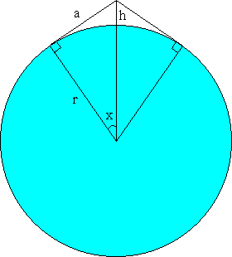

Slide 16
An identity for
n+1 coins
n-k coins
k+1 coins

