Slide 1
The 2½ mile Talk
Ewan Leeming
Edinburgh Mathsjam
@champnav

Slide 2
Navigational Rallying
On the open public road, you must solve a cryptic clue to work out the route and then drive it at 30mph
Solving time and driving time are taken together so the quicker you solve the clue the more time you have to drive each section.
I’m going to introduce you to some clue solving today
I’ve previously used activities like this in classrooms, motor sport club meetings, a date and a WRI meeting.

Slide 3
3 Levels of Clues
Novice , Non Expert and Expert
All have the same route.
Clues get progressively harder
Time limit stays the same

Slide 4
3 Rules
Obey the road traffic act (i.e. roundabouts)
Never use the same piece of road twice other than at crossroads
Always use the shortest route that complies with all the instructions given

Slide 5
Map references
Start is at MR 968725
(96.8, 72.5)
You methods: guesstimating (quicker but less accurate) or measuring using a romer (DIY version on handout, slower but reasonably accurate)

Slide 6
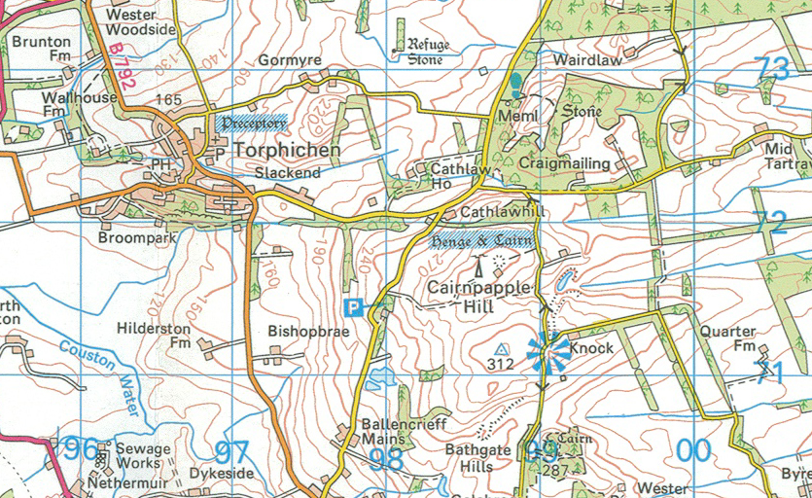

Slide 7
Novice Clues 1-4
1. Plot these points then pass through them in order.
2. These are made up from abbreviations on the info sheet.
3. Grid squares take their names from the numbers on the grid
4. SH means spot height which is a number next to a dot on the road.

Slide 8
Novice Clues 5-8
5. Colours can be found on the info sheet (Brown roads are actually Orange in colour)
6. Enter on the ball, leave on the arrow (the last one is wrong)
7. Imagine a clockface: you enter the junction driving down the hour hand to the centre, then leave driving up the minute hand.
8. Remember to use the shortest route without doubling back.

Slide 9
Novice Clues 9-14
9. Abbreviations again
10. Hunt the bridges again
11. More abbreviations
12. More spot heights
13. Plot these points then don’t pass through any of them
14. Go to this location (this one is more a driving instruction

Slide 10
Non-Ex
You are not given some of the target TCs that you are heading to
2. You must work out each new grid square to go into.
5. You must split this into junctions yourself
6. All the ball and arrow junctions have been joined together

Slide 11
Expert
2. Cumulative spot height total
4. refers to grid lines
5. Colours for junctions
6. Like the Non-ex clue but the ends have been joined up so you don’t know where to start
11. grid lines
12 spot height total

Slide 12
Things I want to Develop:
Interest in both the sport and activity
Clues for your local area
Play by email competition?
Twitter @champnav
ewanleeming@googlemail.com
Facebook: I am in the Edinburgh Mathsjam group

Slide 13
Contact me
Twitter @champnav
ewanleeming@googlemail.com
Facebook: I am in the Edinburgh Mathsjam group

