Slide 2
THIS IS WHAT I CALL...

Slide 3
Dual Inversal Numbers

Slide 4
e.g.
2 & 5
1/2 = 0.5
1/5 = 0.2

Slide 5
OK ... How about 4?
4 & 25
1/4 = 0.25
1/25 = 0.04
Pretty simple, eh? Watch out cos ‘ere they come – more of ‘em!

Slide 6
The Great ...
27 & 37!
1/27 = 0.037
1/37 = 0.027
These lines mean recurring
so 0.037 = 0.037037037037037...

Slide 7
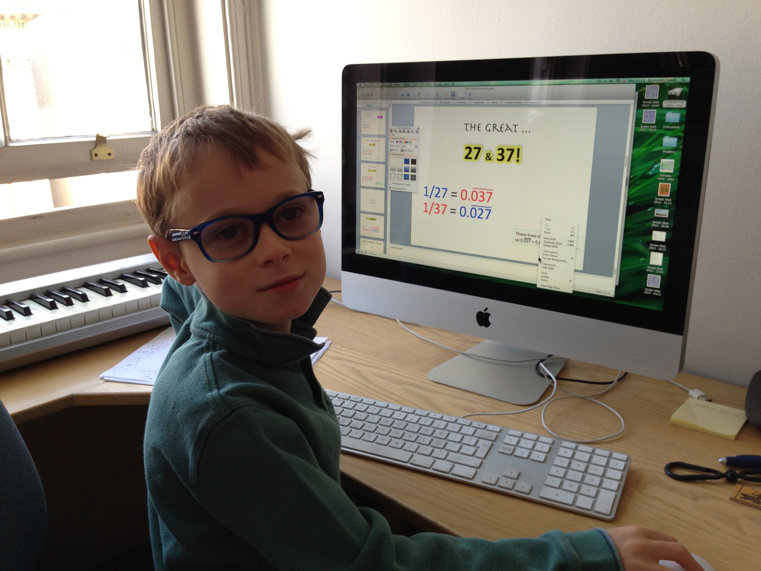

Slide 8
Want
more?

Slide 9
7 & 142857
1/7 = 0.142857
1/142857 = 0.000007

Slide 10
Oh yeah ... I forgot (drum roll please)
3
1/3 = 0.3
1/3 = 0.3
3 is a ‘cannibal’
dual inversal.

Slide 11
Number | Pair |  | Number | Pair
1 | 10 |  | 11 | 9
2 | 5 |  | 12 | *
3 | 3 |  | 13 | 76923
4 | 25 |  | 14 | 714285
5 | 2 |  | 15 | *
6 | * |  | 16 | 625
7 | 142857 |  | 17 | 588235294117647
8 | 125 |  | 18 | *
9 | 11 |  | 19 | 52631578947368421
10 | 1 |  | 20 | 50
*We’ll come back to these later!

Slide 12
Here are a few interesting things ...

Slide 13
*Interesting point no. 1 - It doesn’t work for everything...
12
24
6.
15
18
They are all multiples of 3 but it does
work for some e.g. 21 & 47619

Slide 14
Interesting point no. 2
If A & B and C & D are dual
inversal pairs then AC & BD
and AD & BC are dual inversal pairs.

Slide 15
Interesting point no. 3 - length of the recurring sequence is always the same in a pair
Length = 2
1/4 = 0.25
1/25 = 0.04
1/27 = 0.037
1/37 = 0.027
Length = 3
1/7 = 0.142857
1/142857 = 0.000007
Length = 6
1/17 = 0.588235294117647
1/588235294117647 = 0.0000000000000017
Length = 16

Slide 16
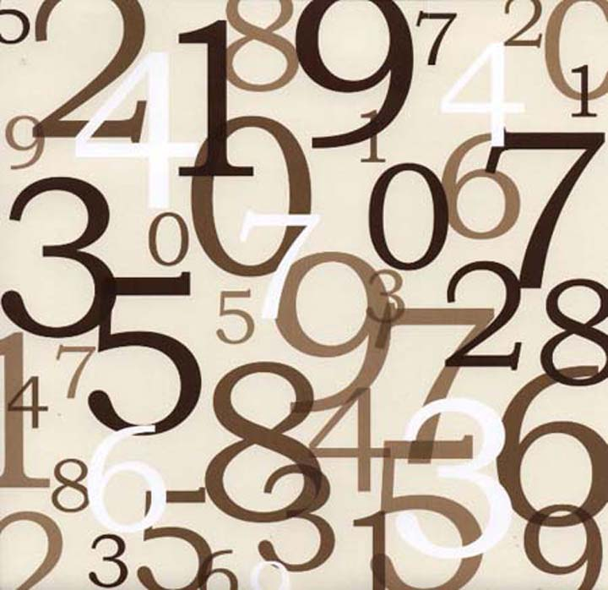
Thanks for watching!
3
Bye!

