Slide 1
Poetry in Motion
Phil Ramsden

Slide 2
A rhyme
Generals gathered in their masses,
Just like witches at black masses.
("War Pigs", from Iommi, T., Osbourne, O., et al., Paranoid, 1970)

Slide 3
Another rhyme
There was an Old Man with a beard,
Who said, "It is just as I feared!-
Two Owls and a Hen,
Four Larks and a Wren,
Have all built their nests in my beard.“
("There was an Old Man with a beard", from Lear, E., A Book Of Nonsense, 1846)

Slide 4
"Rhyming" using whole words instead of final syllables
A long and honourable history!
Example: the sestina form, which dates back to 12th-century troubadours.
Arguably perfected by Dante.

Slide 5
The Maths Jam: a Sestina
Stanza 1
One Saturday, with gladdened heart I gaily rise
And greet the Autumn morn at this unwonted hour
With strong black coffee's aid, I slowly come to life
I shower, shave and dress, bolt down some bread and jam
Pick up my case; take laptop-holder on my back;
And then anon to Turnpike Lane direct my steps.

Slide 6
The Maths Jam: a Sestina
Stanza 2
At Euston station, as I ride the rolling steps
That seem to mumble, groan and mutter as they rise
I muse: it is another year, and we are back!
As time goes by, it seems it quickens by the hour
The world's events now seem to cluster, crowd and jam
Accelerating as they touch my fleeting life.

Slide 7
The Maths Jam: a Sestina
Stanza 3
Inside the station, here is all of human life:
With laughter one child matches her Dad's striding steps;
A baby cries, is comforted; a human jam
Forms now at certain platforms; harassed tempers rise;
A parting couple kisses. Boards foretell the hour
Of all our trips away or, for some, journeys back.

Slide 8
The Maths Jam: a Sestina
Stanza 4
No hesitation grips me; I do not hang back.
I know I only travel to enrich my life.
My train will carry me from here, in just an hour
Or two, as if by some great giant's mighty steps
I were transported. Over dale and craggy rise
Once more I race; once more I race to you, Maths Jam!

Slide 9
The Maths Jam: a Sestina
Stanza 5
Yes, once more I am come to Crewe, my mind to jam
With fresh delights; the daily burdens on my back
To cast away, and once again refreshed, to rise
And marvel, spellbound, as new notions take on life
Some bold and simple; some complex, with many steps
Some but the pleasing playthings of a joyful hour.

Slide 10
The Maths Jam: a Sestina
Stanza 6
Allotted each the briefest twelfth part of an hour
To speak, to show to play, to sing, indeed to "jam"
Each of us mounts stagewards, climbing those steep steps
Defying any inner qualms that urge "Go back!"
For this was mathematics made; this sublime life
Of mind-expanding wonders; let us all then rise!

Slide 11
The Maths Jam: a Sestina
Envoi
Aye, seize the precious hour, my friends! Inspired we rise
The message of our Jam to bear in Gove-cursed life,
With ever bolder steps. Take heart! Be not turned back!

Slide 12
The Sestina's "rhyme scheme"
Every rhyme-word visits every line position exactly once.

Slide 13
The Sestina's "rhyme scheme"

Slide 14
The Sestina's "rhyme scheme"

Slide 15
The Sestina's "rhyme scheme"

Slide 16
The Sestina's "rhyme scheme"

Slide 17
The Sestina's "rhyme scheme"

Slide 18
The Sestina's "rhyme scheme"

Slide 19
The Sestina's "rhyme scheme"

Slide 20
The Sestina's "rhyme scheme"

Slide 21
The Sestina's "rhyme scheme"

Slide 22
The Sestina's "rhyme scheme"

Slide 23
The Sestina's "rhyme scheme"

Slide 24
The Sestina's "rhyme scheme"

Slide 25
The Sestina's "rhyme scheme"

Slide 26
The Sestina's "rhyme scheme"

Slide 27
The Sestina's "rhyme scheme"

Slide 28
The Sestina's "rhyme scheme"
Etc…

Slide 29

The Sestina's "rhyme scheme"
$$δ_{6}\left(u\right)=\left\{\begin{aligned}2u, 1≤u≤3, \\ &13−2u, otherwise \end{aligned}\right.$$

Slide 30
Alternatives to the sestina
The quintina
Five stanzas of five lines (plus an envoi)

Slide 31
The quintina

Slide 32

The quintina
$$δ_{5}\left(u\right)=\left\{\begin{aligned}2u, 1≤u≤2, \\ &11−2u, otherwise \end{aligned}\right.$$

Slide 33

The n-tina
n stanzas of n lines (plus an envoi)
$$δ_{n}\left(u\right)=\left\{\begin{aligned}2u, 1≤u≤n/2, \\ &2n+1−2u, otherwise \end{aligned}\right.$$

Slide 34

So does it always work?
The ottina
$$δ_{8}\left(u\right)=\left\{\begin{aligned}2u, 1≤u≤4, \\ &17−2u, otherwise \end{aligned}\right.$$

Slide 35
The ottina

Slide 36

So does it always work?
The settina
$$δ_{7}\left(u\right)=\left\{\begin{aligned}2u, 1≤u≤3, \\ &15−2u, otherwise \end{aligned}\right.$$

Slide 37
The settina

Slide 38
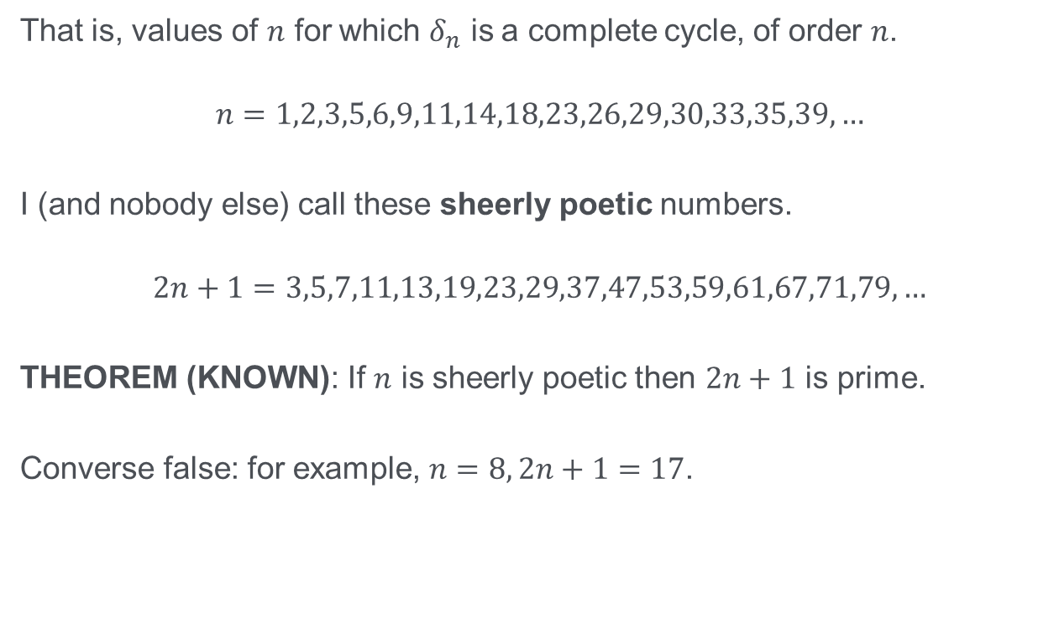
Numbers for which it works
That is, values of $n$ for which $δ_{n}$ is a complete cycle, of order $n$.
$$n=1,2,3,5,6,9,11,14,18,23,26,29,30,33,35,39,…$$
I (and nobody else) call these sheerly poetic numbers.
$$2n+1=3,5,7,11,13,19,23,29,37,47,53,59,61,67,71,79,…$$
THEOREM (KNOWN): If $n$ is sheerly poetic then $2n+1$ is prime.
Converse false: for example, $n=8, 2n+1=17$.

Slide 39
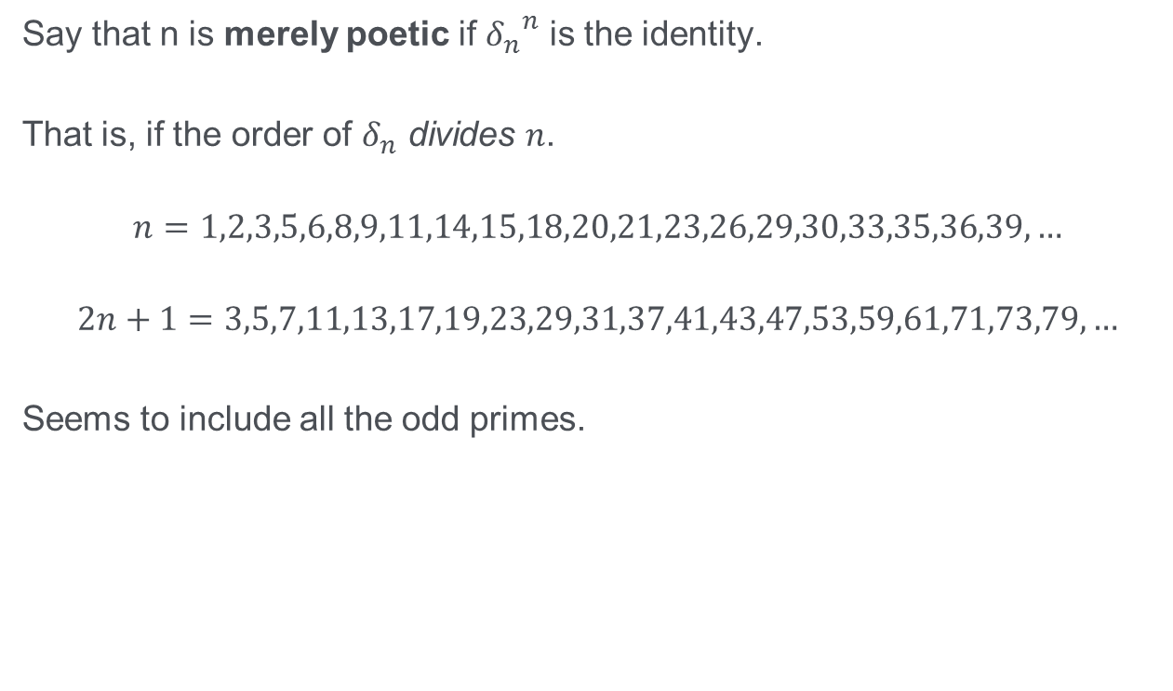
How can we rope in all the primes?
Say that n is merely poetic if ${δ_{n}}^{n}$ is the identity.
That is, if the order of $δ_{n}$ divides $n$.
$$n=1,2,3,5,6,8,9,11,14,15,18,20,21,23,26,29,30,33,35,36,39,…$$
$$2n+1=3,5,7,11,13,17,19,23,29,31,37,41,43,47,53,59,61,71,73,79,…$$
Seems to include all the odd primes.

Slide 40

Theorem I think I've proved
If $2n+1$ is prime then $n$ is merely poetic (and may be sheerly poetic).
Converse false, for example, $n=170, 2n+1=341$.

Slide 41

List of exceptions...
$$n=170, 280, 552, 864, 952, …$$
$$2n+1=341, 561, 1105, 1729, 1905, …$$
All pseudoprime to base 2.
That is, all satisfy
$$2^{p−1}≡1(mod p)$$

Slide 42

Another theorem I think I've proved
If $n$ is merely poetic then $2n+1$ is either prime, or pseudoprime to base 2.
Converse false, for example: $n=322, 2n+1=645$.

Slide 43

How can we rope in all the pseudoprimes?
Say that n is nearly poetic if ${δ_{n}}^{2n}$ is the identity.

Slide 44

A third theorem I think I've proved
If $2n+1$ is either prime, or pseudoprime to base 2, then $n$ is (at least) nearly poetic
Converse TRUE!
(I think. This is a conjecture.)

