Slide 1
dVq

Slide 2
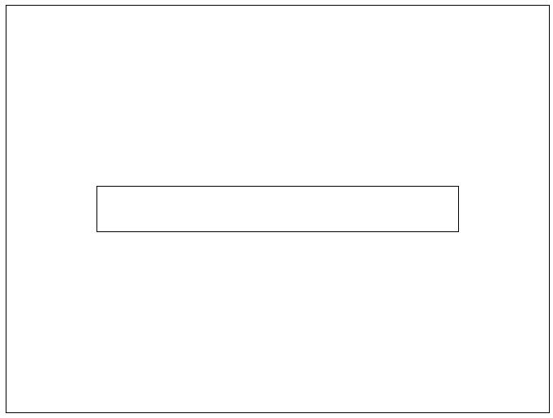
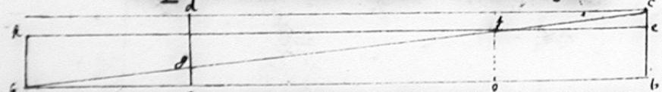
Banner Cut

Slide 3

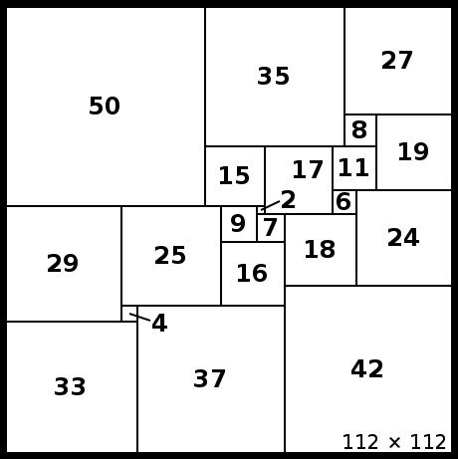
Squaring a square
By N. Morii

Slide 4
Borgo Perugia
A fleet of 3 Ships
30 tons each
30 ports
1 ton of taxation per ship
Can bring anything home? What is the best they manage? How do they do it?

Slide 5
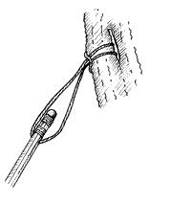
String on A Rope

Slide 6
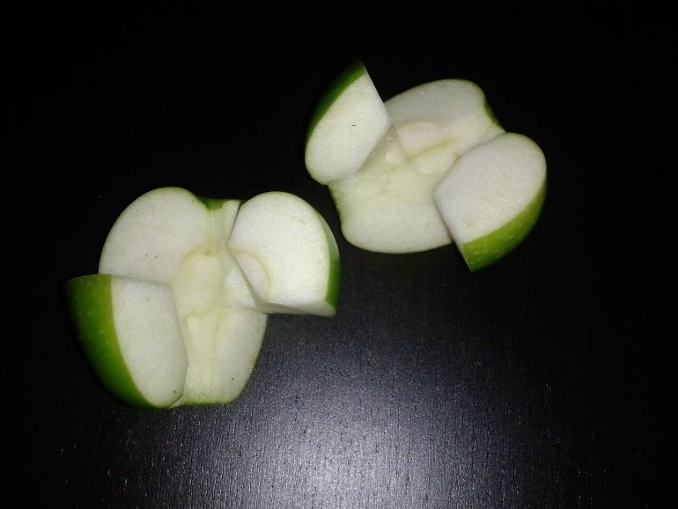
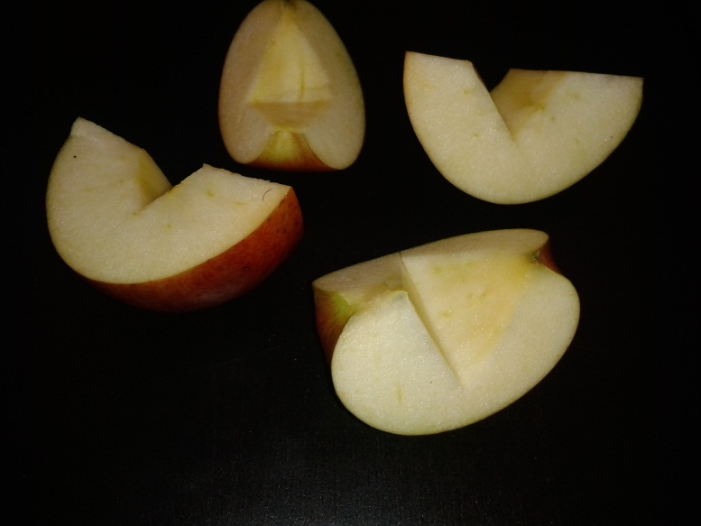
Make an Apple Puzzle
With 2 pieces
  Other Propositions?
With 4 Pieces
  Other Propositions?

