Slide 1
Some of my difficulties with the world
Tony Mann
University of Greenwich

Slide 2
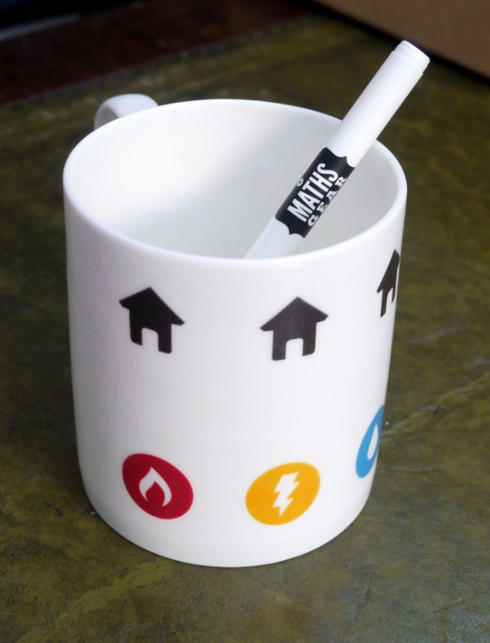
The perfect cup of coffee
How much does it hold?

Slide 3
How much coffee does the mug hold?

Slide 4
The higher up you are, the less it holds

Slide 5
Newton’s Laws are all you need
But my intuition lets me down

Slide 6

Example
SMALL WEIGHT
BIG WEIGHT
What happens when the
small weight is released?

Slide 7
Where does the big weight hit the ground?
1. Directly underneath its starting point
(gravity pulls it straight down)
2. To your right of its starting point (further away from my right hand)
(it picks up momentum from the small weight)
3. To your left of its starting point (nearer my right hand)
(momentum is conserved so it must cancel the momentum gained by the small weight)

Slide 8
Thank you!

