Slide 1
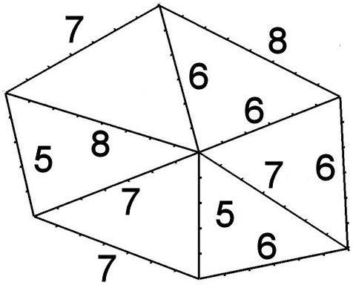
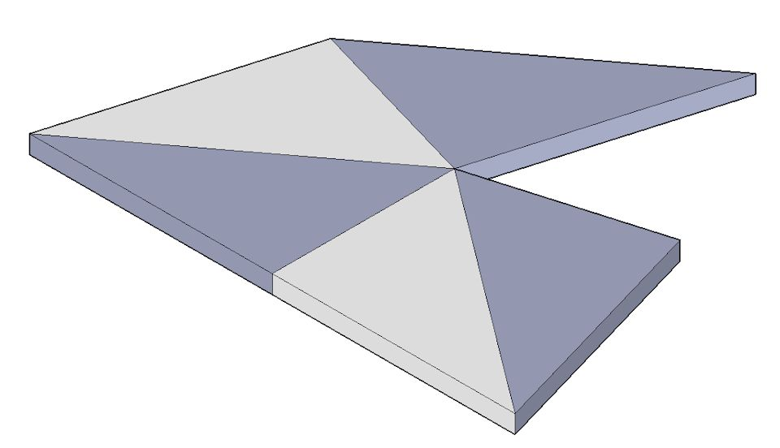
MathsJam 2015
Donald Bell
"Curious and Interesting Triangles"
or
What makes a "nice" puzzle?

Slide 2
The Characteristics of a "nice" Puzzle
Challenging but not impossible (solution time 10-20 minutes)
Not too hard (or expensive) to make
Well presented (looks good on the coffee table)
Contains a surprise (an "Aha!" moment)
Let's look at the "Hexasperation" and
"3-4-5 Symmetry" puzzles
.

Slide 3
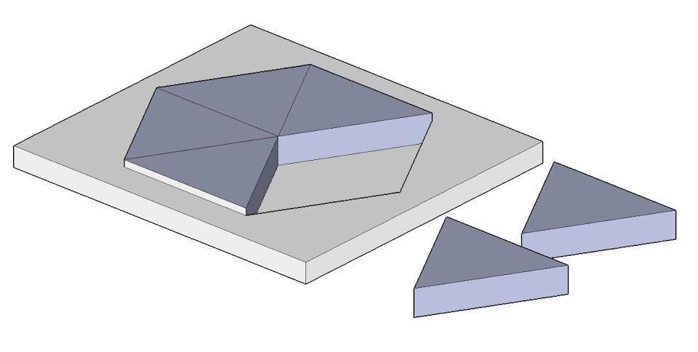
Developing the "Hexasperation" puzzle
Easy to make?
- yes, lots of similar pieces
Looks good on a coffee table?
- yes, in a well fitting frame
Challenging?
- well, no!
not even for a three-year old
(but it's a start)
Version zero:
Equilateral triangles in a regular hexagonal frame

Slide 4
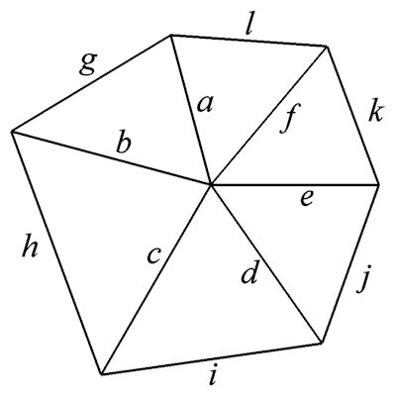
Developing the "Hexasperation" puzzle
It is possible to have six different scalene triangles making up the hexagon.
That means up to 12 different lengths and 18 different angles.
But it is too easy to put the matching edges together.
And it is much to difficult to make!

Slide 5
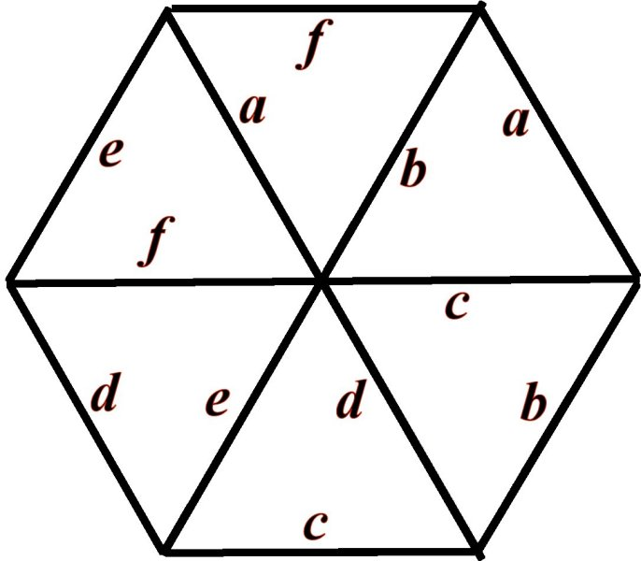
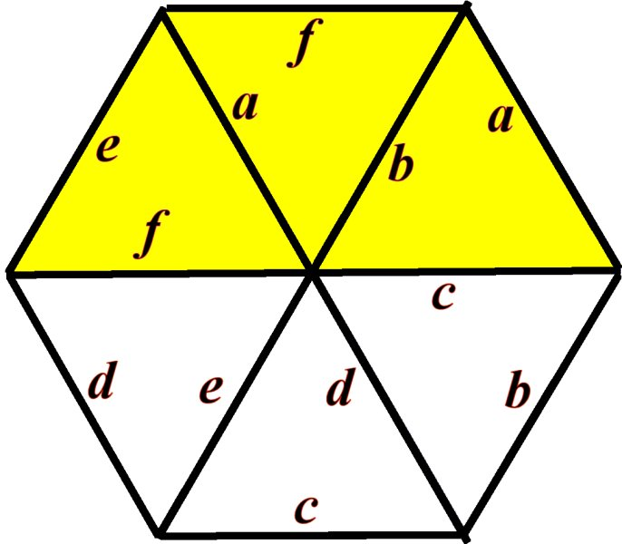
Developing the "Hexasperation" puzzle
If the lengths of the "spokes" (a, b, c, d, e and f) are made the same as the edges, then the puzzle begins to be a bit more challenging.
The three coloured triangles each have one edge of length a. So we don’t immediately know which triangles should be touching.

Slide 6
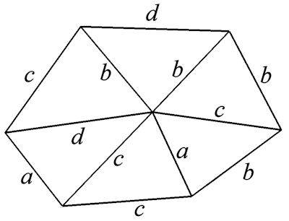
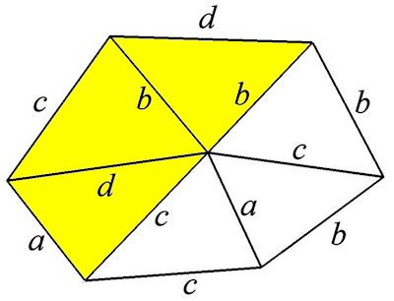
Developing the "Hexasperation" puzzle
If the number of different lengths of the edges can be reduced to four, then the puzzle is a lot more challenging.
The three coloured triangles have one edge of length d.
And four of the triangles have at least one edge of length b.

Slide 7
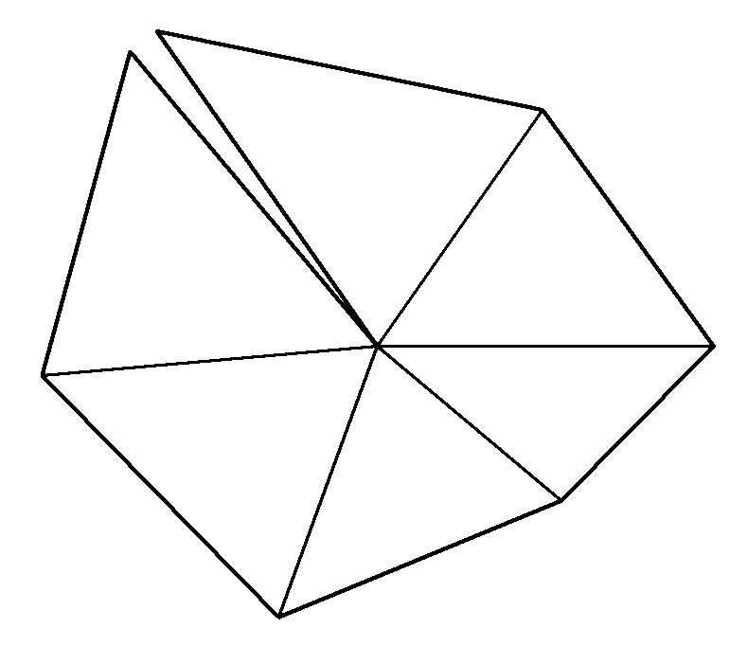
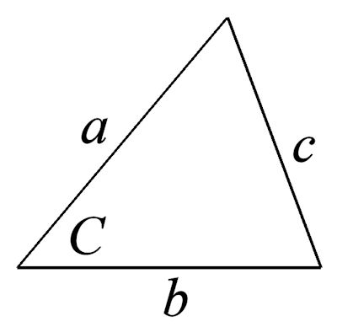
Developing the "Hexasperation" puzzle
But unless the lengths of the triangles are chosen with some care, the central angles will not add up to 360 degrees
The cosine formula for calculating an angle of a triangle is:
cos C = (a² + b² - c²) / 2ab
An Excel spreadsheet is needed to get the six triangle shapes right

Slide 8
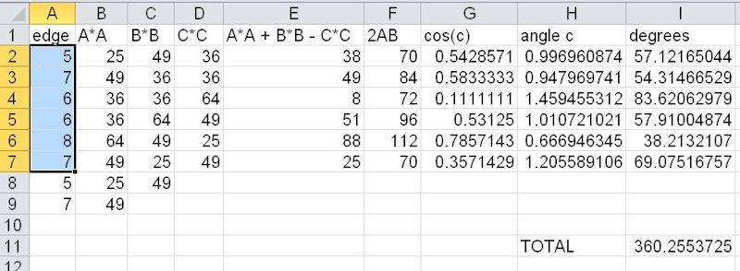
The "Hexasperation" puzzle spreadsheet
With some "trial and error" (and a spreadsheet to do the trigonometry), this is the final version of "Hexasperation".
The sides are integers (5, 6, 7 and 8) and the angles at the centre add up to 360.26 degrees (which is a much smaller error than the errors in woodworking)

Slide 9
The "Hexasperation" puzzle
The sides are integers
(5, 6, 7 and 8)
and the angles at the centre add up to 360.26
Evaluating the criteria for a good puzzle:
Challenging? – certainly
Easy to make? – well, three of the six triangles are isosceles
Well presented? – no, a close fitting frame would make the puzzle too easy.
A surprise or "AHa!" moment? – alas, no.

Slide 10
"this slide is deliberately blank"
It is covering up the next steps in the argument, because that would tell you too much about the final puzzle

Slide 11
The "3-4-5 Symmetry" Puzzle
Surprisingly, the final puzzle has five triangles, not six, and it might, or might not, have anything to do with hexagons.
And all the triangles are identical.
But it DOES satisfy the four conditions of a "nice" puzzle!

Slide 12
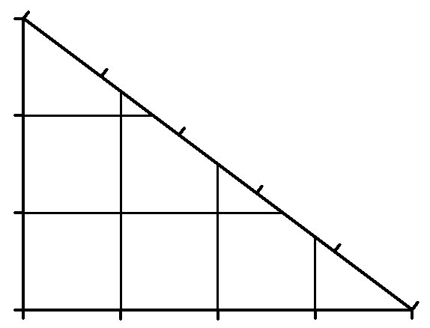
The "3-4-5 Symmetry" Puzzle
The 3-4-5 triangle is right-angled
(because 3² + 4² = 5²)
Can you take FIVE of these triangles and make a symmetrical figure. That is, one where the left half is a mirror image of the right half. And there are no holes in it.
The triangles must lie flat on the table. They may be rotated or turned over, but may not overlap.
(this is, obviously, not the right answer)

Slide 13
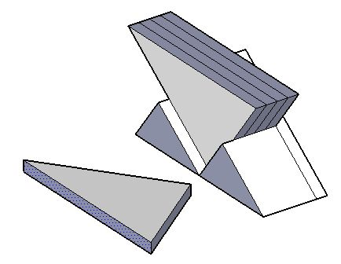
The "3-4-5 Symmetry" Puzzle
Does it fit the four criteria?
YES!
Challenging?
– yes, it takes quite a while
Easy to make?
– yes, all the pieces are the same
Nicely presented?
– it can sit in a holder, like this
A surprise or "Aha!" moment?
– oh, yes
(copies available from me, either card or hardboard)
If you solve it, please keep it hidden.

