Slide 1
Lyness Cycles
Jonny Griffiths
(Cambridge Mathematics Education Project)
Mathsjam 2015

Slide 2








Slide 3







Slide 4
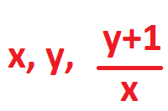
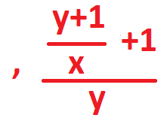
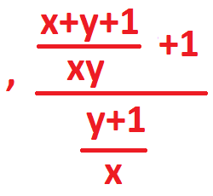
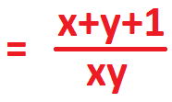
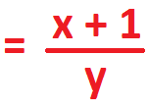




Slide 5





Slide 6




Slide 7
