Slide 1
Coin tossing sequences
Martin Whitworth
@MB_Whitworth

Slide 2
Toss a coin repeatedly until we get a particular sequence.
e.g. HTT
9 tosses
T
T
T
H
H
T
H
T
T
How many tosses on average?
Is it the same for all sequences?

Slide 3
How many tosses on average to get HTT or HTH?
Options:
A. HTT takes longer
B. HTH takes longer
C. Both the same
H
T
T
H
H
T
H
T

Slide 4
Probability = 1/8
Target: HTT
Average wait = 8
6
H
H
T
H
T
T
T
T
T
H
H
H
9
7
H
T
T
T
H
T
H
H
T
T
T
T
11
H
H
T
H
T
H
H
T
T
T
H
T
6
6
H
T
T
H
H
T
H
T
T
T
H
T

Slide 5
Probability = 1/8
Target: HTH
Overlaps don’t get counted
Average wait > 8
4
H
H
T
H
T
T
T
T
T
H
H
H
15
H
T
T
T
H
T
H
H
T
T
T
T
9
H
H
T
H
T
H
H
T
T
T
H
T
9
6
H
T
T
H
H
T
H
T
T
T
H
T

Slide 6
Calculating the average wait
Target: HTH
T
H
H
T
T
H
T
H
Stake
1
1
1
1
1
1
1
1
8
Payout
0
0
0
0
0
8
0
2
10
Bet £1 on each coin being start of chosen sequence
In a fair game, payout for matching all 3 is £8
Also payout £4 for matching 2, £2 for matching 1
For HTH, payout = £10
For fair game, average stake = payout
∴ Average number of tosses = 10 for HTH

Slide 7
Calculating the average wait
Target: HTH
T
H
T
T
H
T
H
Stake (£)
1
1
1
1
1
1
1
7
Payout (£)
0
0
0
0
8
0
2
10
Bet £1 on each coin being start of chosen sequence
In a fair game, payout for matching all 3 is £8
Also payout £4 for matching 2, £2 for matching 1
For HTH, payout = £10
For fair game, average stake = payout
∴ Average number of tosses = 10 for HTH

Slide 8
Average wait
Sequence | Average wait
H | 2
T | 2
Sequence | Average wait
HH | 6
HT | 4
TH | 4
TT | 6
Sequence | Average wait
HHH | 14
HHT | 8
HTH | 10
HTT | 8
THH | 8
THT | 10
TTH | 8
TTT | 14
Sequence length n
Minimum wait = 2^{n}
Maximum wait = 2^{n+1}-2
Longer sequence always has longer wait

Slide 9
Two sequences
Which is more likely to occur first?
e.g. HTT, HTH
T
H
H
T
T
H
T
H
Penney’s game
Walter Penney, Journal of Recreational Mathematics, October 1969, p.241

Slide 10
Probability of red sequence preceding blue
 | HHH | HHT | HTH | HTT | THH | THT | TTH | TTT
HHH |  | 1/2 | 3/5 | 3/5 | 7/8 | 7/12 | 7/10 | 1/2
HHT | 1/2 |  | 1/3 | 1/3 | 3/4 | 3/8 | 1/2 | 3/10
HTH | 2/5 | 2/3 |  | 1/2 | 1/2 | 1/2 | 5/8 | 5/12
HTT | 2/5 | 2/3 | 1/2 |  | 1/2 | 1/2 | 1/4 | 1/8
THH | 1/8 | 1/4 | 1/2 | 1/2 |  | 1/2 | 2/3 | 2/5
THT | 5/12 | 5/8 | 1/2 | 1/2 | 1/2 |  | 2/3 | 2/5
TTH | 3/10 | 1/2 | 3/8 | 3/4 | 1/3 | 1/3 |  | 1/2
TTT | 1/2 | 7/10 | 7/12 | 7/8 | 3/5 | 3/5 | 1/2
n=3

Slide 11
Probability of red sequence preceding blue
n=3

Slide 12
Which sequence is more likely to occur first
n=3
14
8
10
Shorter wait always at least 50% probability of preceding longer one
8
8
10
8
14
14
8
10
8
8
10
8
14
Average wait

Slide 13
Which sequence is more likely to occur first
n=4
Average wait

Slide 14

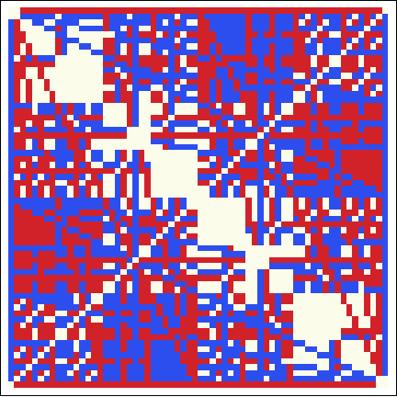
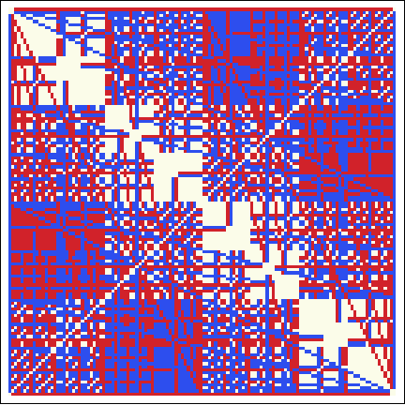
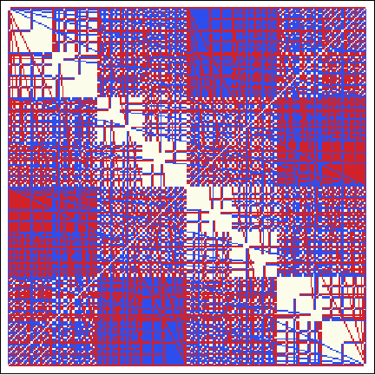
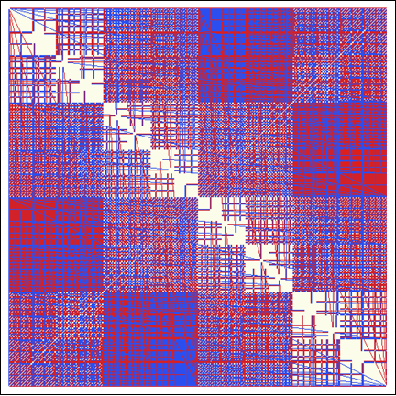
Which sequence is more likely to occur first
n=5
n=6
n=7
n=8
n=9

Slide 15
Which sequence is more likely to occur first
n=4
Average wait

Slide 16
Which sequence has the shorter waiting time
n=4
Average wait

Slide 17
Which sequence is more likely to occur first
n=4
Longer average wait is more likely to precede shorter one!
Average wait

Slide 18
Shorter wait can precede longer wait
Ignoring transposition of H,T, distinct cases are:
HTHH (18) beats HHTT (16) with p=4/7 ≈ 0.57
HTHH (18) beats THHH (16) with p=7/12 ≈ 0.58
THHT (18) beats HHTT (16) with p=7/12 ≈ 0.58
THTH (20) beats HTHH (18) with p=9/14 ≈ 0.64
THTH has an almost 2/3 probability of preceding HTHH, yet takes longer to occur on average!

Slide 19
References
Martin Gardner, Time Travel and other Mathematical Bewilderments, 60-66
https://plus.maths.org/content/os/issue55/features/nishiyama/index
Same article, but also including proof based on average wait time: http://www.i-repository.net/il/user_contents/02/G0000031Repository/repository/keidaironshu_063_004_269-276.pdf
Theorems X and Y in this article can be seen to be true based on the gambling approach shown in the following
Martingale approach: http://projecteuclid.org/download/pdf_1/euclid.aop/1176994578
Which sequence will occur first? http://www.agenarisk.com/resources/probability_puzzles/equal_sequences.shtml
Penney Ante: Counterintuitive Probabilities in Coin Tossing bact.mathcircles.org/files/Summer2010/PenneyAnte.pdf
Penney’s game https://en.wikipedia.org/wiki/Penney%27s_game
http://ed.ted.com/lessons/peter-donnelly-shows-how-stats-fool-juries
How to win at coin flipping http://blog.wolfram.com/2010/11/30/how-to-win-at-coin-flipping/

