Slide 1
MathsJam 2016
(and U3A and G4G CoM)
Symmetric Oddities (and Eventies)
Donald Bell
donald@marchland.org

Slide 2
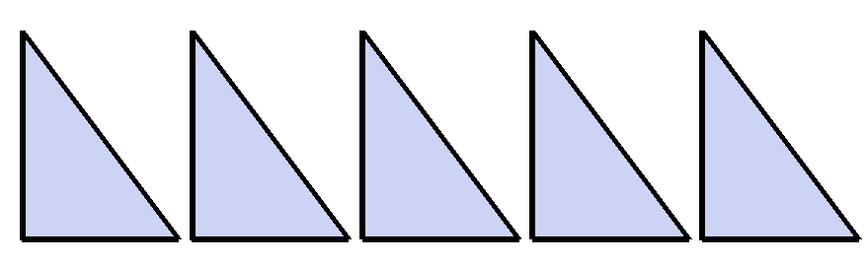
Symmetric Oddities (and Eventies) – MathsJam 2016
Last year, I presented this puzzle:
"place these five 3-4-5 triangles side by side to make a mirror-symmetric shape. They may be rotated or turned over, but they must not overlap."
So there is an ODD number of ASYMMETRIC pieces which makes a TWO-WAY SYMMETRICAL shape (the left half is the mirror image of the right half).
The first of the "Symmetric Oddities"

Slide 3
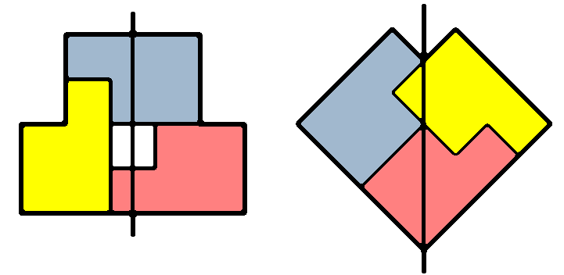
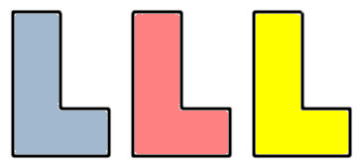
Symmetric Oddities (and Eventies) – MathsJam 2016
If the shape is a polyomino (ie made up of squares), then it can still make a wide variety of puzzles, some hard, some easy
Three P-pentominos can be arranged to make a symmetrical shape in several ways. Here are just two of them:
Three L-tetrominos can be arranged to make a symmetrical shape in two ways, making a nice puzzle.

Slide 4
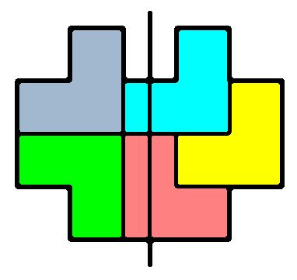
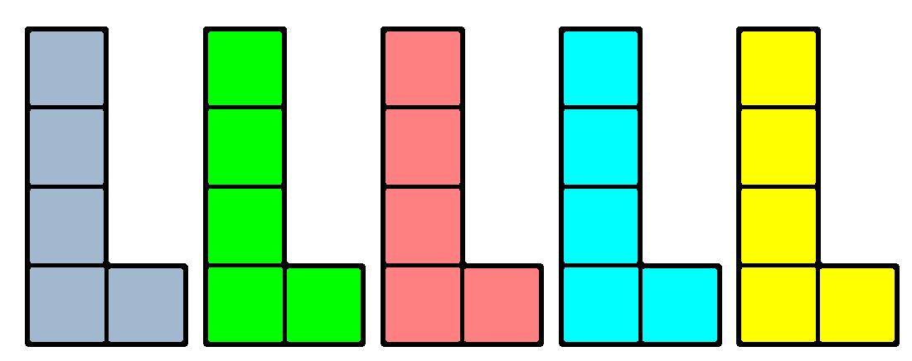
Symmetric Oddities (and Eventies) – MathsJam 2016
If the (odd) number of pieces is five, then there are several more polyomino puzzles.
Five L-triominos will go together without much of a challenge
But it is very difficult to find a mirror-symmetric shape that can be made with five L-pentominos

Slide 5
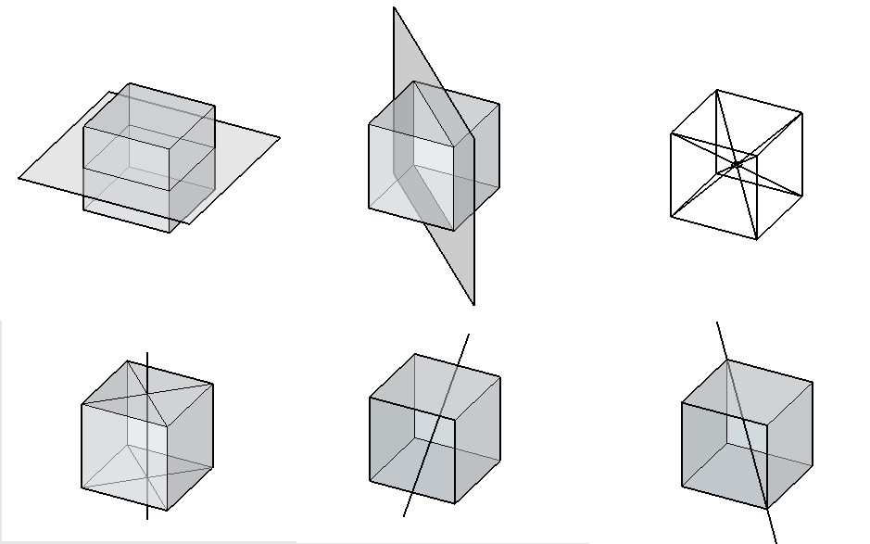
Symmetric Oddities (and Eventies) – MathsJam 2016
So, in TWO dimensions, it is possible to make a TWO-way symmetrical shape using an ODD number of identical ASYMMETRIC pieces. What about THREE dimensions?
A cube can have six types of symmetry.
Two mirror-image
One point-symmetric
Three rotational
That's far too many to have to explain in a puzzle leaflet.

Slide 6
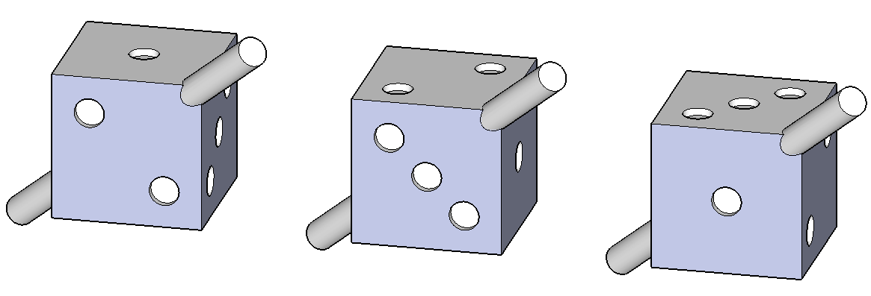
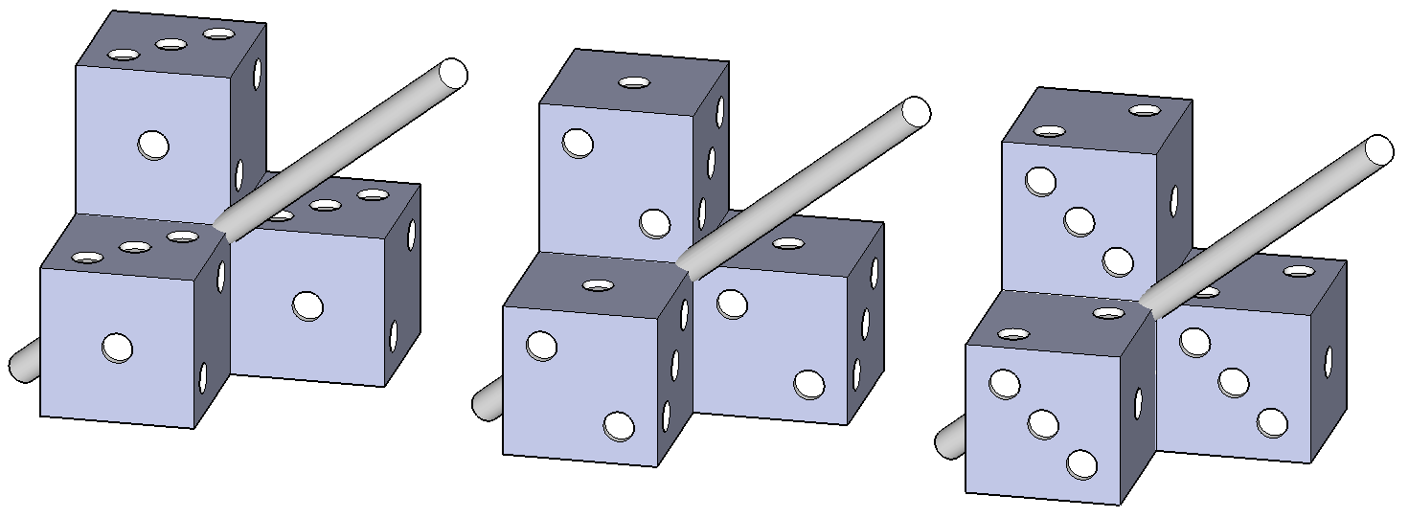
Symmetric Oddities (and Eventies) – MathsJam 2016
One of the rotational symmetries uses the body diagonal of the cube.
It is a THREE-way symmetry with 120° rotation.
A polycube can have the same kind of symmetry.
Here is one of the tetracubes (also marked up as a dice)

Slide 7
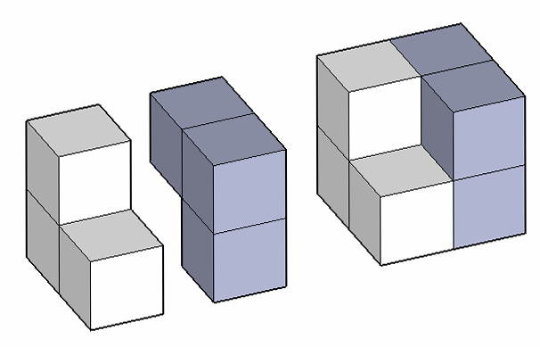
Symmetric Oddities (and Eventies) – MathsJam 2016
But the "three" in three-way symmetry is an ODD number.
Can there be an EVEN number of identical polycube pieces that can make a shape with ODD symmetry?
Two L-tricubes will go together to make a hexacube with three-way rotational symmetry.
It's a 2x2x2 cube with a cube missing from opposite corners.

Slide 8
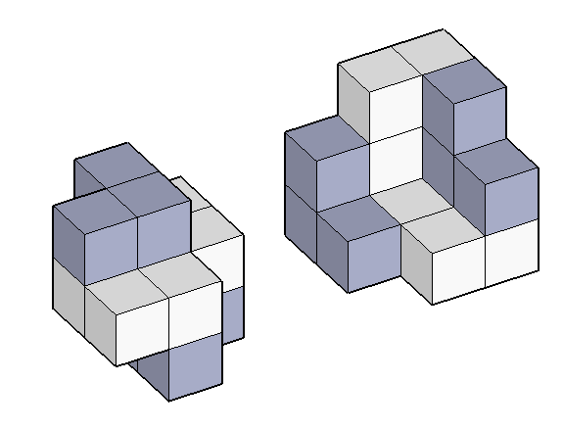
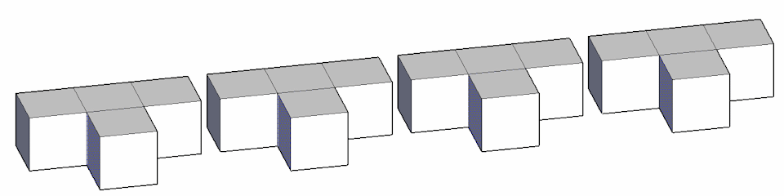
Symmetric Oddities (and Eventies) – MathsJam 2016
A bit more difficult:
FOUR L-tricubes making a
three-way symmetrical shape.
It is not easy to see the symmetry.
Now for something a bit harder:
Make a three-way symmetrical shape using four T-tetracubes

Slide 9
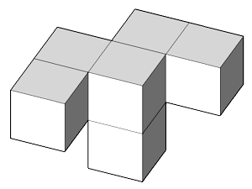
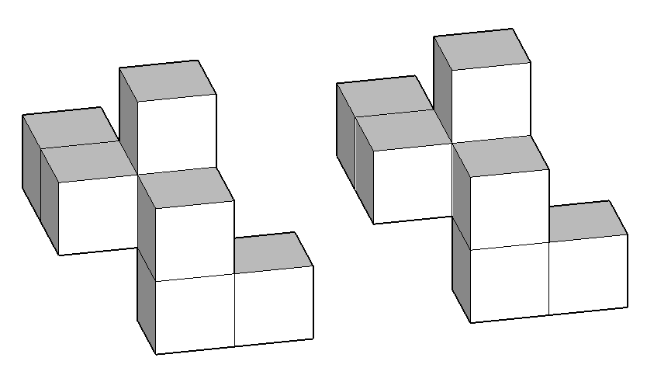
Symmetric Oddities (and Eventies) – MathsJam 2016
If the polycube pieces are a bit bigger, it is possible to make a decent puzzle with only two pieces.
Two of these "bumpy-W" hexacube pieces can make a three-way symmetric shape.
And this is a bit harder:
Make a three-way symmetrical shape using two heptacubes, like this:
(samples of all these puzzles are available on the tables)

