Slide 1
The Pigeonhole Principle

Slide 2
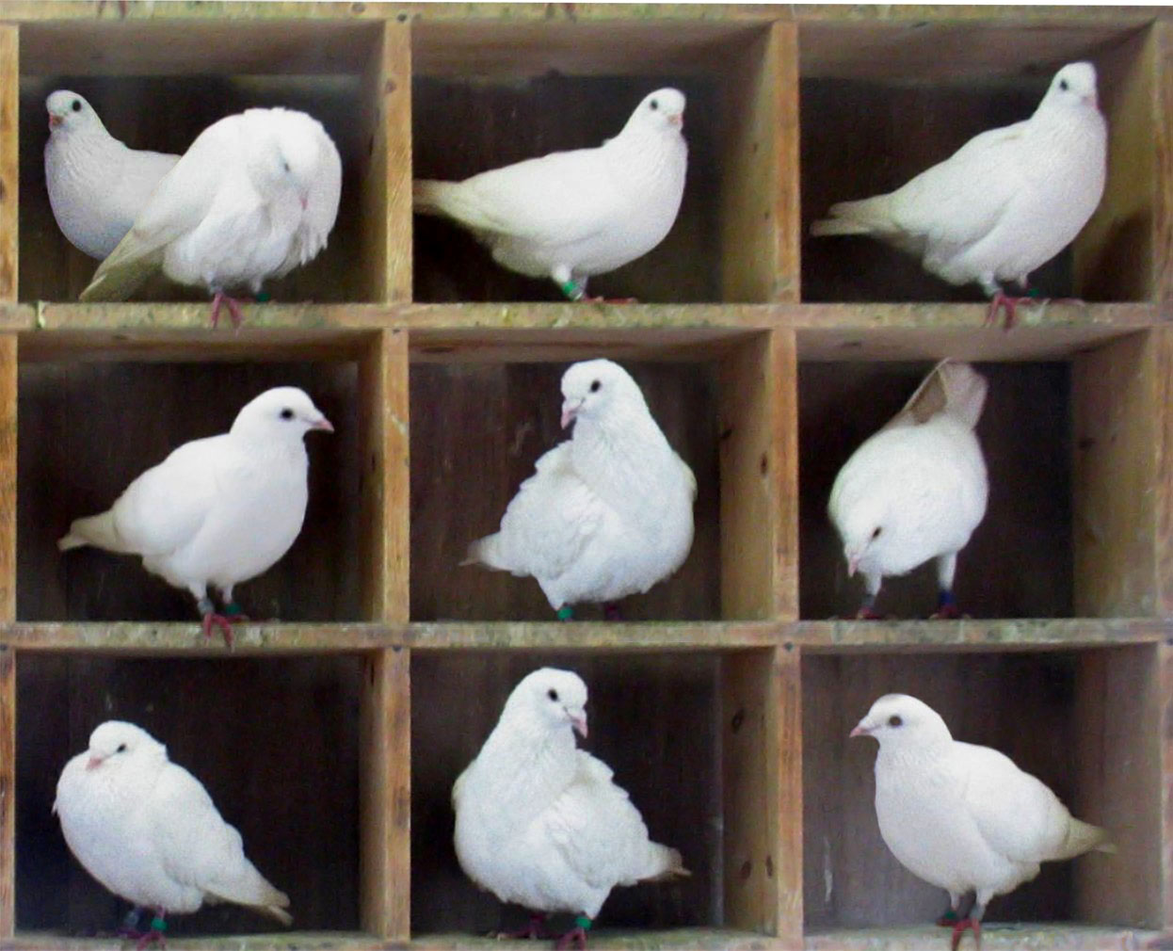
What is the pigeonhole principle?

Slide 3
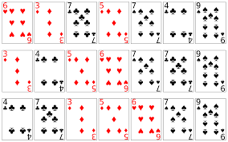
The Marching Band problem

Slide 4

In a large group, any pair of people are either friends or they’re not. Prove that there must be at least 2 people with the same number of friends

Slide 5
Are there 2 powers of 3 whose difference can be divided by 2016?

Slide 6
Can 5 people stand in this infinite lattice forest, so that everybody can see everybody else?

