Slide 1
Digesting the Indigestible
Improving the use and visualisation of data

Slide 2





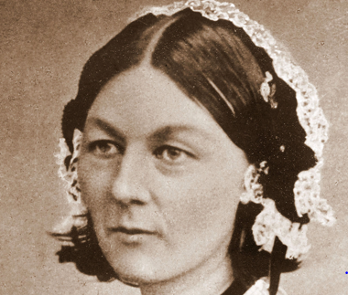
This Photo by Unknown Author is licensed under CC BY-NC-ND

Slide 3
Data-driven KPIs and targets
Too much data
Understandable data
How do non-numerate people use data?
The mathematician’s role?

Slide 4

Misleading data

Slide 5
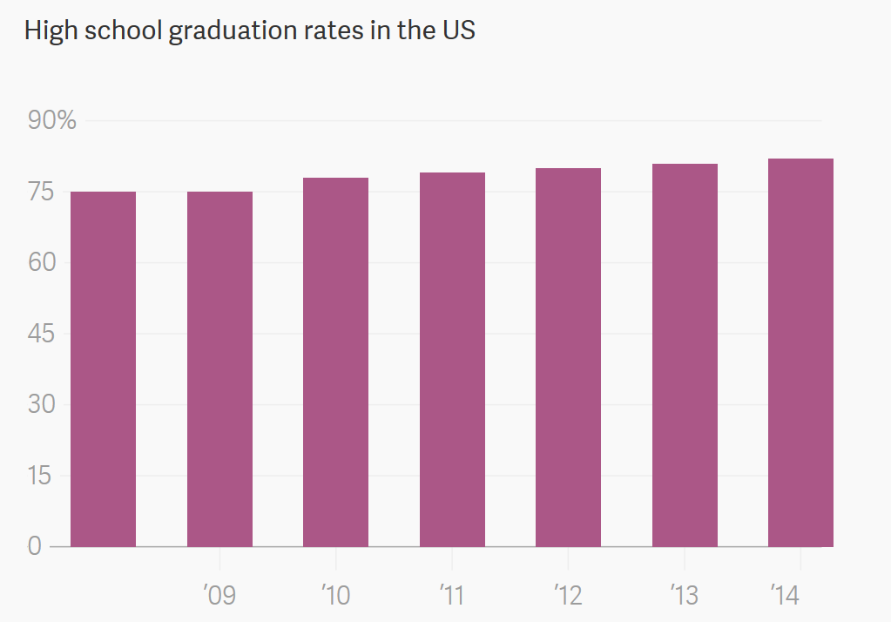

Slide 6
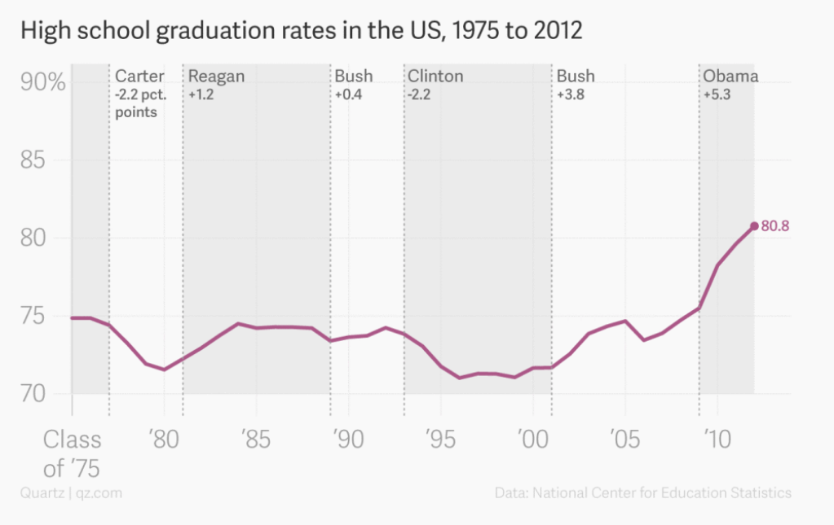

Slide 7
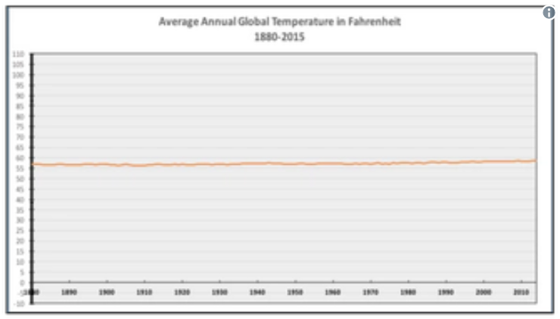

Slide 8
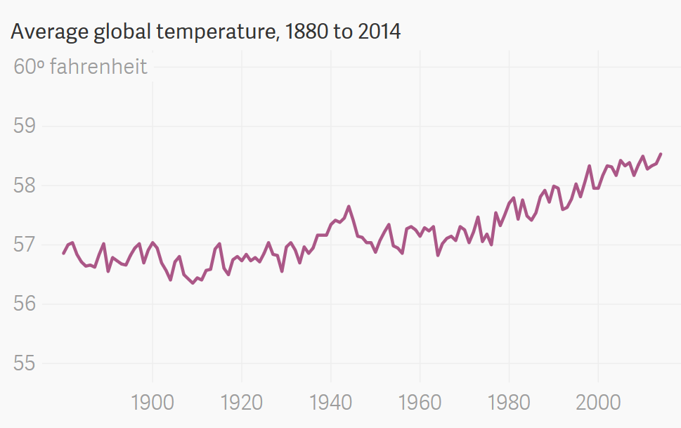

Slide 9
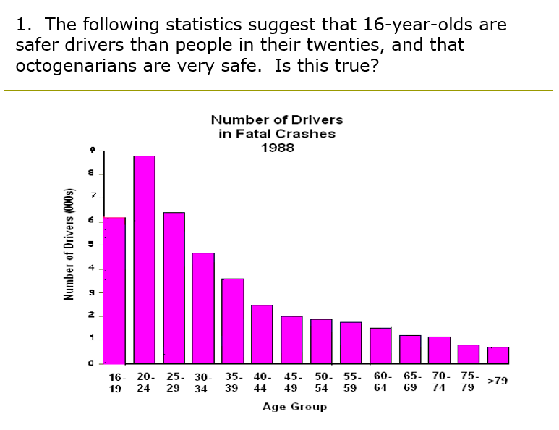

Slide 10
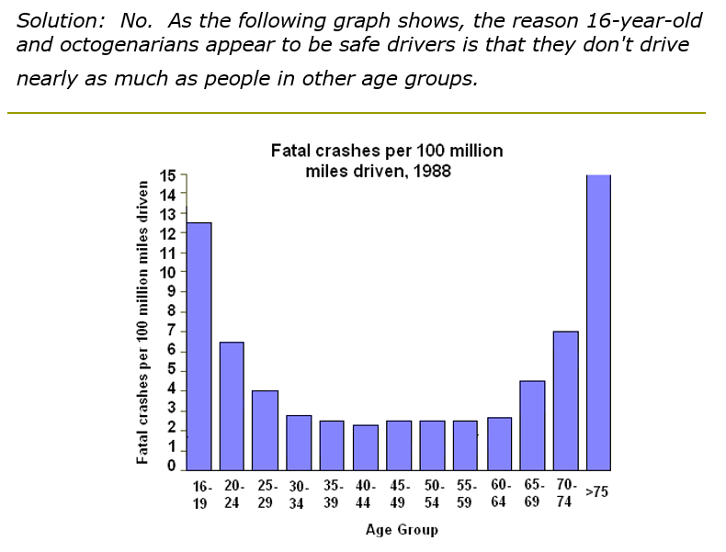

Slide 11
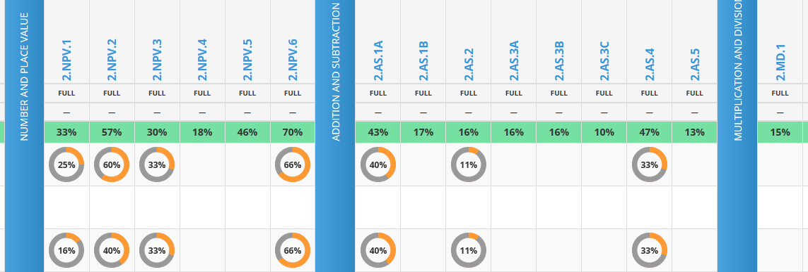
Problem:
Online Education company KS 1,2,3 – ages 5-14.
How should they portray data on student performance in the different parts of the curriculum?

Slide 12
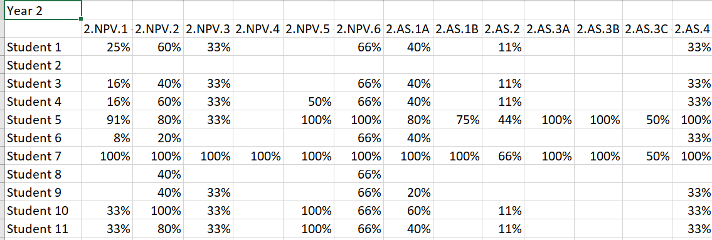
Problem:
Online Education company KS 1,2,3 – ages 5-14.
How should they portray data on student performance in the different parts of the curriculum?

