Slide 1


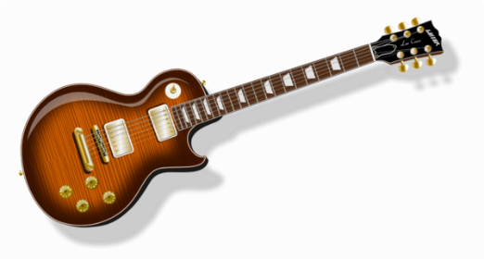
Random advice from a rank amateur songwriter and haphazard guitarist

Slide 2
5 tips for writing a MathsJam Jam song….
……in 5 minutes

Slide 3
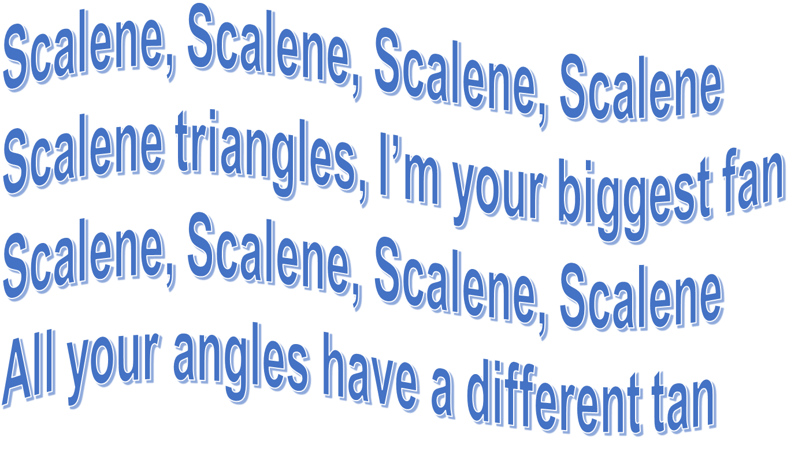

Slide 4
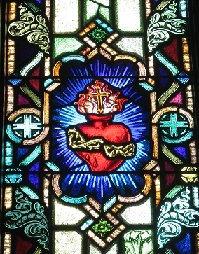
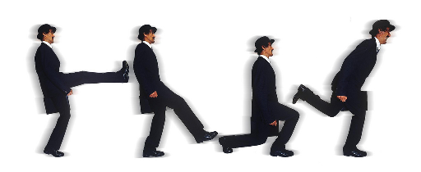
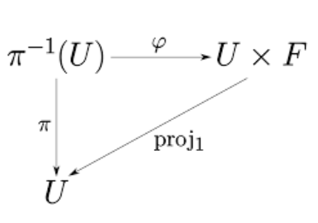
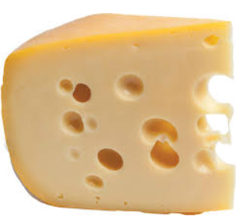
Tip #1
No source is
too sacred
or too silly,
no area of maths too trivial
and no line too cheesy.

Slide 5
2016
A song about…
based on…
The golden ratio
Prime numbers
The Monty Hall problem
Being a maths jammer
Limits
Approximating pi
Scalene triangles
Trig ratios
Sweet Child O’ Mine
Creep
The Winner Takes it All
Modern Major General
59th Bridge St Song
American Pie
Jolene
Santa Claus is Coming to Town

Slide 6
2017
A song about…
based on…
Ada Lovelace
The Argand diagram
The Mandelbrot set
The best maths lecturer
Congruent triangles
Division by zero
Kinematics
Using Tau
MC Escher
The Millennium Prize
Bicycle Made for Two
Roxanne
Vincent
Pinball Wizard
L.I.F.E.S.G.O.E.S.O.N
Ever Fallen in Love with Someone
Free Fallin’
Fulsome Prison Blues
Helter Skelter
Where Have All the Flowers Gone

Slide 7
Tommy is a triangle who’s searching for amour
Hoping for some romance
with the triangle next door
She's got acute angles and a common side
…look at the right
angle there in the triangle, opposite the hypotenuse
and when I know …. one side length and an angle
I know which ratio to use
Once upon a time I used a function for y,
but then it only drew the top part
With parametrics: I get a total ellipse, not a half

Slide 8
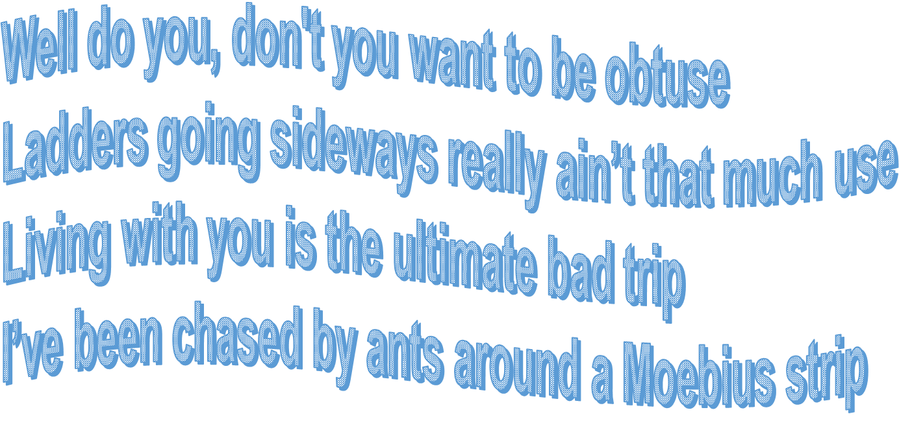


Slide 9
Tip #2
You can get away with a lot if you have at least one really good line..
“So I shot a man in Math class, just 'cause he used pi”
Fullsome Circle Blues – Tom Button
“The winner gets to gloat…..the loser gets a goat”
A Game with Monty Hall – Me

Slide 10
At his age his hearing falters,
His eyes have gone as well
But that won’t even stop him,
He writes by sense of smell
Always knows the theorems,
I’ve never seen him floored
That crazy maths professor
Sure plays a mean black board

Slide 11
Tip #3
Try to keep some recognisable elements of the original song
i) in the words
A long long time ago
I can still remember how
That music used to make me smile
And I knew if I had my chance
That I could make those people dance
And maybe they'd be happy for a while
A long, long time ago
I can still remember how those circles used to make me smile
And I knew if I had my chance,
That I’d find the
circumfer-ance
And maybe I'd be happy for a while
A long long time ago
I can still remember how
That music used to make me smile
And I knew if I had my chance
That I could make those people dance
And maybe they'd be happy for a while
A long, long time ago
I can still remember how those circles used to make me smile
And I knew if I had my chance,
That I’d find the
circumfer-ance
And maybe I'd be happy for a while

Slide 12
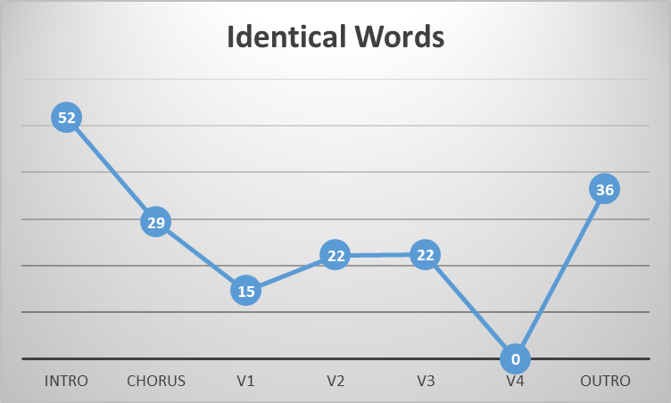

Slide 13
ii) in the general feel of the song
Look at you, twenty-four
You divide so many ways
In fours and in sixes
In threes and in eights
You’re a composite number
In a composite world
You’ve so many factors
I wish I had factors
Prime – Sam Hartburn
=
=
=
=
+1
=
=
=
When you were here before
Couldn't look you in the eye
You're just like an angel
Your skin makes me cry
You float like a feather
In a beautiful world
And I wish I was special
You're so ****** special
Creep – Radiohead
Word stumble

Slide 14
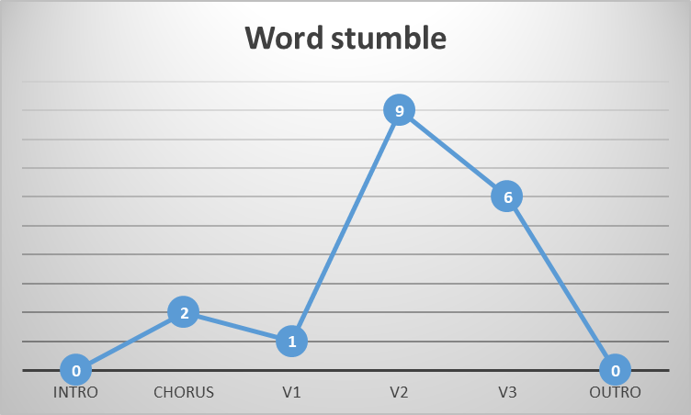
Approximate Pi

Slide 15
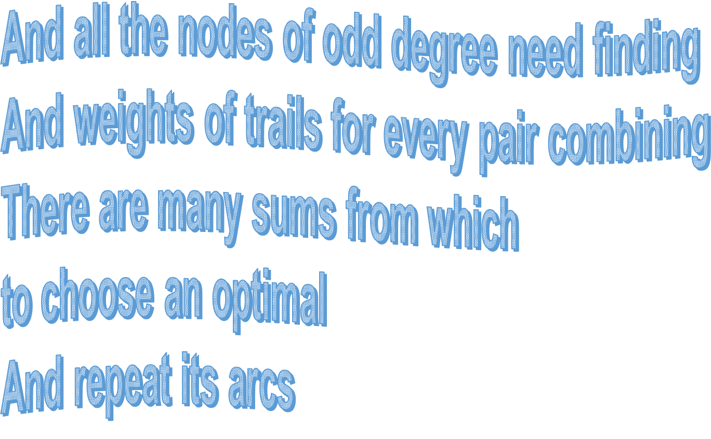

Slide 16
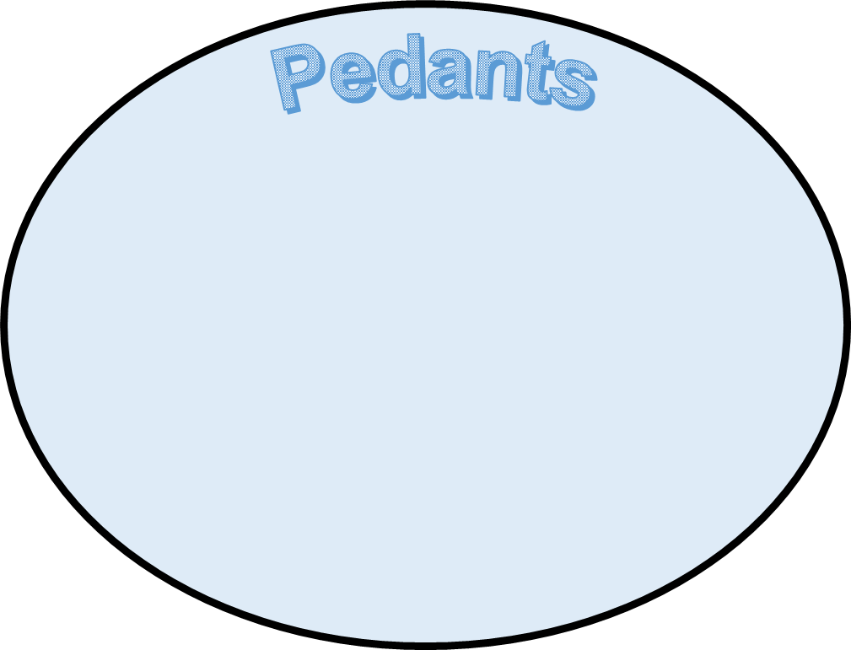
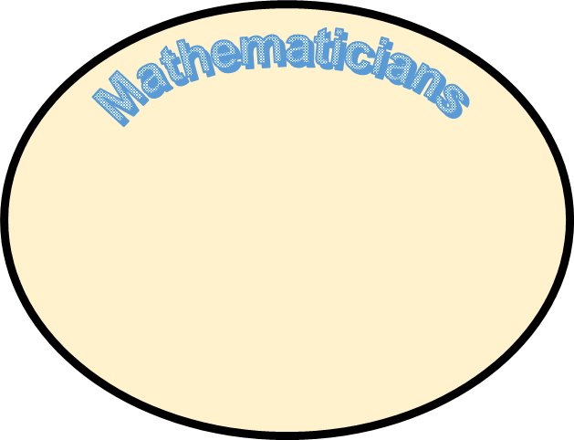
Tip #4
Try to make sure the maths is accurately described
That’s not right, I’m not pedantic.

Slide 17
And all the nodes of odd degree need finding
And weights of trails for every pair combining
There are many sums from which
to choose an optimal
And repeat its arcs

Slide 18
Tip #5
It doesn’t have to be really funny or really clever.
Tan, cos and sine
Functions never seemed so good
Now I can find
Lengths I never thought I could
I’m a point mass in a high school problem
No dimensions to call my own
I’m a point mass modelling a baseball
An’ I’m movin’ ‘cos I’ve just been thrown

Slide 19


Slide 20
MathsJam Jam songs waiting to be written…..
Maths Jokes Hurt so Much
Sad Songs (say so much)
“If it’s purple and commutes it’s a grape that’s abelian”
“To make sure all hope is gone why don’t you tune in and turn them on”

Slide 21
MathsJam Jam songs waiting to be written…..
Smooth Integral
Smooth Criminal
“I was looking for a function
From a gradient - made an assumption”
“You’ve been searching for a smooth integral”

Slide 22
MathsJam Jam songs waiting to be written…..
No title yet, possibly “The Topologist”!
Piano man
“It’s five o’clock in the common room,
the regular crowd shuffles in.
There’s an old man sitting next to me
……………..
He said son can you find me a manifold, I’m not really sure how it goes
But it’s ………….”

