Slide 1
Fake It Till You Make It
MathsJam 2017

Slide 2
Why Am I Here?

Slide 3
The 10 Second Boring Maths Bit

Slide 4
Node
Node
Node
Probability = 2/3
Probability = 1/3

Slide 5
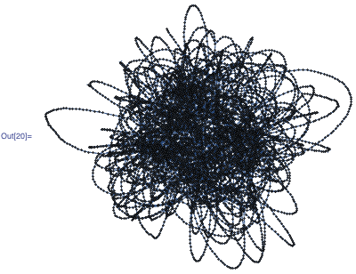

Slide 6
The Fun Maths Bit

Slide 7
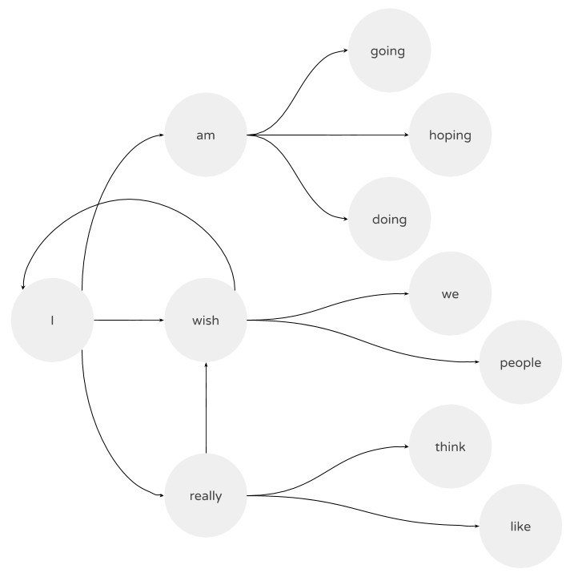

Slide 8

What do we need?
Large sample size (lots of tweets) to build chain
Simple language to avoid over complication
Readily available, legally obtained data (not web scraped!)
Who can offer us such a dataset?

Slide 9
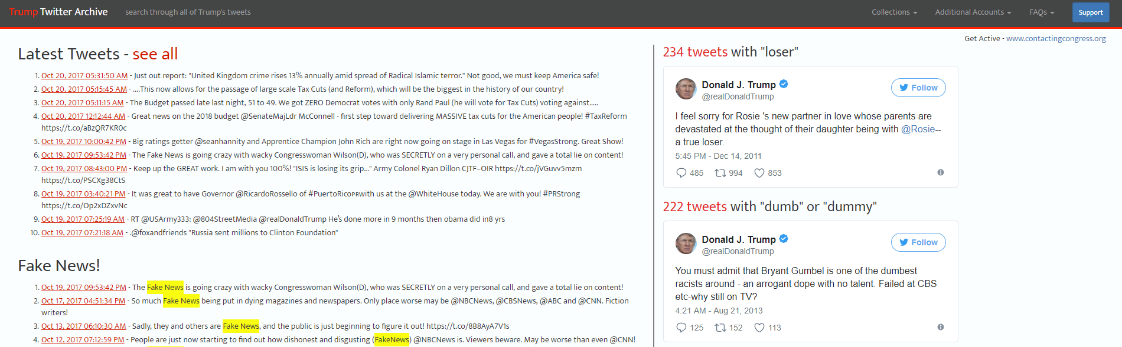

Slide 10
Greatest Hits…?

Slide 11
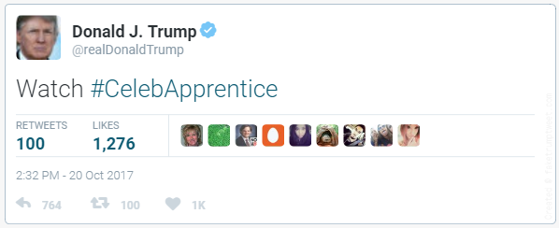

Slide 12
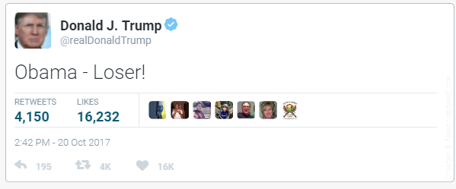

Slide 13
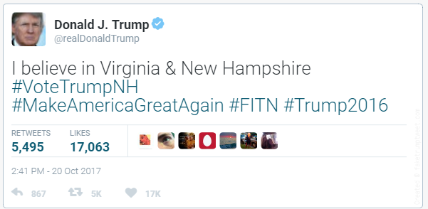

Slide 14
Near Misses

Slide 15
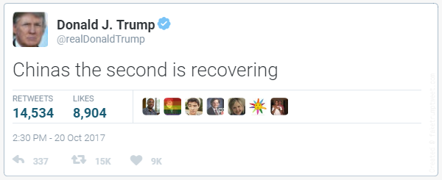
FakeTrumpTweet.png

Slide 16
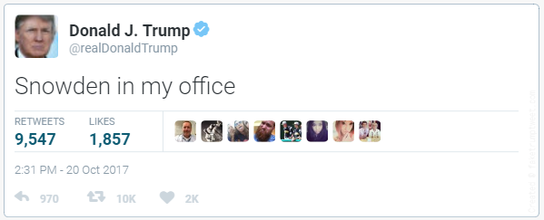

Slide 17
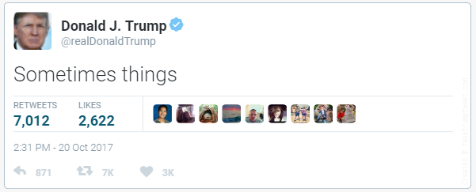

Slide 18
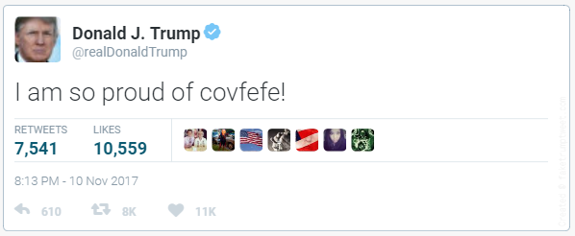

Slide 19
stmball.wordpress.com
@stmball
stmball@gmail.com
hipy.uk
@hipyliv

Slide 20
Thanks For Listening!

