Slide 1
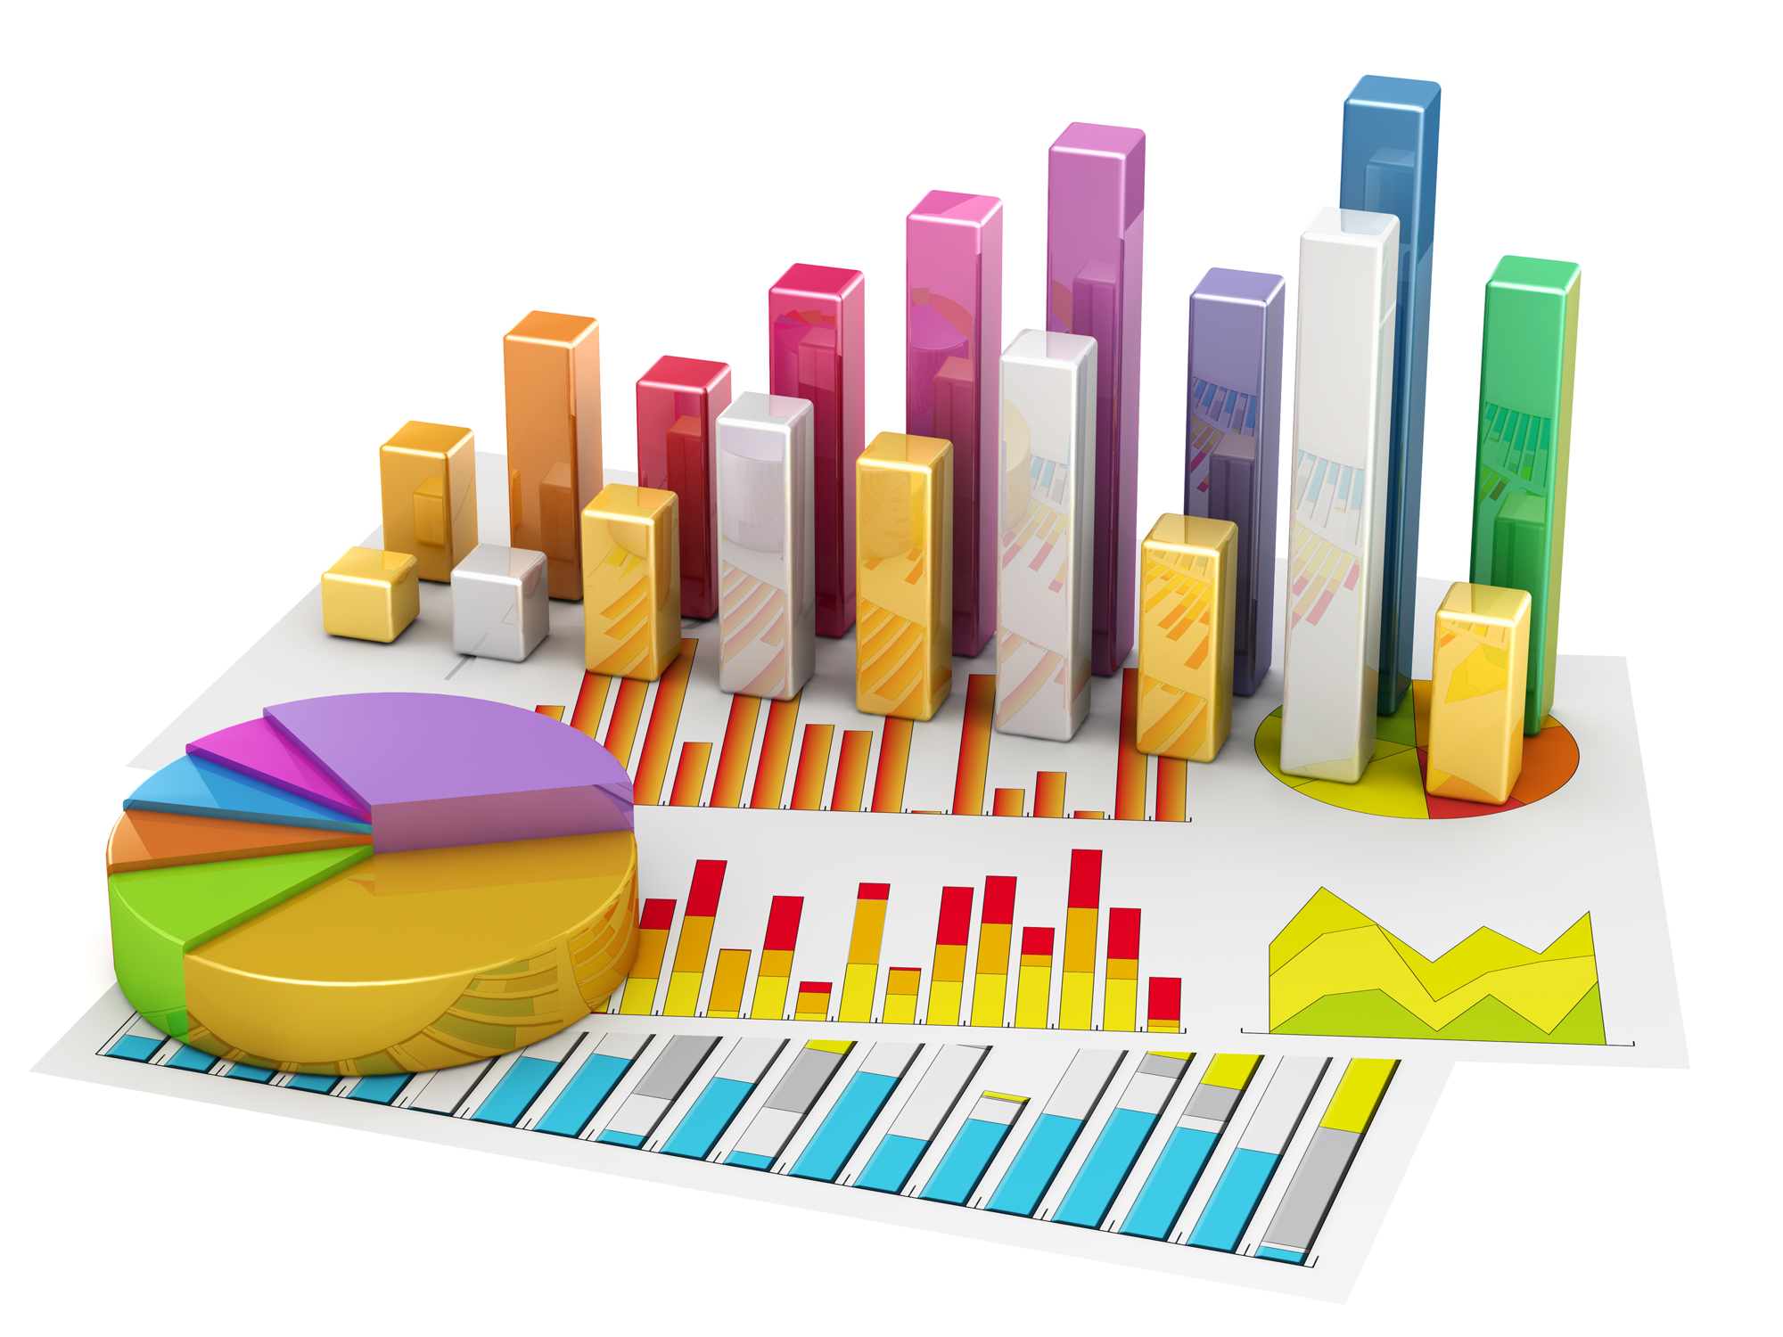
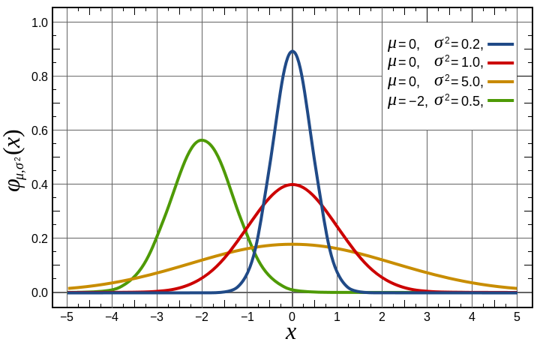
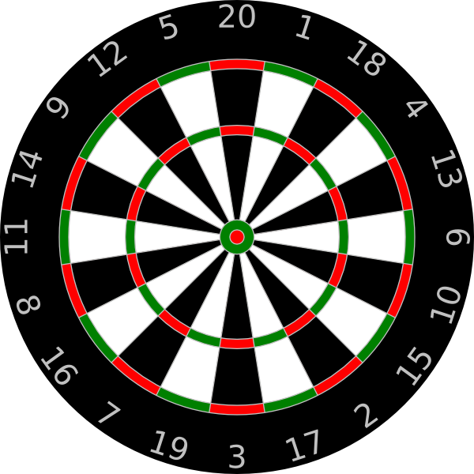
180 ways
NOT to model a darts player
Notes:
Growing up with my brother Chris, we played a lot of darts. Neither of us were any good, and in my case you are unfortunately going to see evidence of that in a moment.

Slide 2
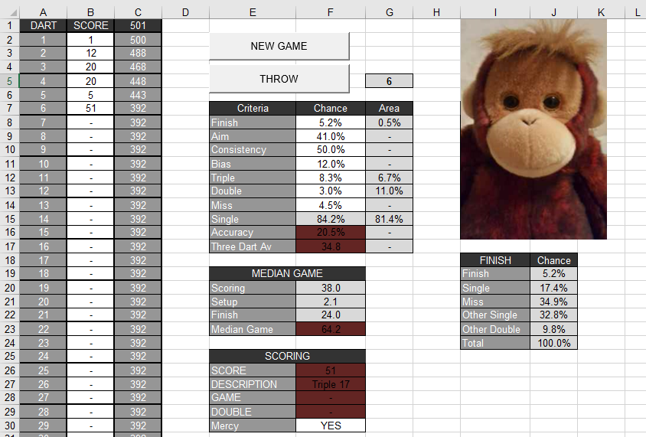
Notes:
We played so much, in fact, that Chris created AI opponents for us to have tournaments against... Using Microsoft Excel – an example is pictured here. He used excel’s random number generator and a bunch of hidden cells to generate the games, and using this we were able to set up opponents of varying difficulty.
We used this happily for quite a long time, until one day I chanced upon seeing the inner workings…

Slide 3
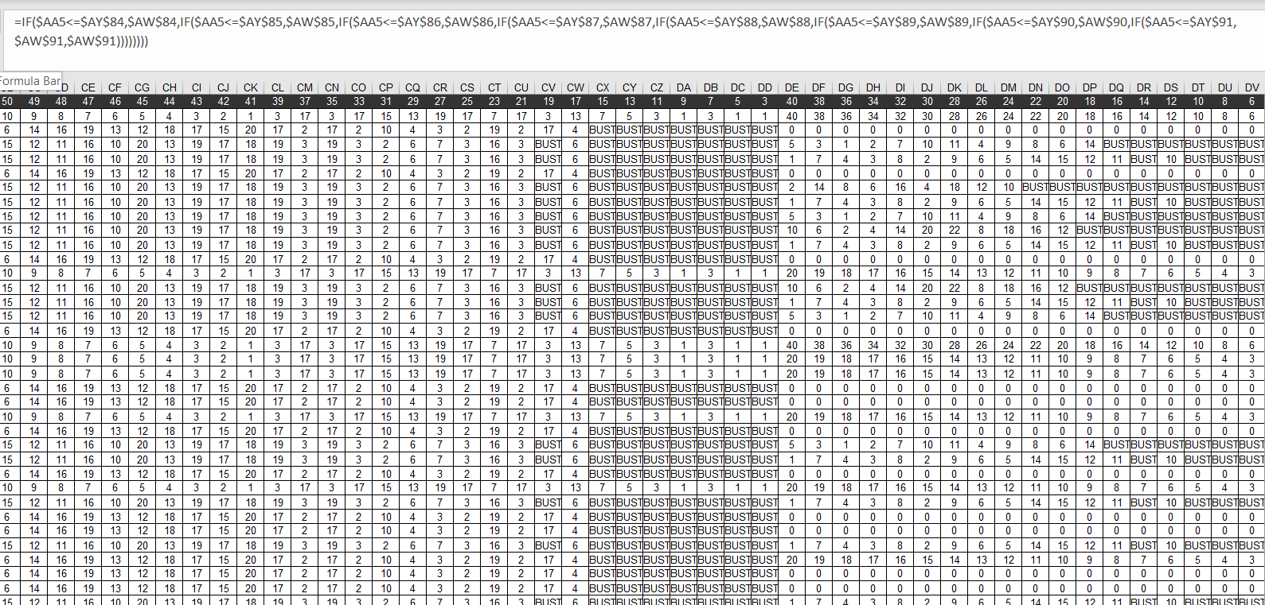
ARRRRRRGH!
Notes:
…and was confronted with this. Suffice to say, playing a game of darts is not what a spreadsheet is designed to do. For anyone who can’t see, that formula at the top there contains 7 embedded IF statements, and that’s just the calculation for one of these cells. Seeing this made one thing very clear to me – the spreadsheets needed to stop!
By this time, I’d been working as a software developer for several years, so I set out to create an actual darts programme with a proper database and real coding behind it. And that meant coming up with my own model for the AI – unsurprisingly I wasn’t going to try and copy whatever the hell this was doing. So I did what any maths graduate would do who’s forgotten almost the entirety of their statistics education…

Slide 4
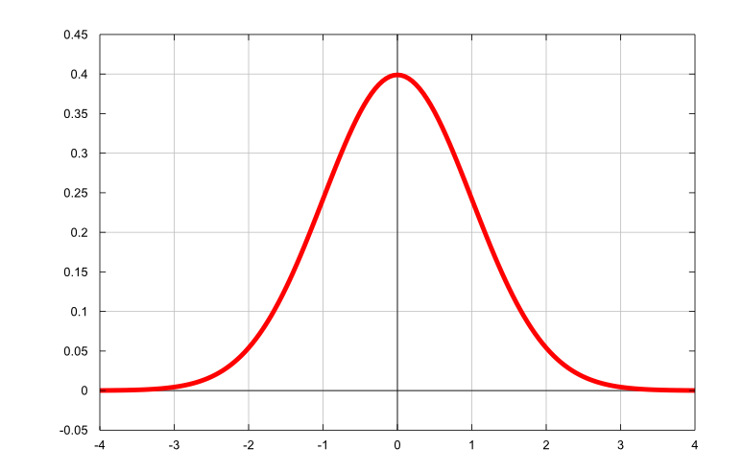
Notes:
…and plumped for the Normal Distribution. It’s simple, often effective and as a bonus happened to already be supported by the programming language I had chosen. Sweet.

Slide 5
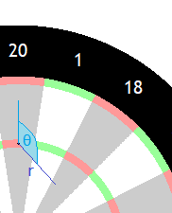
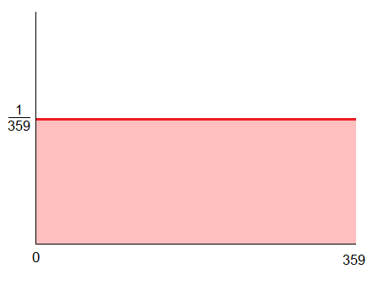
Normal Dist.
r
Aim here
Uniform Dist.
θ
Dart lands here
Notes:
Specifically, the model works like this. The computer aims for a particular point on the board, and two values are generated to make up the ‘throw’. The first one is the distance they end up away from that point, r, which is sampled from a Normal distribution with a Mean of 0. The Standard Deviation is configurable per opponent so you can make them easier or harder.
The second value is the angle at which that distance is applied, theta. This is just picked as a random number between 0 and 360. So that was it, dead simple. And, I thought, surely more realistic than whatever that grid of numbers was doing.

Slide 6
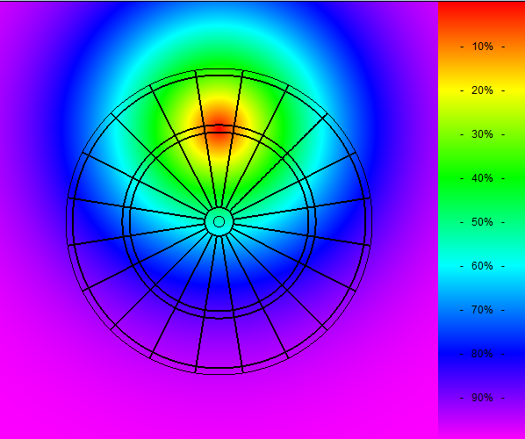
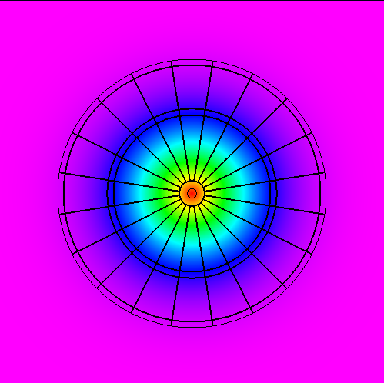
Notes:
One of the immediate advantages of the model was that you could plot nice charts like these to visualise how good an opponent was going to be. Here we’ve got two different AIs, one aiming for treble 20 on the left, and the other aiming for the bullseye on the right. The bullseye opponent is quite a bit better, which you can see from the tighter circles around where they’re aiming.
So this was the model we started with and we switched to using the new program. And it worked, in a lot of ways, but after a while it became clear that something wasn’t quite right.

Slide 7
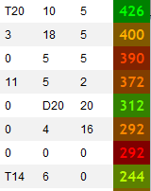
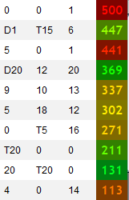
Scoring too erratic
Missing the board unrealistically often
Notes:
I’ve grabbed some example snippets from real games the computers played to demonstrate what I mean. What this big one on the left shows is that they were missing the board much more than I would have expected – in this example, 8 times out of 30 throws. But then again, they’re also hitting some big scores. In one round, the AI has stepped up and thrown a treble 20 – the perfect dart – followed by two misses! They’re just all over the place.
I wrote it off as short-term variance at first, but the longer we played the more it became clear this was an actual problem. So I started to try and come up with ways that I could fix it.

Slide 8
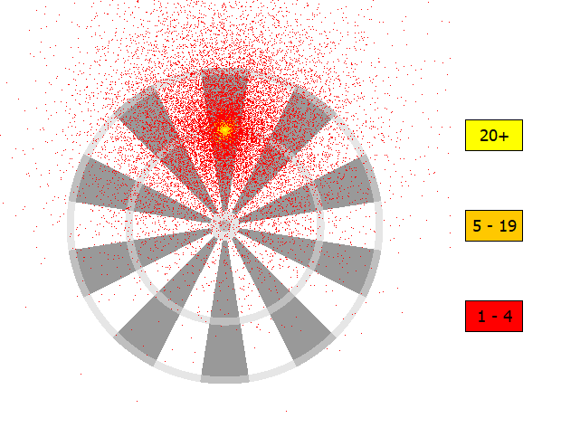
Player | Avg. Game | Score per dart | Miss % | Double % | T20 %
Me | 58 | 14.3 | 3.0 | 6.0 | 4.4
AI | 60 | 14.2 | 15.5 | 8.8 | 7.7
σ = 84
Notes:
To start with, I had to figure out some metrics to use in order to judge how well the model was doing. Here, I’ve gone for their average game, which is how many darts it takes for them to go from 501 to 0, their average score per dart, the percentage of the time they miss the board (clearly important), how often they successfully hit a double when aiming for it, and finally how many darts land in the triple 20.
I’ve also gathered those stats for myself for the 200 odd games that I’ve played since we’ve had my new program. In this first slide, we’re looking at the model at it’s simplest – where the only variable that you can tweak is the standard deviation. I’ve managed to make the average game, and average score per dart pretty much line up – which means it should be a decent opponent – but you can see that some of the other figures are wayyyy off. This is what was contributing to the “unrealistic” feeling.

Slide 9
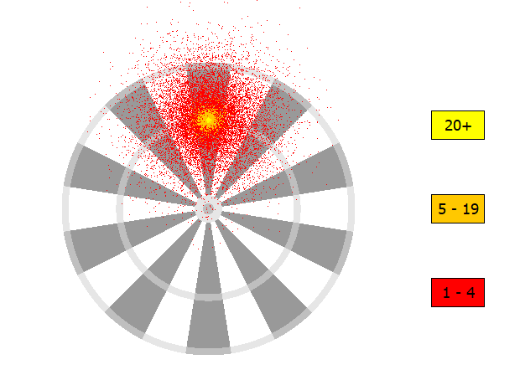
Player | Avg. Game | Score per dart | Miss % | Double % | T20 %
Me | 58 | 14.3 | 3.0 | 6.0 | 4.4
AI | 34 | 19.3 | 3.2 | 16.1 | 14.7
σ = 45
Notes:
To illustrate this a bit more, in this comparison all I’ve done is lower the standard deviation until the miss percentage came into line with my own. By this point, the AI is a much, much stronger player than me in every respect – they’re finishing games on average 24 darts faster than I am. So, I need a way to bring that miss percentage in line without creating a monster.

Slide 10
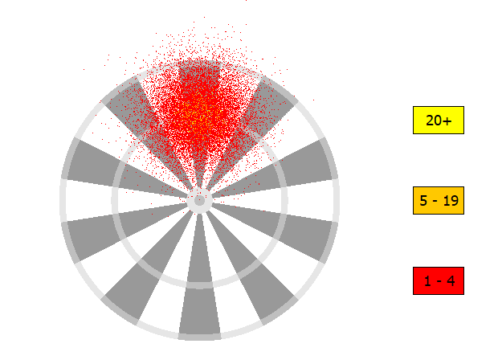
Player | Avg. Game | Score per dart | Miss % | Double % | T20 %
Me | 58 | 14.3 | 3.0 | 6.0 | 4.4
AI | 60 | 13.5 | 2.0 | 6.6 | 4.2
σ = 50
Avg r over 2 samples
Notes:
My first thought was just that I needed to remove the “extreme” values, and that one way I might go about doing this would be to take two samples of my normal distribution and average them out. This should effectively “pull in” the wild misses and make the computer a little more consistent.
When trying to make it line up to my own stats, it seems to work pretty well. But it does feel like a bit of a “dirty” solution, and there was another problem with it which became apparent when I looked at what would happen if I averaged over even more samples…

Slide 11
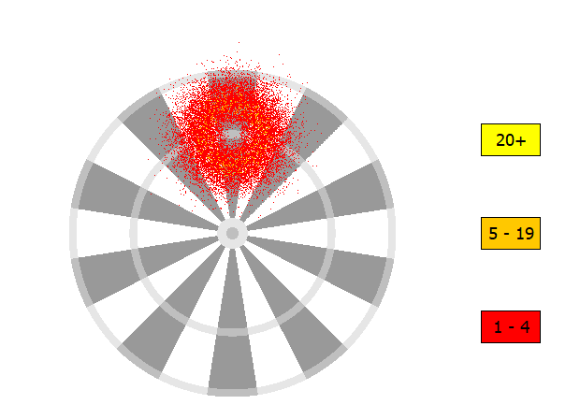
Player | Avg. Game | Score per dart | Miss % | Double % | T20 %
Me | 58 | 14.3 | 3.0 | 6.0 | 4.4
AI | 121 | 10.4 | 0.4 | 2.3 | 0.5
σ = 50
Avg r over 5 samples
Notes:
…they’re now barely hitting what they’re aiming at at all! Averaging the radius not only eliminates the extremely bad shots, but it also drives away a lot of those that were on target for where the AI was aiming. This seems obvious, in hindsight, but when I first ran this and saw a picture like that it did make me scratch my head for a second!

Slide 12
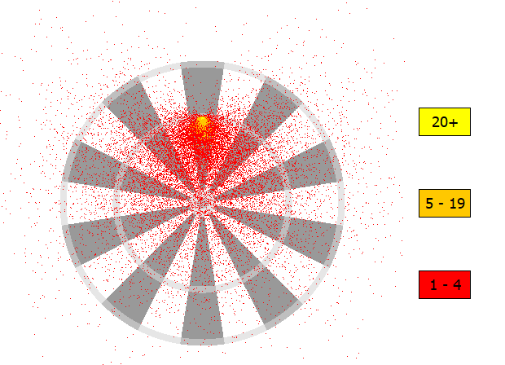
Player | Avg. Game | Score per dart | Miss % | Double % | T20 %
Me | 58 | 14.3 | 3.0 | 6.0 | 4.4
AI | 56 | 14.4 | 5.2 | 7.0 | 5.2
σ = 105
σ₂ = 50
Notes:
The only other idea I’ve had a stab at was to play around with the way that the angle is generated. I reasoned that maybe the reason humans don’t miss as much is because they’re naturally cautious, tending to throw the dart so it lands “safe”. So when aiming for treble 20, you tend to land more below it than you do above.
I’m not sure if it’s true, but I gave it a go. Again, I’m hopeless with distributions, so I just ripped out the random angle and replaced it with another Normal distribution. For this one, the mean angle is the one that points you directly into the centre of the board.
This does reduce the miss percentage, but not significantly enough. It also doesn’t feel natural at all – that scatter diagram looks nothing like what I imagine a human one would look like.

Slide 13
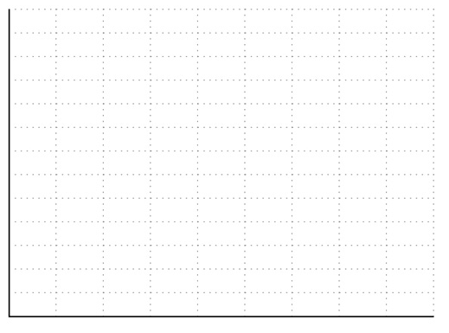
?
Notes:
Of course, what I suspect I *really* need to do is go back to the distribution I’m using in the first place… which is where I’m hoping I can get help from the people in this room. Maybe the answer is to bin the Normal distribution… but what do I replace it with?

