Slide 1
Ray Casting and Rabbits
Callum Mulligan
@CalMaths

Slide 2
Whoops!

Slide 3
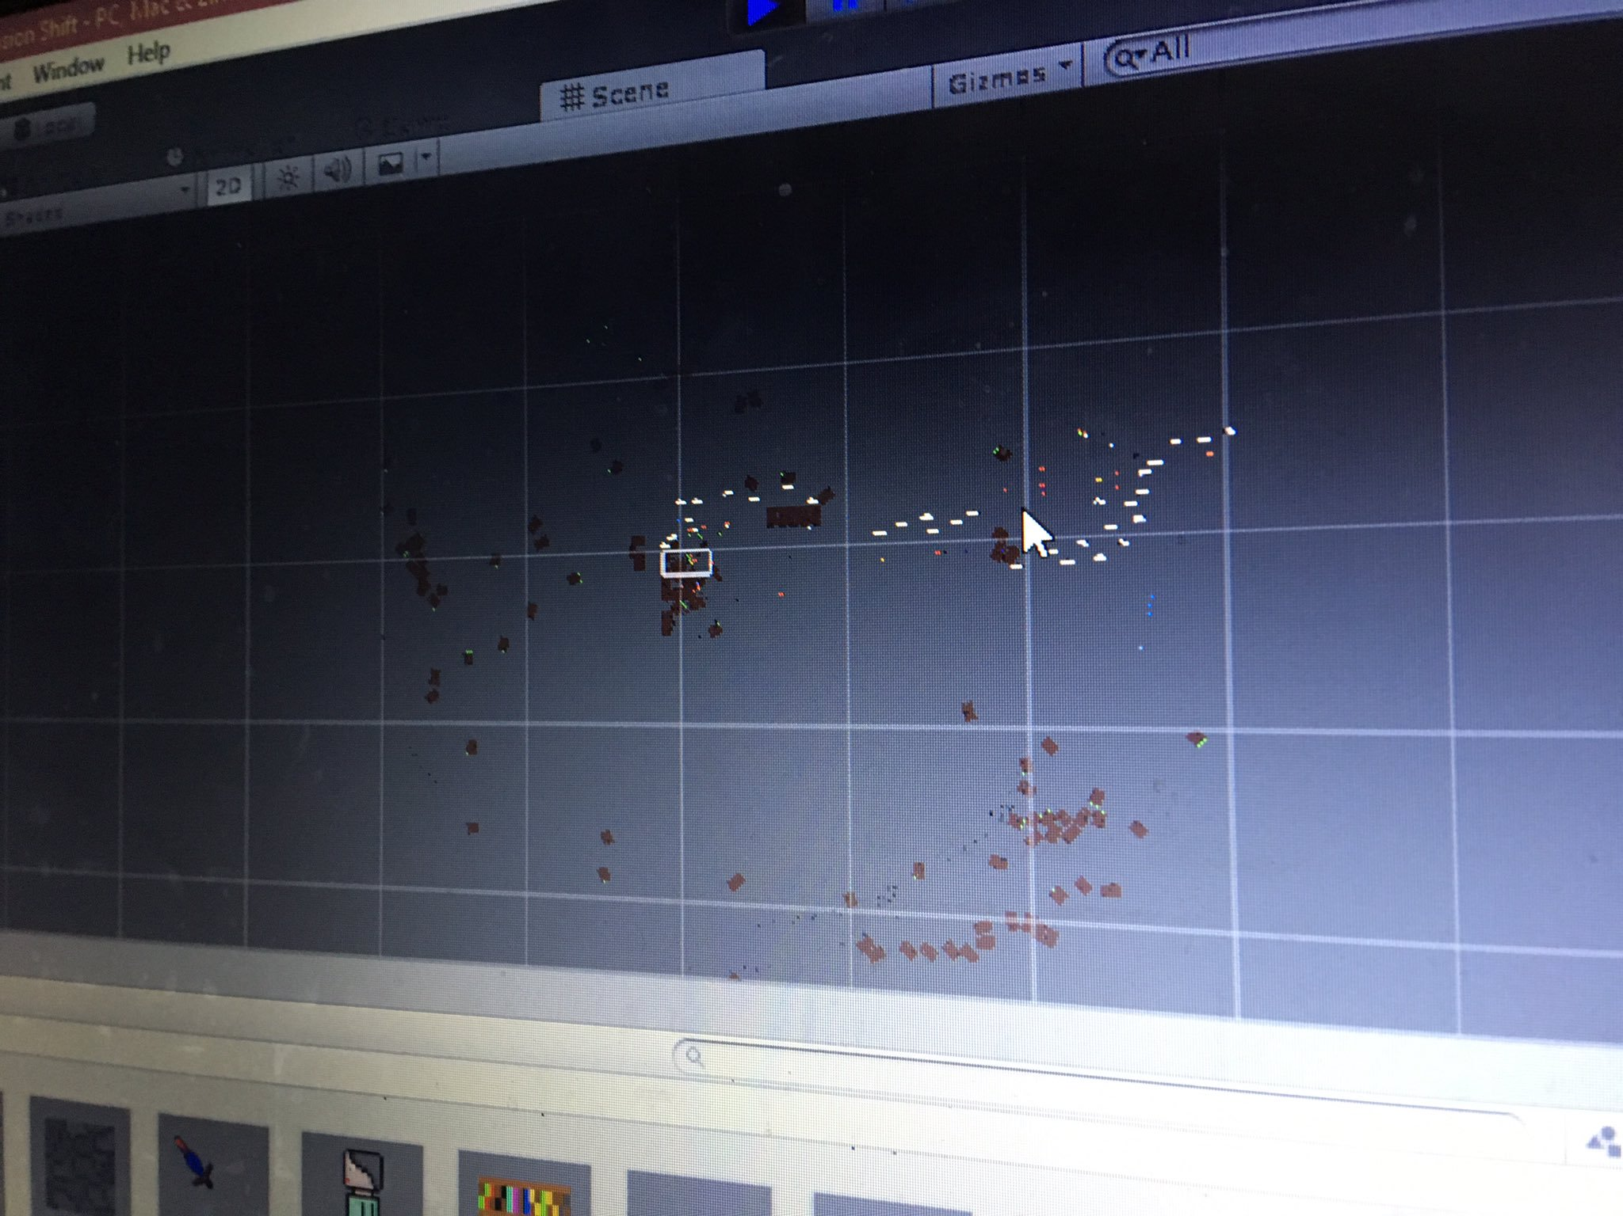

Slide 4
Student: 'what will happen if I add a spring joint to everything' Me:'Try it!' Result: Chaos
21st September 2017

Slide 5
Raycasting

Slide 9
Paul
Hatty

Slide 10
Paul
Hatty

Slide 11
Paul
Hatty

Slide 12
pew
Paul
Hatty

Slide 13
Paul
Hatty

Slide 14
We Win

Slide 15
Raycasting & Rabbits

Slide 19


Slide 20
Wolfenstein 3D

Slide 21

Wolfenstein 3D

Slide 22
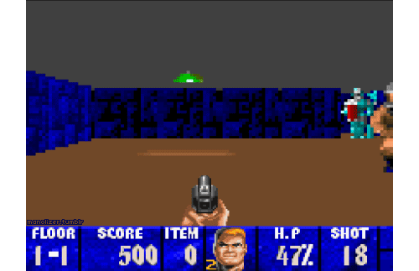

Slide 23
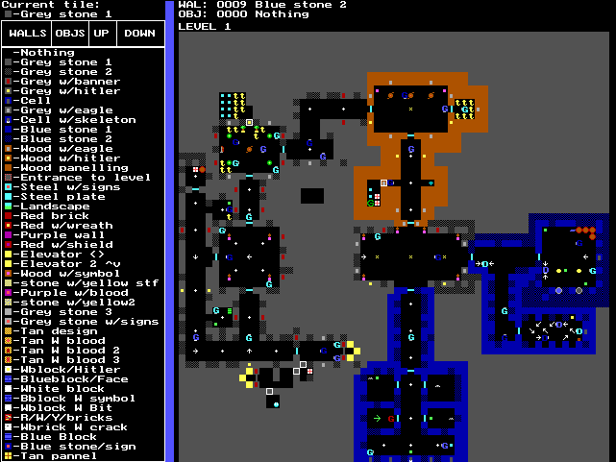

Slide 25
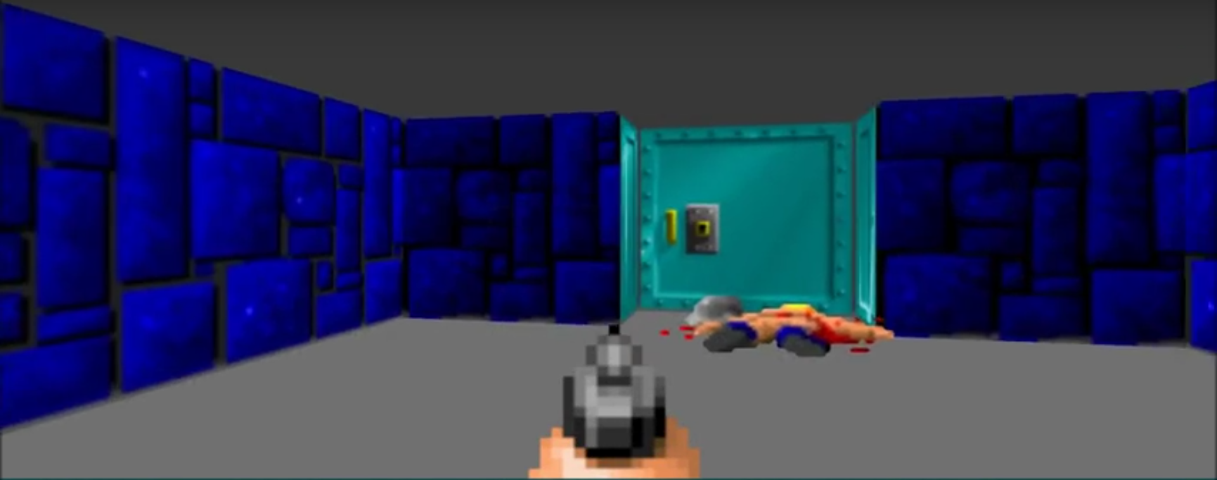

Slide 27
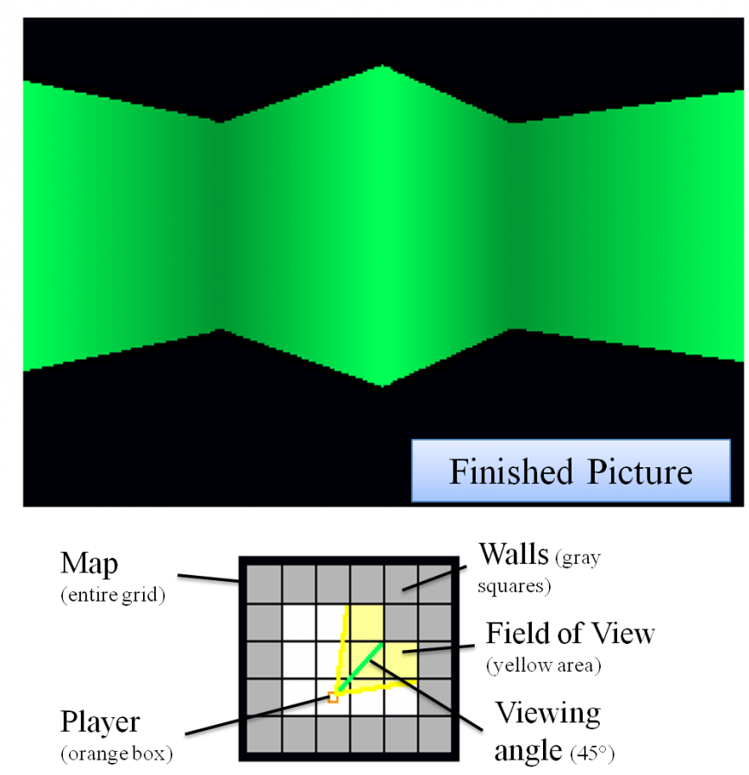
https://en.scratch-wiki.info/wiki/Raycaster

Slide 28
Player:
-Coordinates
X

Slide 29
1 1 1 1 1 1
1 0 0 0 0 1
1 0 0 0 0 1
1 0 0 0 0 1
1 1 1 1 1 1
Player:
-Coordinates
X

Slide 30
Player:
-Coordinates
-Direction
X

Slide 31
Player:
-Coordinates
-Direction
-FOV

Slide 32
Player:
-Coordinates
-Direction
-FOV

Slide 33
Player:
-Coordinates
-Direction
-FOV

Slide 34
Player:
-Coordinates
-Direction
-FOV

Slide 35
Player:
-Coordinates
-Direction
-FOV

Slide 36
Player:
-Coordinates
-Direction
-FOV

Slide 37
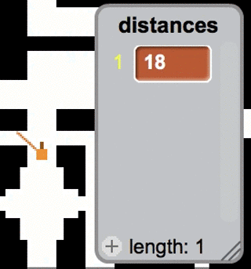
https://en.scratch-wiki.info/wiki/Raycaster

Slide 38
Fin

