Slide 1

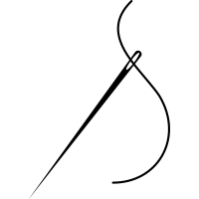
A needling problem from embroidery
Eleanor Doman

Slide 2
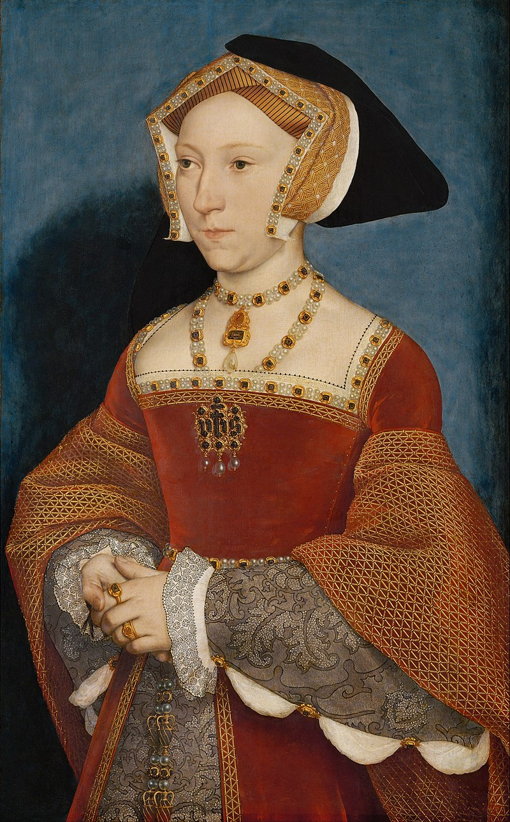
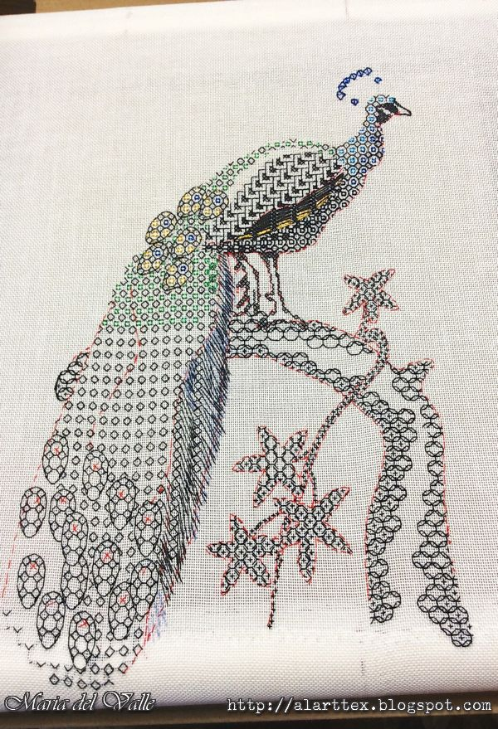
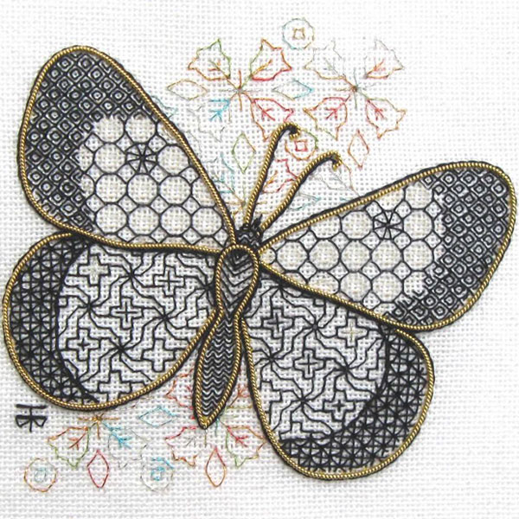

Slide 3
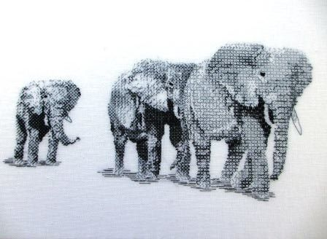

Slide 4
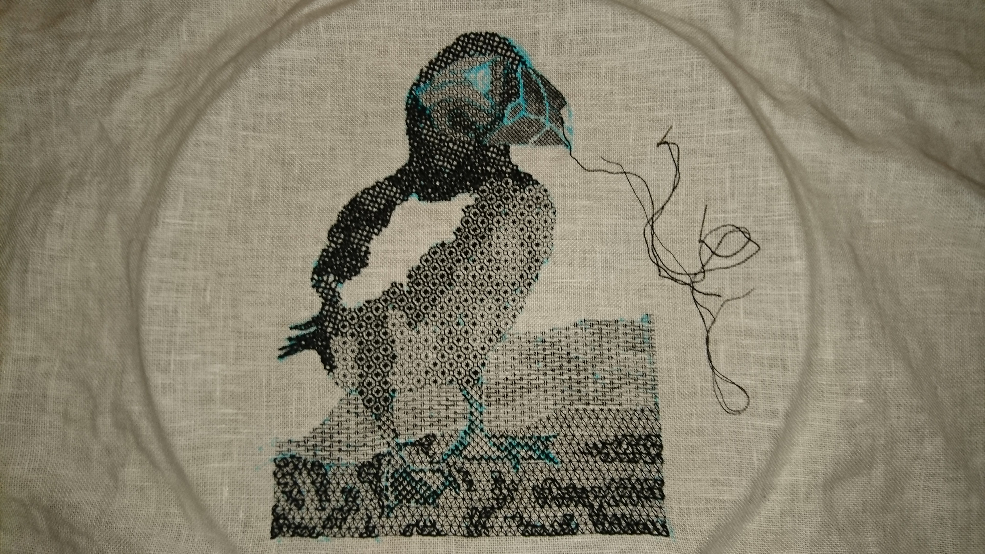

Slide 5
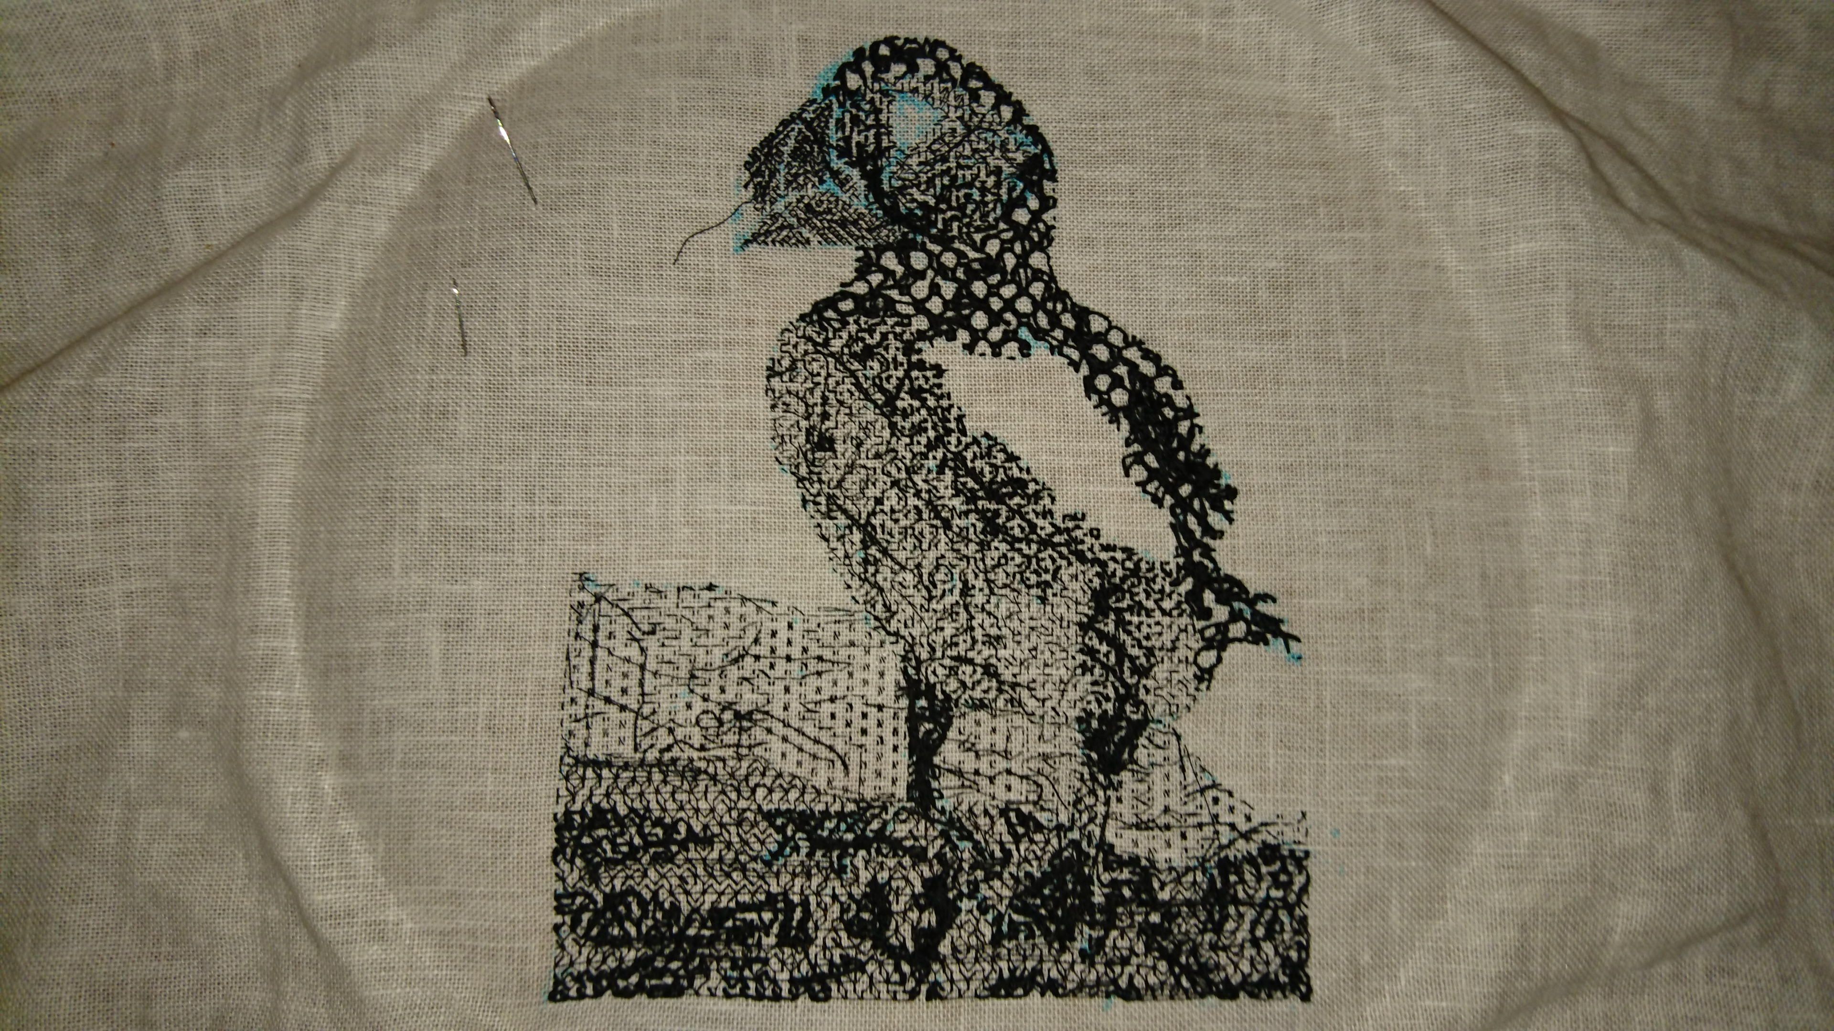

Slide 6
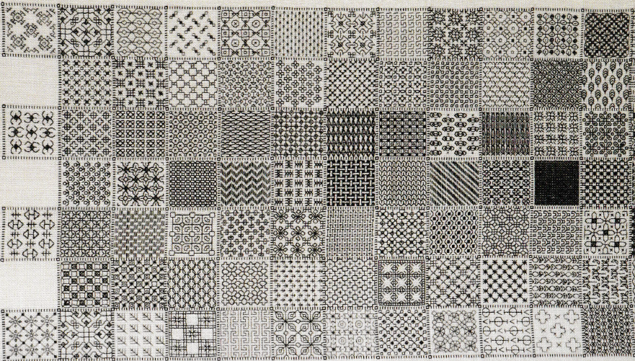



Slide 7


Slide 8
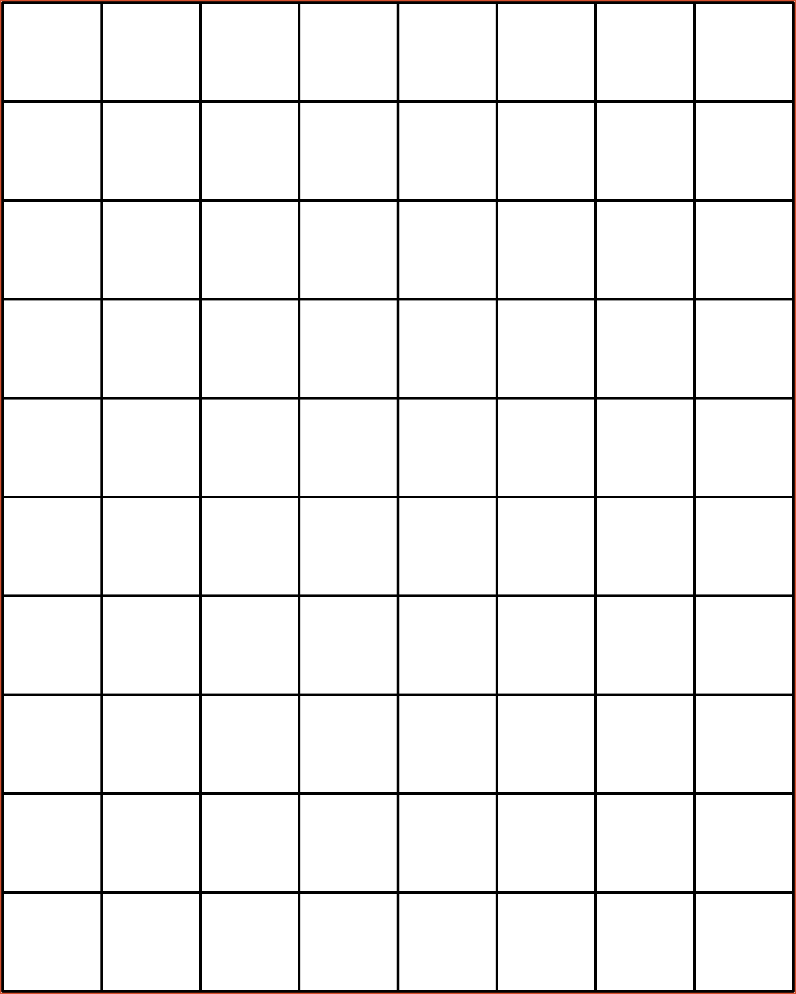

Slide 10


Slide 11
Does the ’even node’ rule still work for ‘textured’ blackwork patterns?
What is the largest area we can cover using a single thread?
Is there an algorithm we can use to cover an area?

Slide 12

Thank you for listening!
Eleanor Doman
eleanordoman54@gmail.com

