Slide 1
Here’s My Card Trick!
Michael GibSON
mikegibson2010@gmail.com

Slide 2

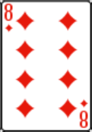

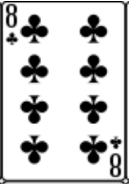

The Original “Effect”
?
Can you guess the missing card?

Slide 3
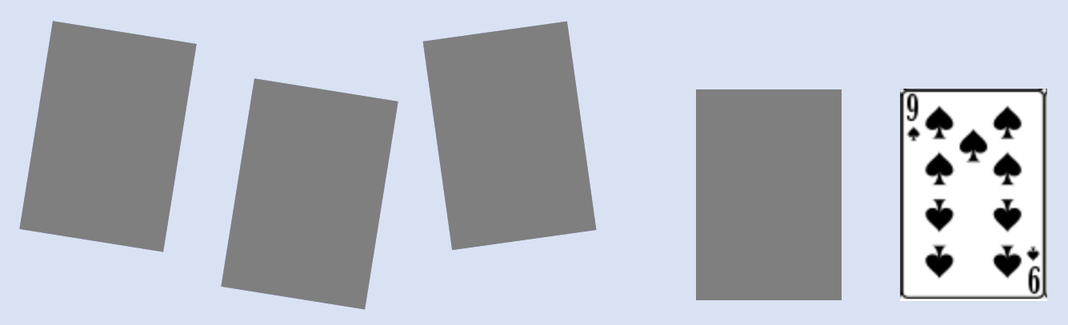
The New “Effect”
Can you guess all four missing cards?

Slide 4
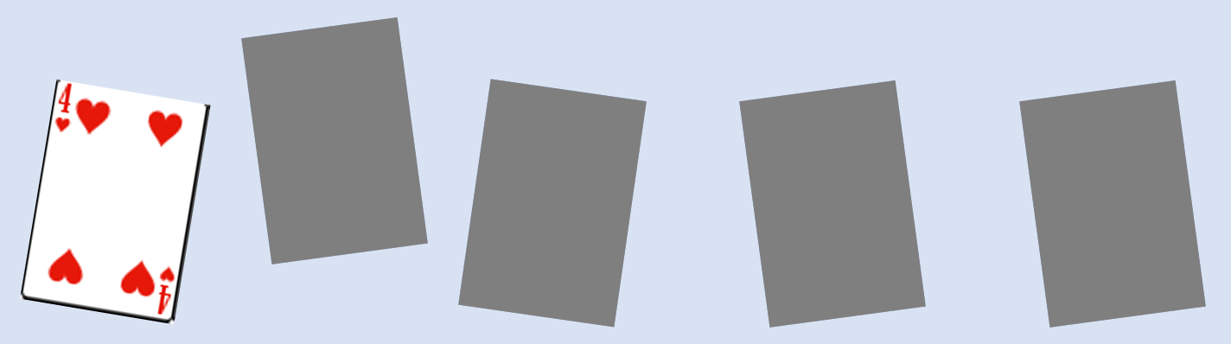
The New “Effect”
Can you guess all four missing cards?

Slide 5

The New “Effect”
Can you guess all four missing cards?

Slide 6
Thanks!
Michael GibSON
mikegibson2010@gmail.com

