Slide 1
Banach-Tarski: make peace with it
Tom Reddington
17 November 2018
Notes:
I occasionally find myself in the pub, talking about maths with...muggles, and I almost always end up in an argument when I talk about the Banach-Tarski paradox. I'm just here to set the record straight.
So, the Banach-Tarski paradox is a theorem from 1924 that states the following:

Slide 2
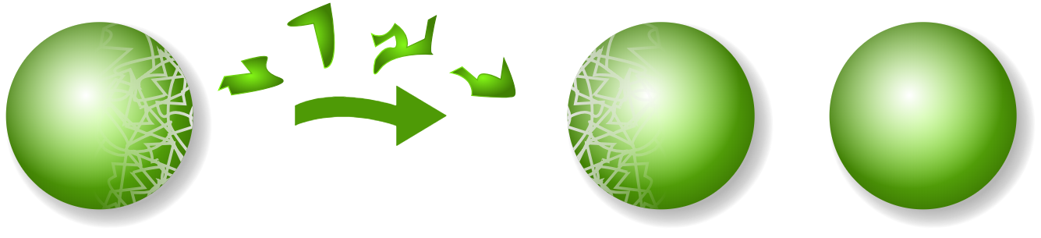
The theorem
There exists a way to divide a sphere into a finite number of pieces and rearrange those pieces into two spheres, both of which are the same size as the original.
Notes:
[Read statement]
Basically, you're somehow doubling the sphere. This is a completely kosher theorem and is only called a paradox because it violates intuition.
So, if you've not seen this before, you'd be forgiven for assuming that this is directly breaking some sort of mathematical conservation law, and it almost does but uses a loophole.

Slide 3
Preserving the Lebesgue measure
Measure: 1
Notes:
In maths, the generalisation for a length, area or volume is the Lebesgue measure.
If you're translating or rotating a shape, all of its Lebesgue measures stay the same.
So if a sphere has measure 1, I cut it into two pieces and move them around…

Slide 4
Preserving the Lebesgue measure

Slide 5
Preserving the Lebesgue measure
Measure: 0.25
Measure: 0.75
Notes:
The Lebesgue measure of each piece is preserved. And if we reassemble…

Slide 6
Preserving the Lebesgue measure

Slide 7
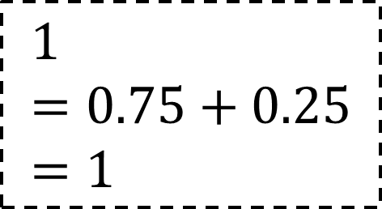
Preserving the Lebesgue measure
$$1=0.75+0.25=1$$
Measure: 1
Notes:
the total Lebesgue measure is still 1, because we’re just adding the measures of the pieces.

Slide 8
Preserving the Lebesgue measure: loophole
Measure: 1
Notes:
However, in a similar way to making an integer the sum of two irrational numbers, I can cut the sphere in such an awful, jagged way so that there is no sensible way to define a Lebesgue measure on any of the pieces, and there’s nothing to conserve when those are moved.

Slide 9
Preserving the Lebesgue measure: loophole

Slide 10
Preserving the Lebesgue measure: loophole

Slide 11
Preserving the Lebesgue measure: loophole
Measure: ?
Measure: ?
Measure: ?
Measure: ?
Notes:
And if we rearrange…

Slide 12
Preserving the Lebesgue measure: loophole

Slide 13
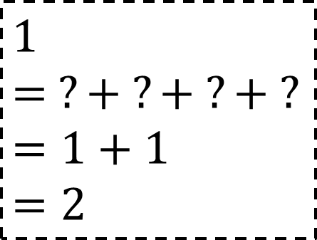
Preserving the Lebesgue measure: loophole
$$1= ?+ ?+ ?+ ? =1+1 =2$$
Measure 1
Measure 1
Notes:
Adding them together might give a different answer to the original total measure, so total measure isn’t always preserved and we have our loophole.

Slide 14
Why I’m not rich
Notes:
So your next question's probably "Alright, Reddington, here's an Easter egg and a Stanley knife, why don't you demonstrate?". Well, there are two difficulties when translating it into the real world:

Slide 15
Why I’m not rich
Matter in the real world isn’t continuous.
Notes:
1. The Universe isn't continuous. We have atoms and the Planck length to deal with.

Slide 16
Why I’m not rich
Matter in the real world isn’t continuous.
We’re not allowed to know what the pieces look like, because it would break maths.
Notes:
2. More interestingly, we know that these pieces have to be "unmeasurable", but we're forbidden from knowing what the pieces actually look like. If we did, it would break maths.

Slide 17
Why I’m not rich
Matter in the real world isn’t continuous.
We’re not allowed to know what the pieces look like, because it would break maths.
Notes:
To explain what I mean, we need to look at the axiom of choice.

Slide 18
The axiom of choice (AC)
Given any collection of sets, each containing at least one object, it is possible to make a selection of exactly one object from each set, even if the collection is infinite.
Axioms of mathematics are the building blocks of sets.
AC stands out because it doesn’t say which members are in the resultant set.
Notes:
[Read statement]
For what we’re doing, there’s a useful analogy for the axiom of choice, and I have no idea what it is. But the thing to remember is that using the axiom of choice gives us a new set, but unlike the other axioms, we don’t know which members are in the resultant set.

Slide 19
Why can’t we know what the pieces are?
Any proof of the paradox must use the axiom of choice.
So if you knew what the pieces were, you’d be able to show the paradox without AC!
Notes:
When the paradox was first proven, it used the axiom of choice when creating the pieces, so we couldn’t say exactly which points made up a piece. Later attempts tried to reprove it without using choice, but they failed and it was eventually proved that the paradox requires the axiom of choice.
So, if someone knew exactly what the pieces looked like, they’d be able to demonstrate the paradox without the axiom of choice, in which case our whole body of theorems would fall apart and maths would need to be rewritten.

Slide 20
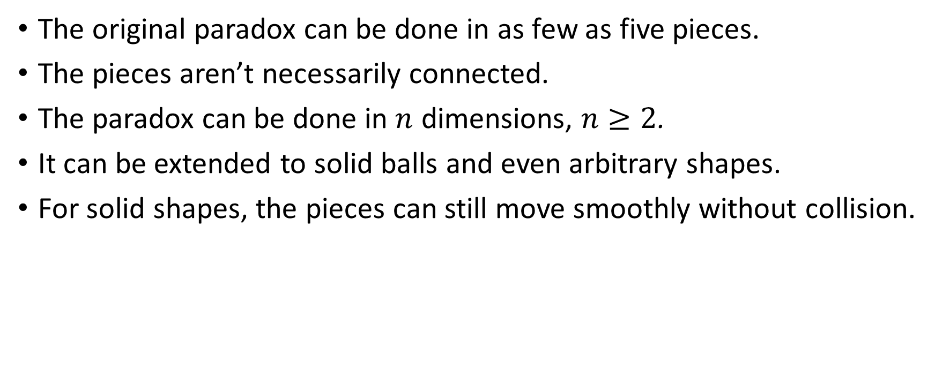
Concluding one-liners
The original paradox can be done in as few as five pieces.
The pieces aren’t necessarily connected.
The paradox can be done in $n$ dimensions, $n≥2$.
It can be extended to solid balls and even arbitrary shapes.
For solid shapes, the pieces can still move smoothly without collision.

