Slide 1
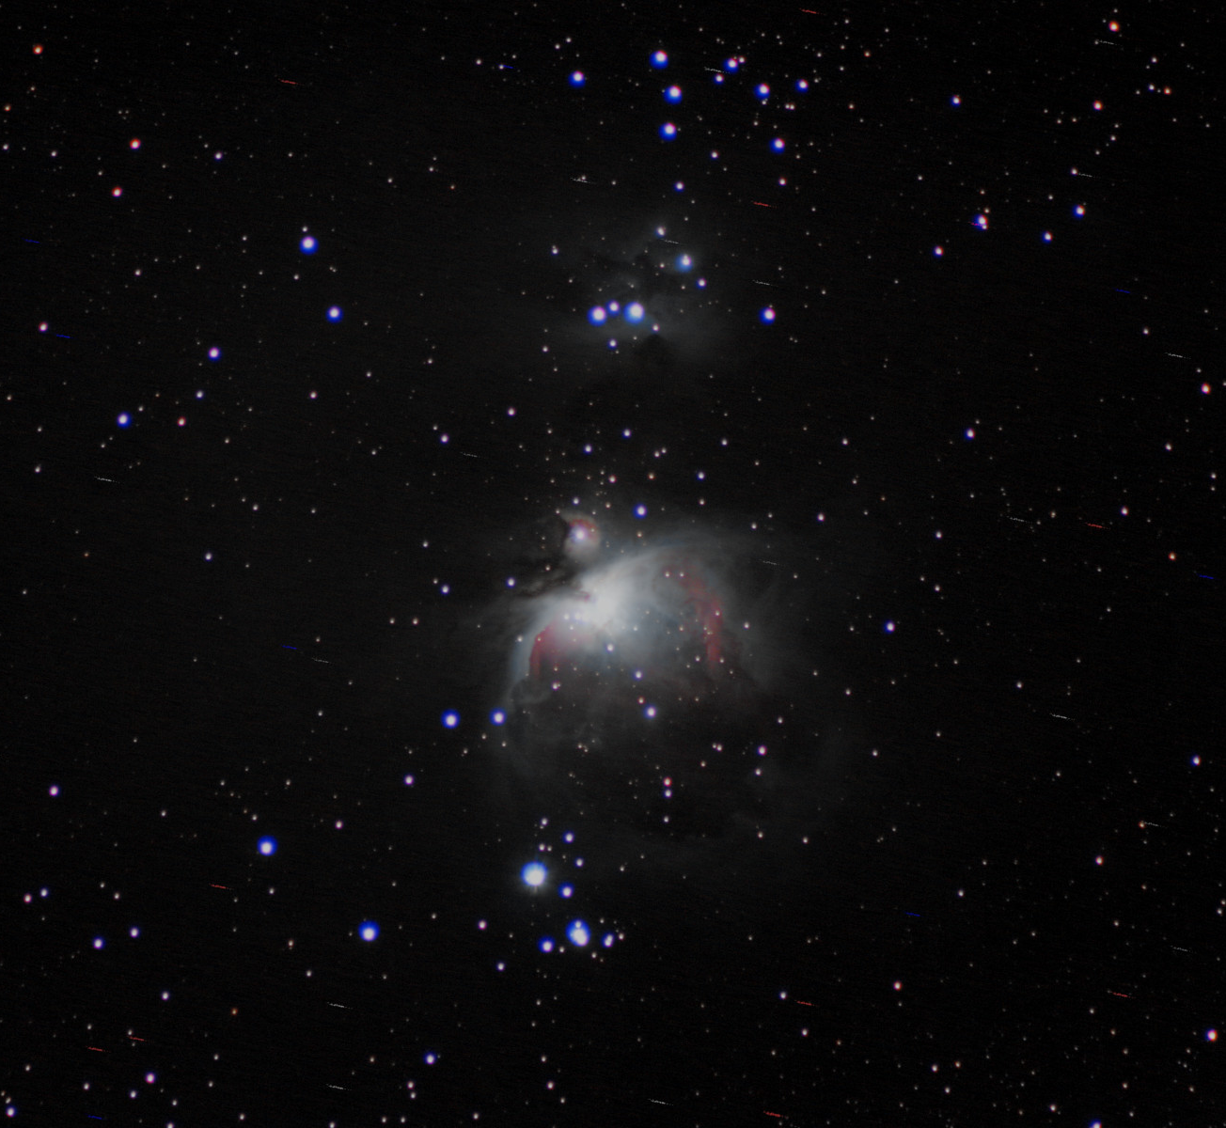
Maths or conspiracy?
Dave Hartburn

Slide 2
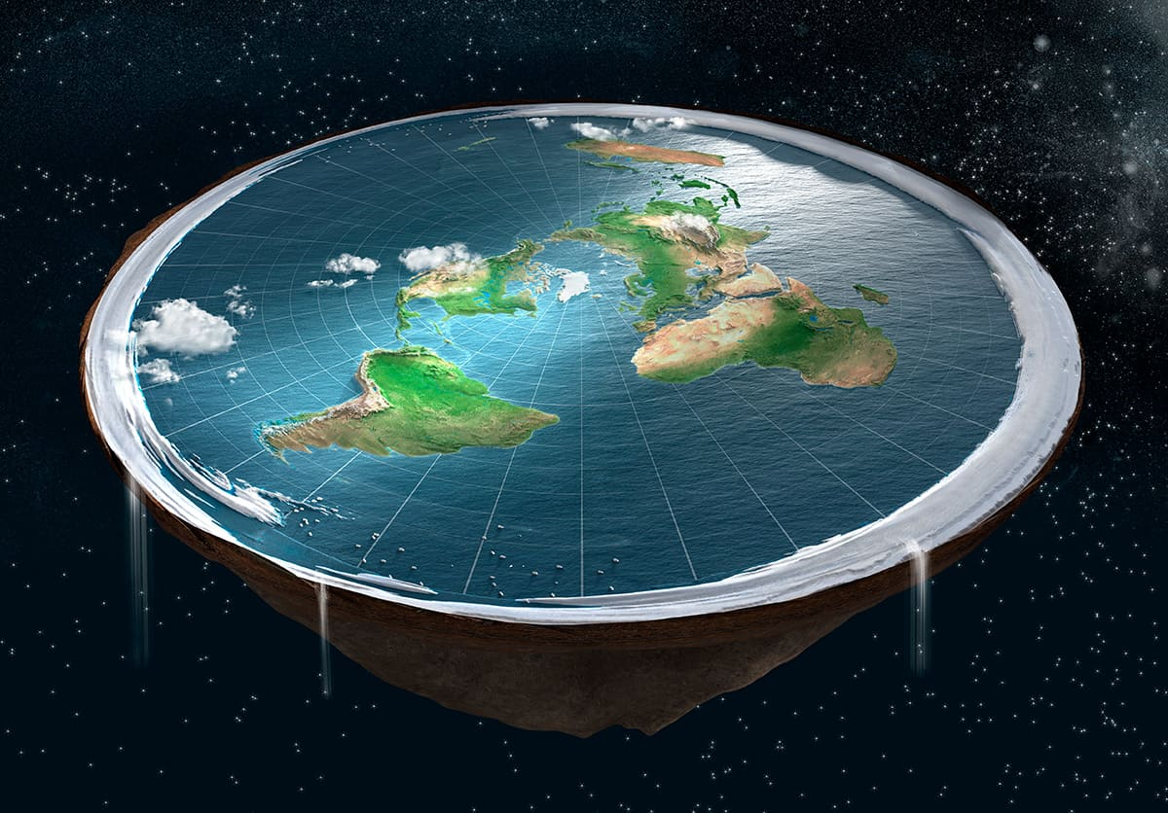
“If the earth was a globe, then the drop to the horizon would be 8 inches per mile squared”
Errr, what?

Slide 3
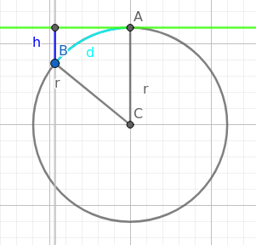
What does ‘drop from the horizon’ mean?
If an observer is at point A, then their horizon is the tangent to the curve of the earth (or planet radius r)
The vertical distance between a point B at distance d across the surface is the drop (h = height of drop)

Slide 4
Breaking down the rule
the drop to the horizon would be 8 inches per mile squared
Try again in metric, convert to km
h = 0.0002032 ( d / 1.60943 )²
Where d is in miles
Units = cubic km
h = 8d²
h = inches x miles squared
Units = inch mile squared
Or units = square mile inches

Slide 5
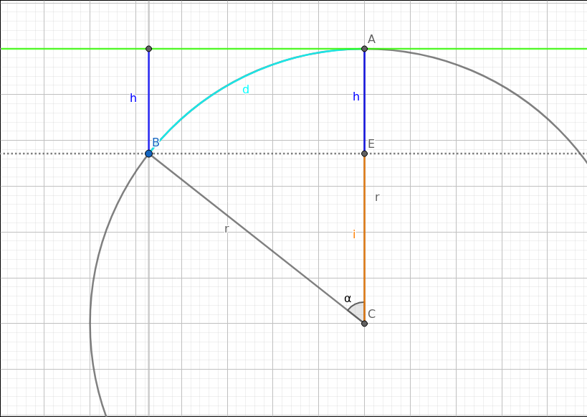

What about actual maths?
$$i=r\cos{\text{α}}$$
$$h=r −i$$
$$h=r −r\cos{\text{α}}$$
$$α= \frac{d}{r}$$
$$h=r −r\cos\left(\frac{d}{r}\right)$$

Slide 6
Comparison of the rules
Radius of Earth r = 6,371 km
Distance d | Cosine |  | Square
Kilometres | Kilometres | Metres | Kilometres | metres
5 | 0.0020 | 1.96 | 0.0020 | 1.96
10 | 0.0078 | 7.85 | 0.0078 | 7.84
25 | 0.0491 | 49.05 | 0.0490 | 49.03
100 | 0.7848 | 784.79 | 0.7845 | 784.48
400 | 12.5528 | 12,552.77 | 12.5516 | 12,551.61
1,000 | 78.3196 | 78,319.62 | 78.4476 | 78,447.57
1,500 | 175.7672 | 175,767.19 | 176.5070 | 176,507.04

Slide 7
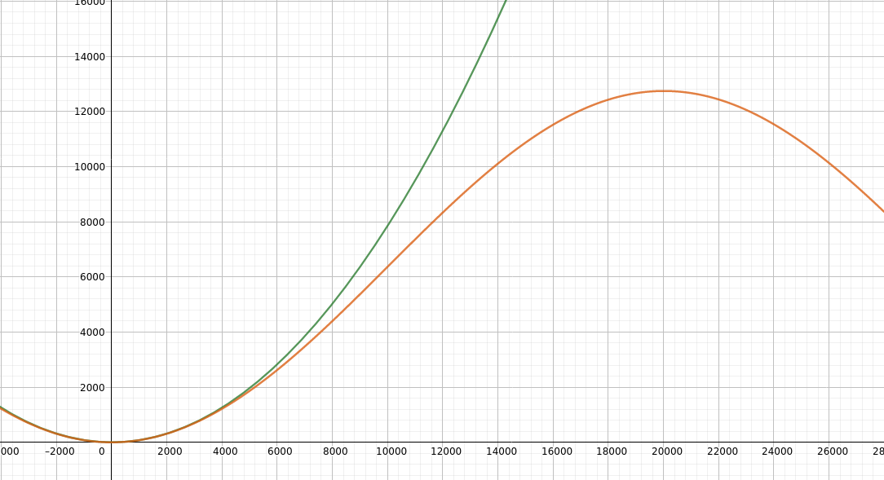
As a graph…..

Slide 8
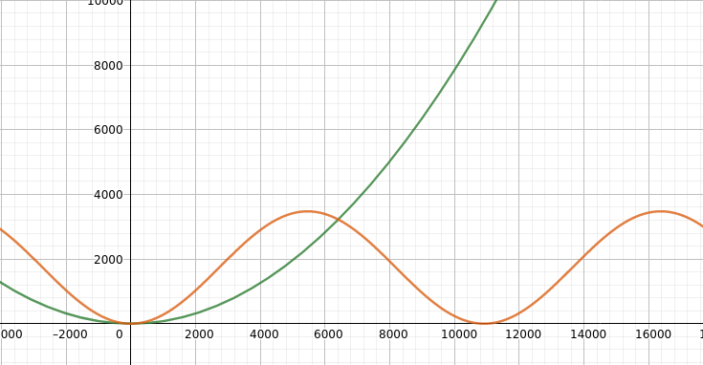
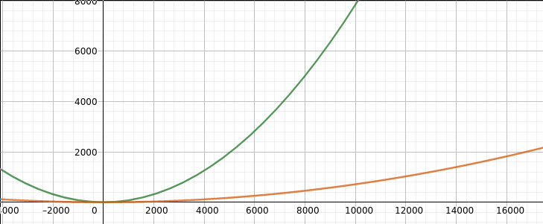
What about elsewhere?
Jupiter
The moon

