Slide 1
“A BODMAS Sandwich”

Slide 2
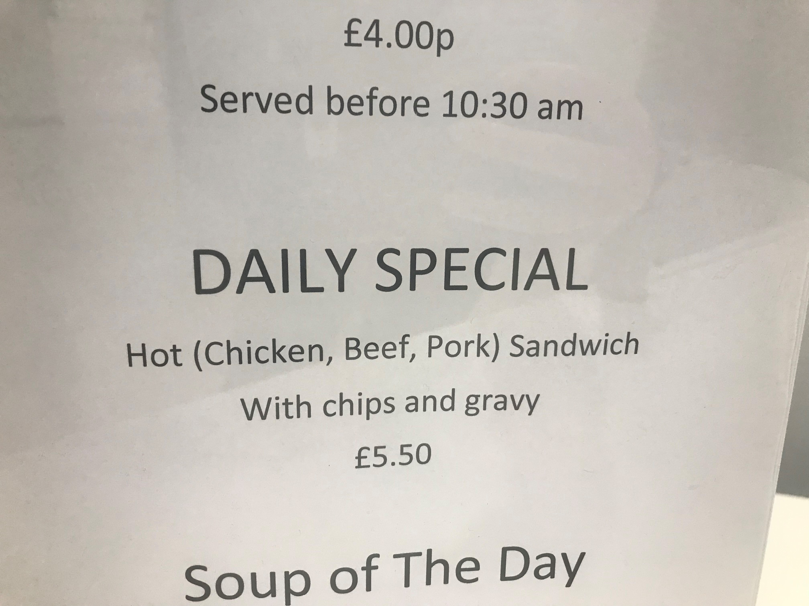

Slide 3
Brackets
Orders
Division
Multiplication
Addition
Subtraction

Slide 4
Brackets
Orders
Division
Multiplication
Addition
Subtraction

Slide 5
Brackets
Orders
Division
Multiplication
Addition
Subtraction

Slide 6
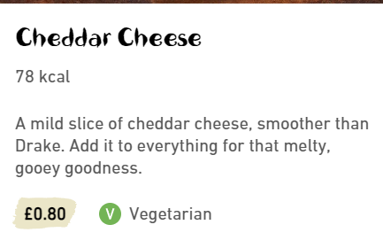
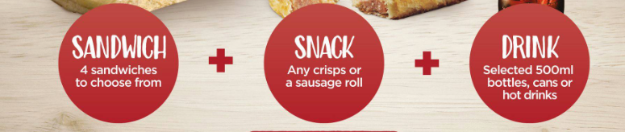
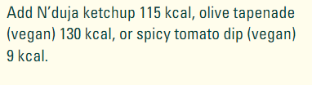

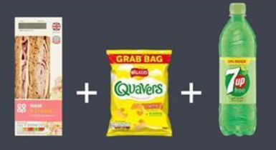
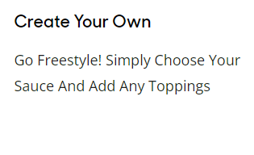
Adding foods together is easy!

Slide 7
Brackets
Orders
Division
Multiplication
Addition
Subtraction

Slide 8
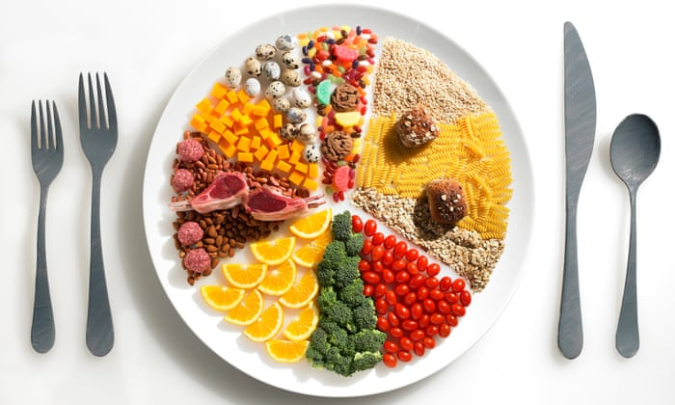
Subtracting food is easy(ish)

Slide 9
Brackets
Orders
Division
Multiplication
Addition
Subtraction

Slide 10
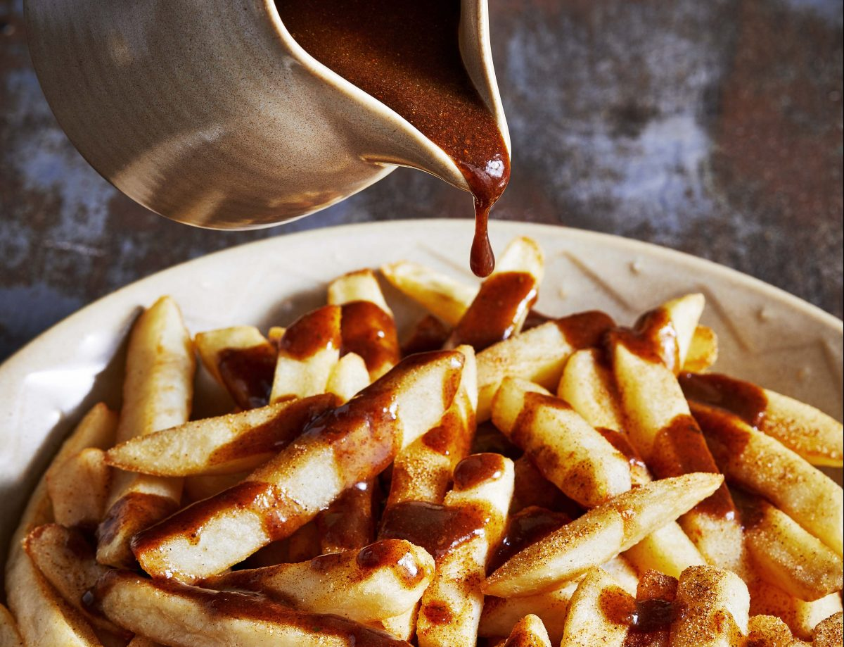

It’s all in the pronunciation!
$$\frac{gravy}{chips}$$

Slide 11
Brackets
Orders
Division
Multiplication
Addition
Subtraction

Slide 12
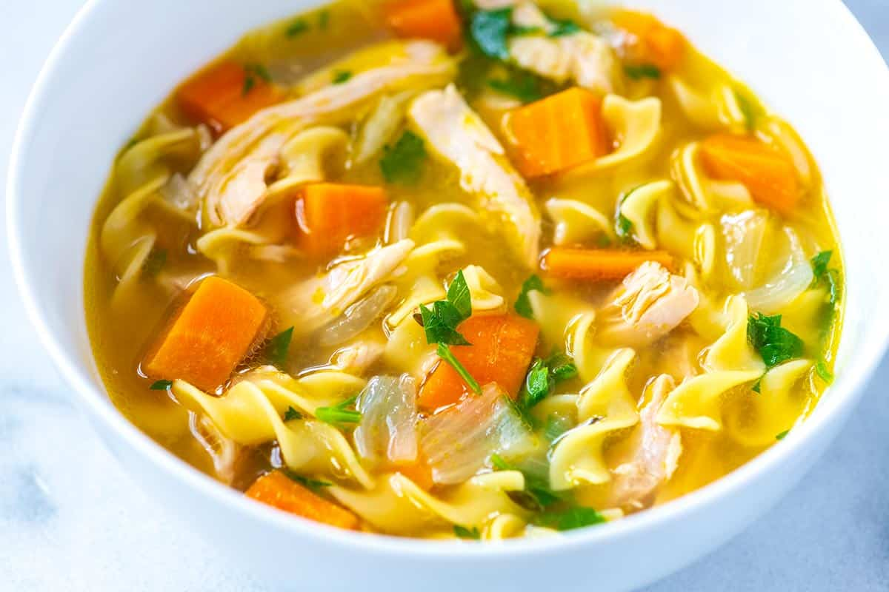
How can I combine two foods in a way that’s hard to undo?
…soup?

Slide 13
Brackets
Orders
Division
Multiplication
Addition
Subtraction

Slide 14
Maybe I can’t square-root a sandwich
But I can cube one!

Slide 15
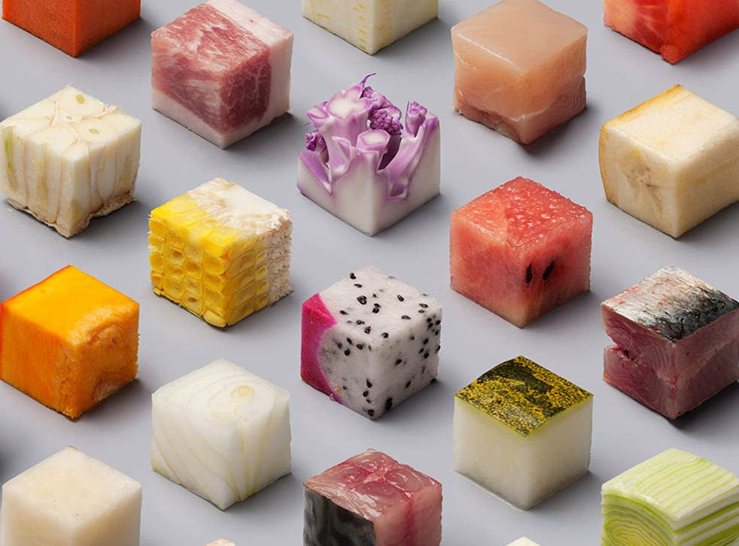

Slide 16
Brackets
Orders
Division
Multiplication
Addition
Subtraction

Slide 17
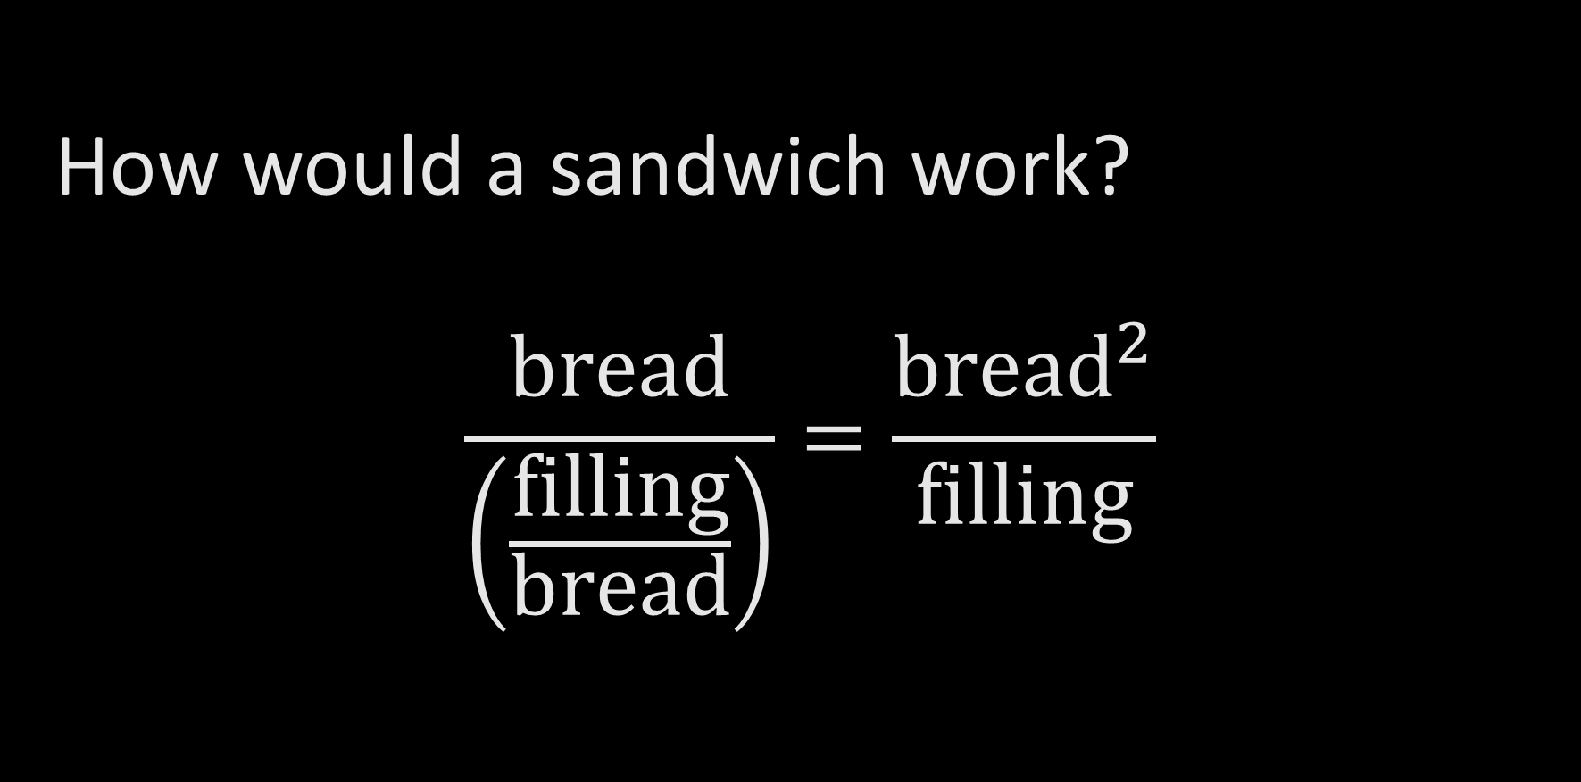
How would a sandwich work?
$$\frac{bread}{\left(\frac{filling}{bread}\right)}=\frac{{bread}^{2}}{filling}$$

Slide 18
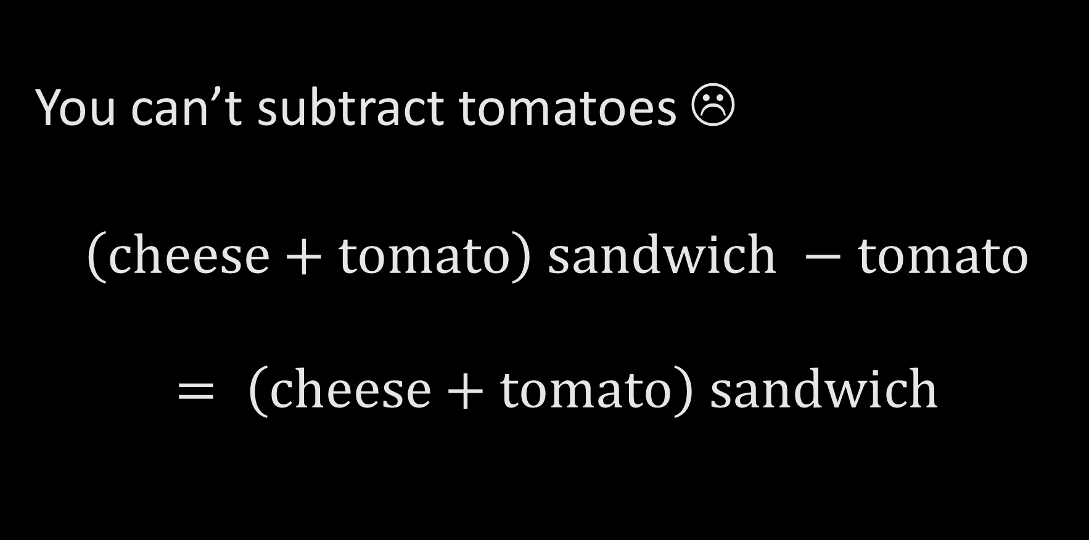
You can’t subtract tomatoes ☹
$\left(cheese+tomato\right) sandwich −tomato$
$$= \left(cheese+tomato\right) sandwich$$

Slide 19
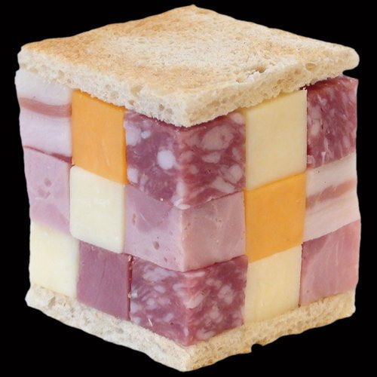
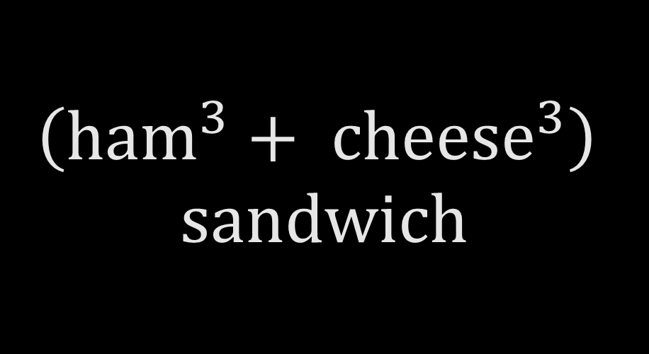
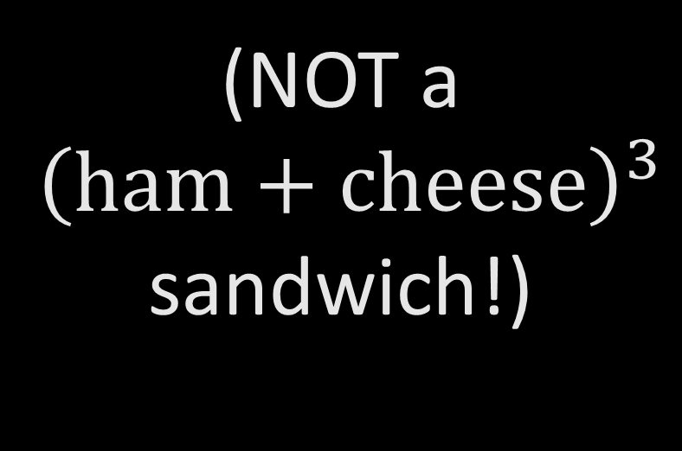
$$\left({ham}^{3}+ {cheese}^{3}\right)$$
$$sandwich$$
(NOT a
${\left(ham+cheese\right)}^{3}$ sandwich!)

