Slide 1


I hexagons
@hexagonhannah

Slide 2
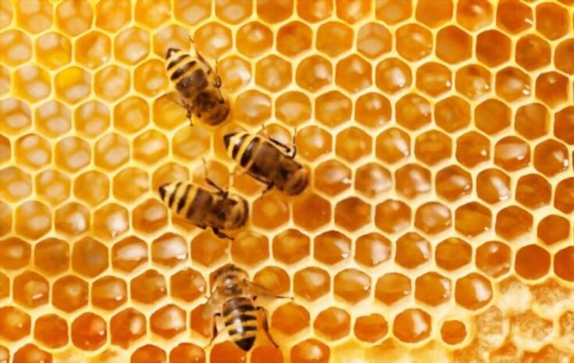

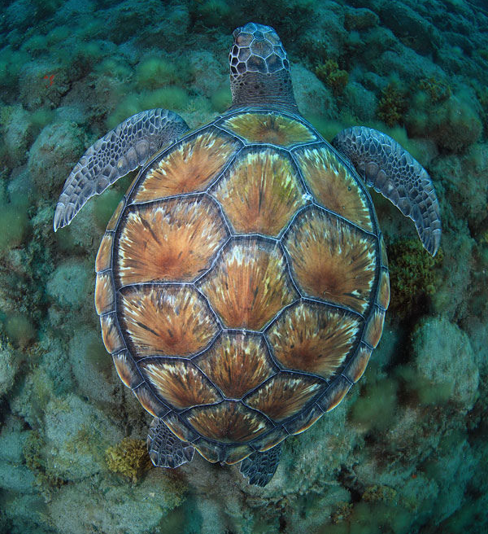
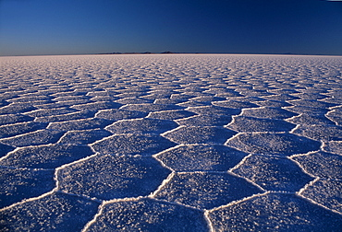
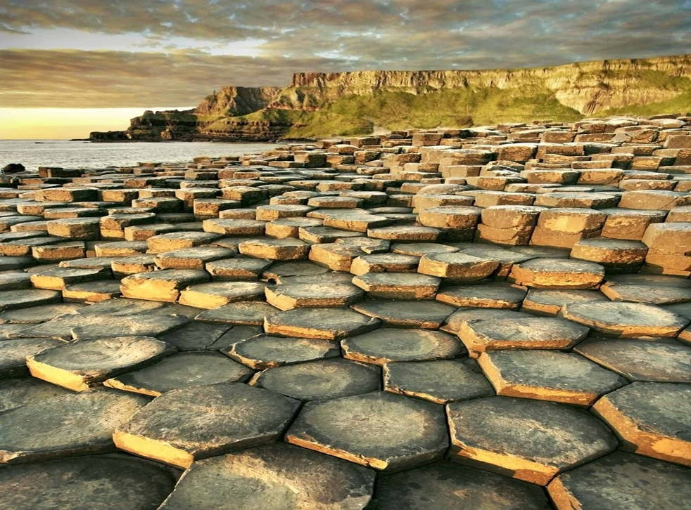
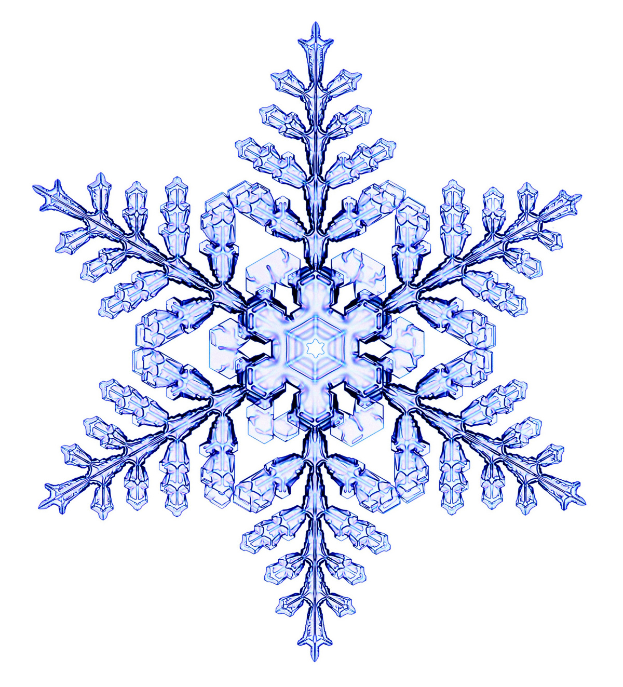
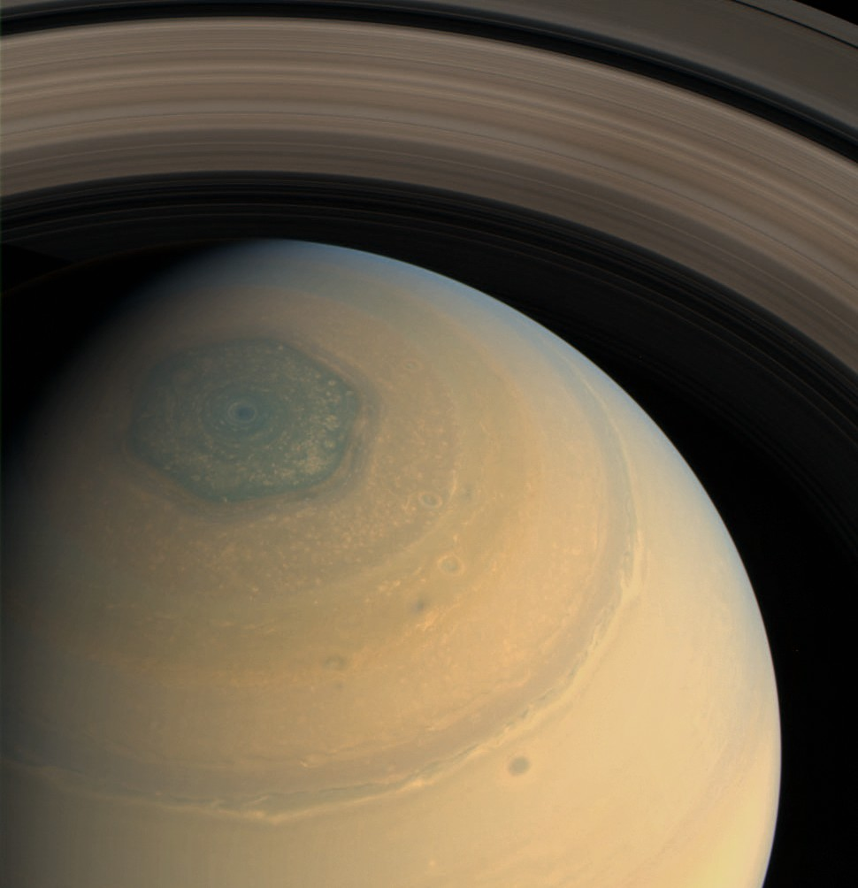
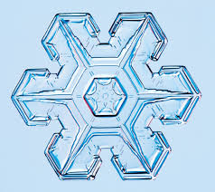
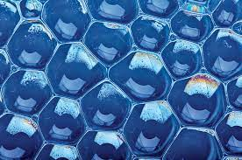
Hexagons are everywhere!

Slide 3
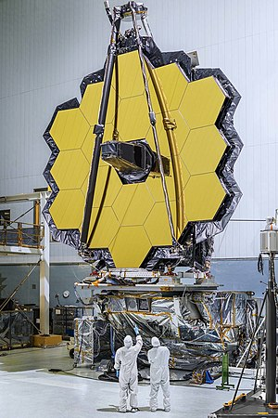
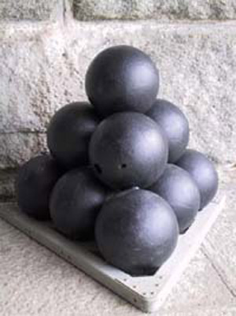

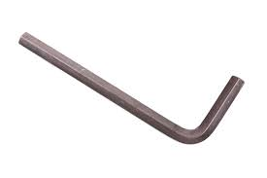
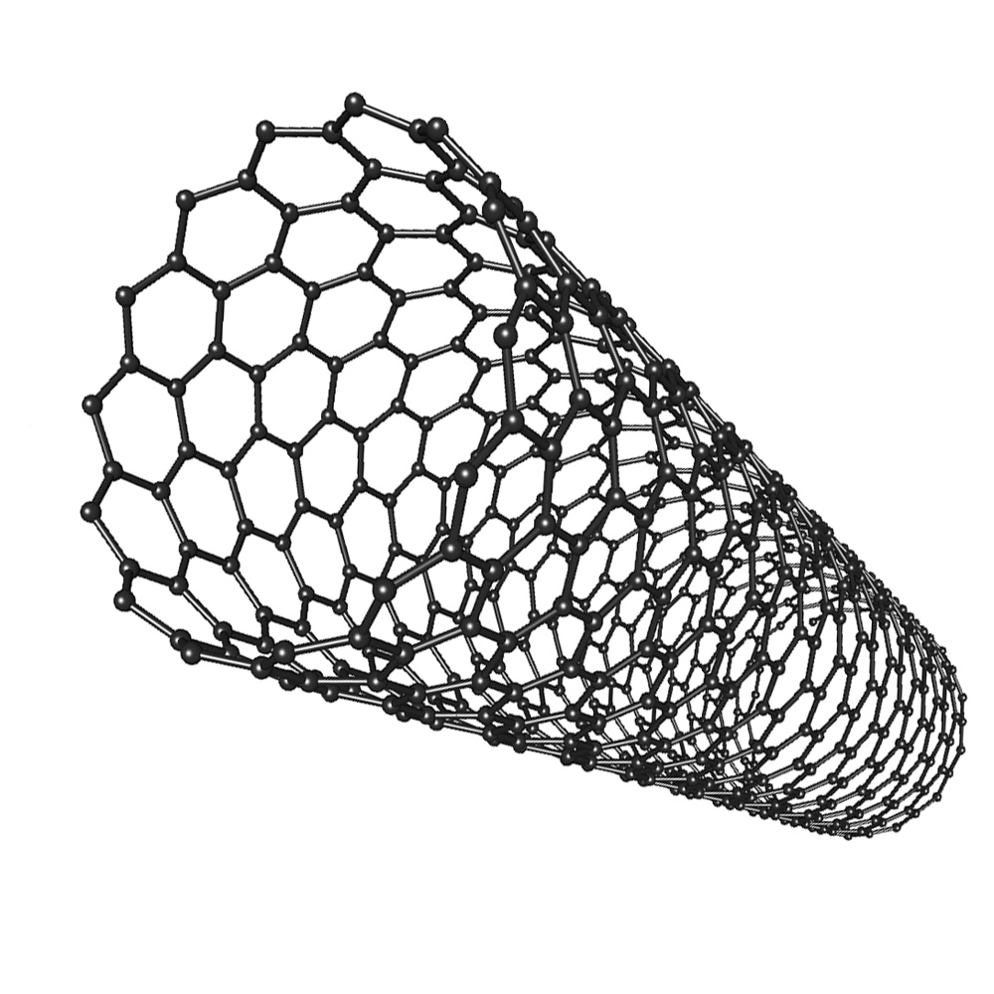

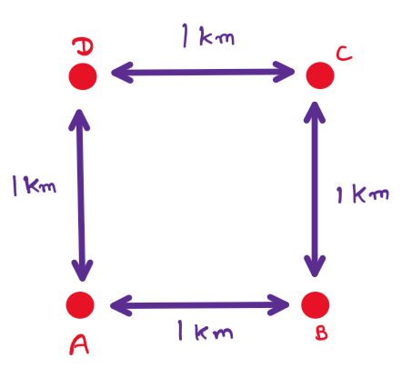
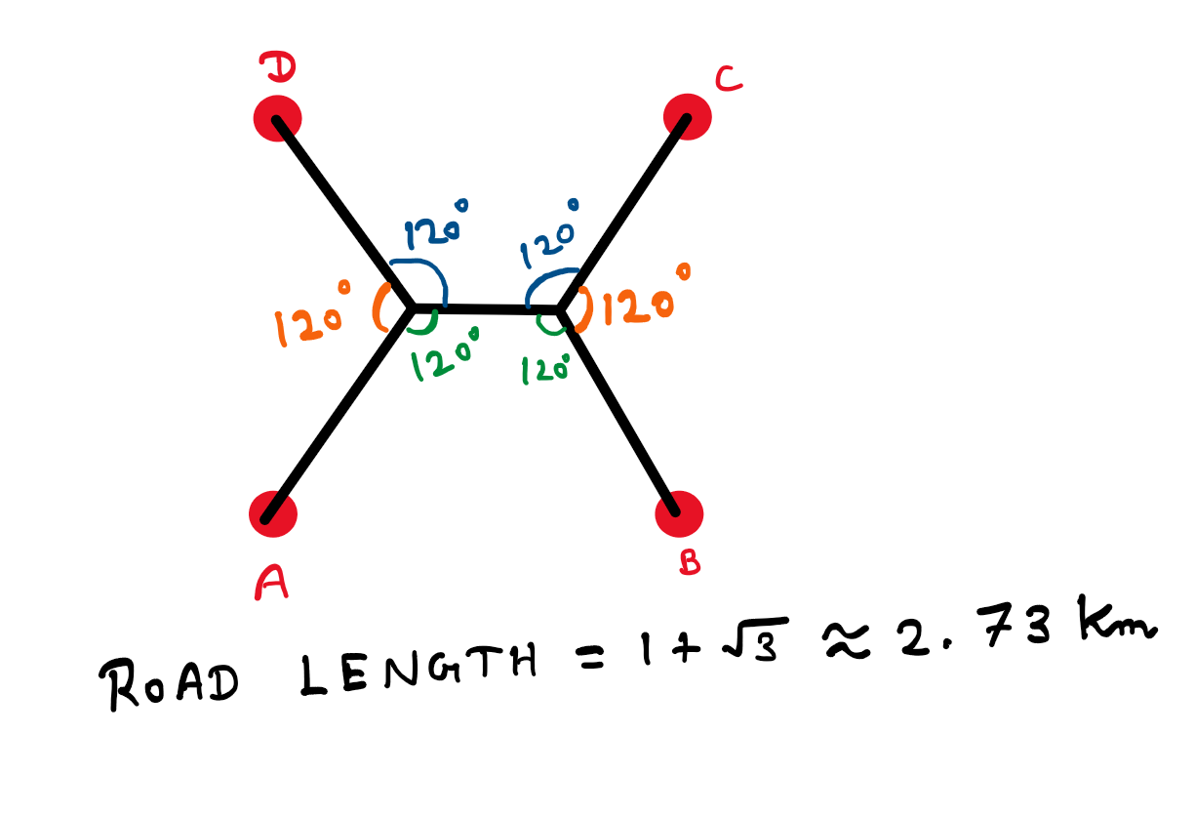
Hexagons are everywhere!

Slide 4
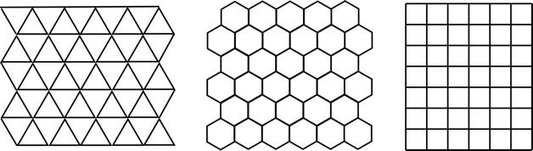
Hexagons ‘best fit’ the plane
360°
equilateral triangle 60°
square 90°
hexagon 120°

Slide 5
How much better?
1
1
2
2
1
1
1
1
2

Slide 6
How much better?
+50%

Slide 7


How much better?
1.5
1
1
$$\frac{3\sqrt{3}}{2}$$
$$\frac{9}{4}$$
1.5
1.5
1
1
1
1
1.5

Slide 8
How much better?
+50%
+15%
+30%

Slide 9
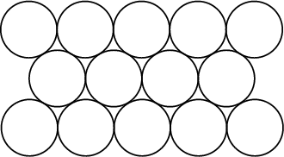
Hexagons and circles
r
r
60°
r
r
r
r
120°
Best for:
max area
min perimeter

Slide 10
Hexagons and circles
r
r
60°
r
r
r
r
120°
Best for:
max area
min perimeter

Slide 11

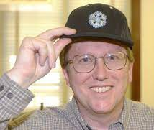

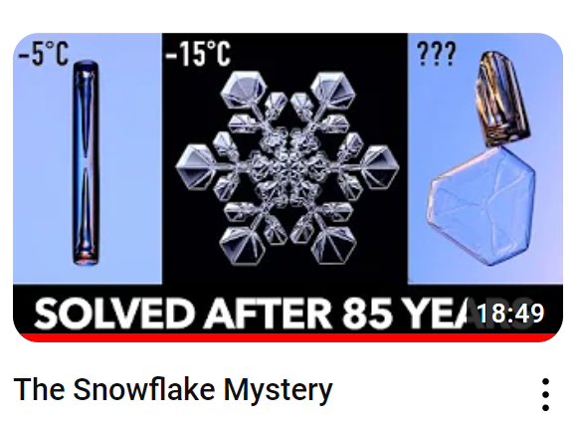

Check these out!

Slide 12
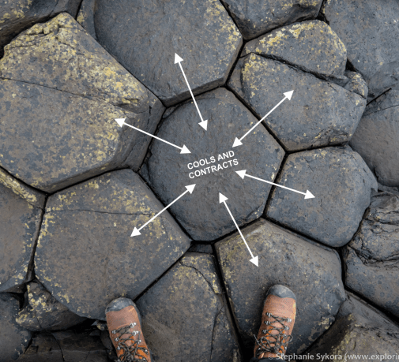
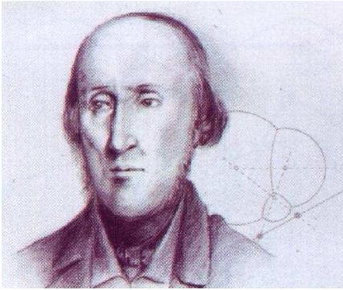
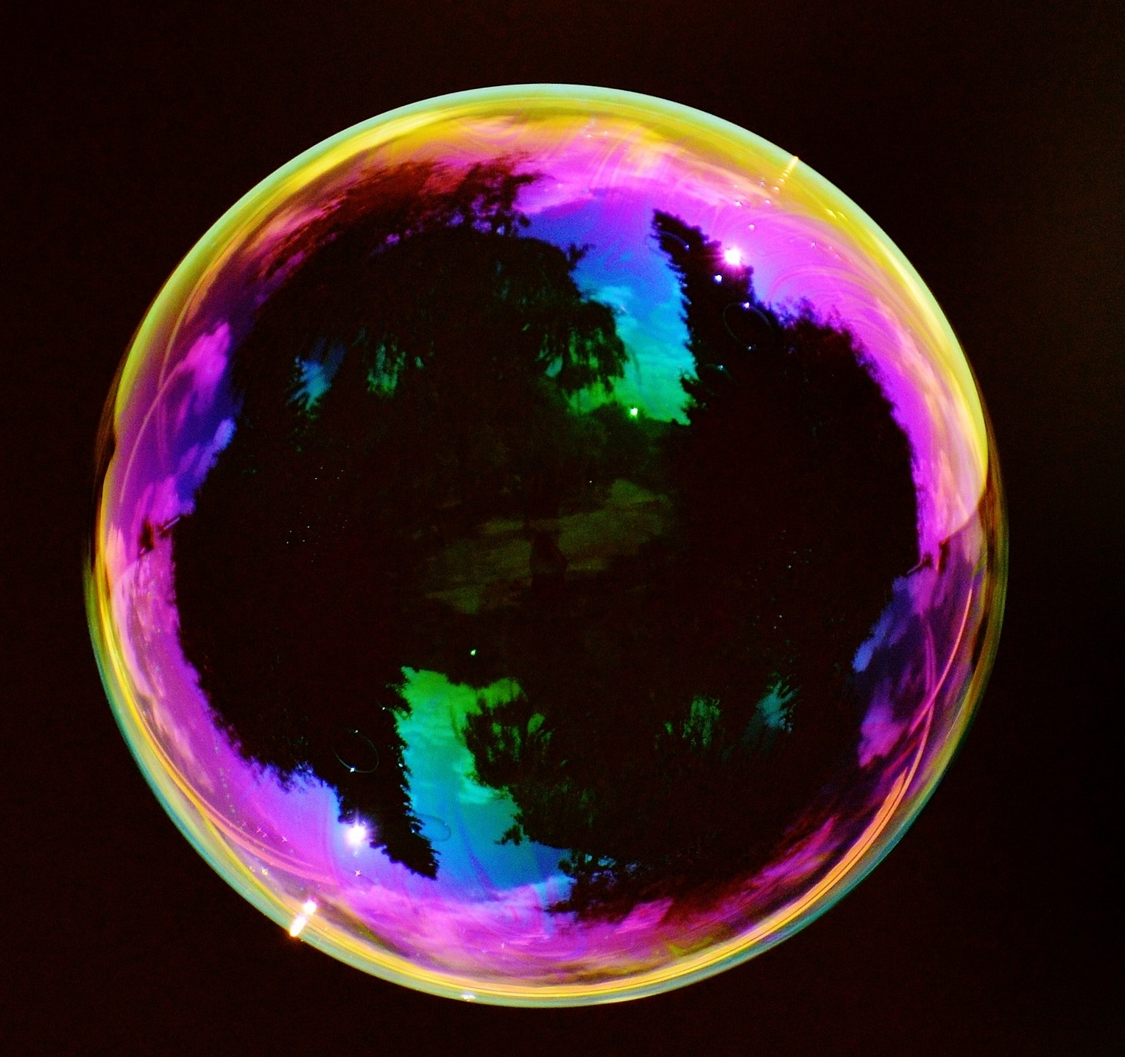
Why do they occur in nature?
Joseph Plateau

