Slide 1
How to Not Lose at Games
(Game Theory in practice)

Slide 2
What is a Game?
More than one person (player)
Each player has a decision to make (decision space)
Each combination of decisions from all players has an outcome for each player (outcome space)
Outcome might be win/lose or a number (utility) they will seek to maximise

Slide 3
Mean guessing game
This game is for 2+ players.
Each player secretly picks an integer between 0 and 100.
The winner is the player who picked closest to two thirds of the mean of all numbers picked.

Slide 4
Common assumptions in Game Theory
Rationality
Players will try to win/maximise their utility i.e. do the best they can
Common Knowledge of Rationality
Everyone knows that all players are rational (and that everyone knows this, and so on)

Slide 5
Approach assuming other players are rational
2/3 of the mean will never be more than ~67, so it is not rational to pick a number higher than this
If you believe that all other players are rational, then 2/3 of the mean will never be above 2/3 of 67 = 44, so it is not rational to pick a number higher than this
If you believe that all other players are rational, and that they believe all other players are rational….
And so on, until the only remaining rational strategy is to select 0!
Note: 0 is a Nash Equilibrium

Slide 6
Approach with weaker assumptions
Assuming everyone else is irrational and guesses randomly, the mean will be 50 and so the best guess is 33
Assuming everyone else thinks this too (that everyone else is irrational) and also guesses 33, the best guess would be 22
And so on…until you reach zero again
K-level reasoning
L12
L3
L2
L1
Level 0
…

Slide 7
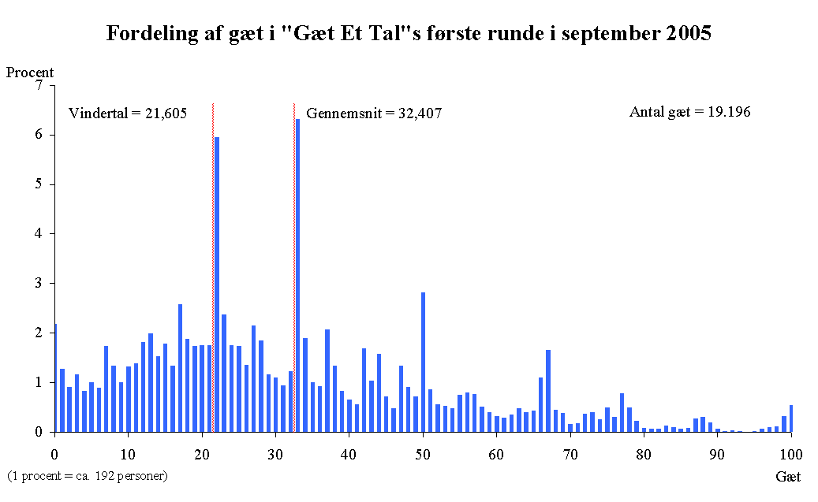
What happens in practice?
Level 2
Level 1
Average iterations: 1

Slide 8
What happens if you play multiple times?
Iterations: 1.8
Winner: 16
Mean: 24
Mean: 16
Iterations: 2.8 (+1)
Winner: 11
Iterations: 2.7 (-0.1)
Winner: 11
Mean: 17…

