Slide 1
What do we mean by
1=0.9 reoccurring
A conversation with a none Mathematician who will not believe it

Slide 2
How I first came across this idea
At Open University Summer School for the Maths foundation Course
Every Morning 15 minutes of Quick fire questions such as
  Is 1 > 0.9 reoccurring
Answer 1= 0.9 recurring
Proof they gave
  If two real numbers are different then by the density property of the real numbers there is a third number which is the average of the two sitting between them
  But 1 + 0.9… = 1.9… and 1.9../2 = .9… hence 1 = 0.9..

Slide 3
Reaction of my friend
Very intelligent
First in History and politics
But claimed he got a head ache when he considered or thought of any mathematical ideas
His reaction
  Disbelief
  This is some sort of mathematical slight of hand
  No way they can be the same
My reaction :- come up with further proofs to try and convince him

Slide 4
Two further proofs
Proof 1
  Let s = 0.9.. = 9/10 + 9/100 +9/1000 + …
  10s = 9 + 9/10 + 9/100 + 9/1000+ …
  10s = 9 + s => 9s = 9 => s = 1
Proof 2
  1/3 = 0.3..
  3X1/3 = 3 x 0.3. .
  1 = 0.9..
My friends reaction
  Just further Mathematical slight of hand

Slide 5
So why does my Friend not accept these proofs ?
All three proofs assume
  that numbers like 0.9.. and 0.3.. Exist
  That you can treat then algebraically in the same way as none-reoccurring numbers
Are these assumptions valid or was my friend right to be cynical
What happens if we apply a similar technique the other way that is to .9.0
  let s =. .9.0 = 9 +9X10 + 9X100 + 9 X1000 ….
  10s = 9X10 + 9 X100 +9X1000.. = s -9
  9s = -9 => s = -1
  Clearly not a reasonable answer !!
What about ...9.9… apply the same reasoning we get S = 0
So it seems we are on dangerous ground when we try to apply algebraic procedure to reoccurring numbers
Seems my friend was right

Slide 6
What is the difference. Introducing limits
For …9.0 s does not exist
  We have the sequence , 9, 90, 900, 9000
  Each term in this sequence is larger then the pervious term so by the divergence test the series formed by the partial sums of his sequence is divergent so has no limit, so in this case s does not exist
For 0.9.. s may exist
  We have the sequence 9/10, 9/100, 9/1000,9/10,000
  Each term in the sequence is small than the previous term so in this case the divergence test is inconclusive and the series formed by partial sums of this sequence may converge hence s may exist

Slide 7
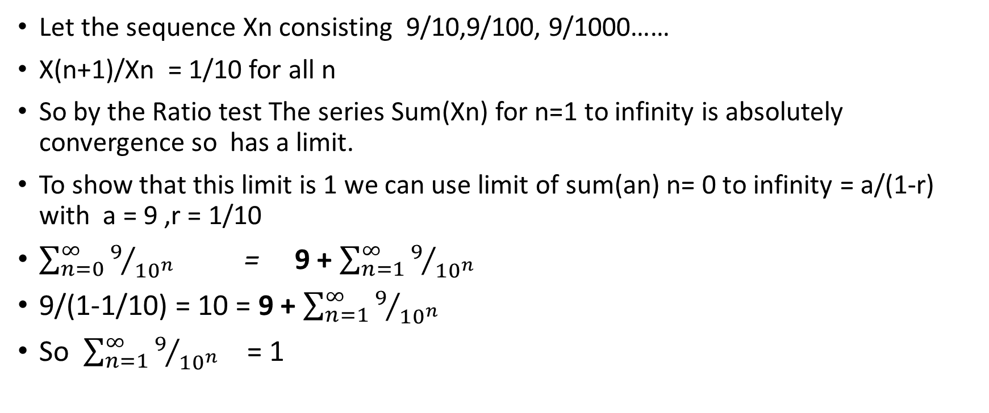
Does s exist for 0.9.. Have a limit and if so what is it ?
Let the sequence Xn consisting 9/10,9/100, 9/1000……
X(n+1)/Xn = 1/10 for all n
So by the Ratio test The series Sum(Xn) for n=1 to infinity is absolutely convergence so has a limit.
To show that this limit is 1 we can use limit of sum(an) n= 0 to infinity = a/(1-r) with a = 9 ,r = 1/10
$\sum_{n=0}^{∞}{9/{{10}^{n}}}$ = 9 + $\sum_{n=1}^{∞}{9/{{10}^{n}}}$
9/(1-1/10) = 10 = 9 + $\sum_{n=1}^{∞}{9/{{10}^{n}}}$
So $\sum_{n=1}^{∞}{9/{{10}^{n}}}$ = 1

Slide 8
So does it all mean
  1= 0.9… are we really saying the limit of the partial sums of the sequence 9/10, 9/100 .. Is 1 and as this limit exist we can use algebraic methods to manipulate it
  Also that the limit of …99999.0 does not exist so we cannot use algebraic methods to manipulate it
  And For numbers with infinite decimal expansions we can only manipulate them using algebraic methods if they can be expressed as a convergent sequence with a limit

Slide 9
So what does my friend say
I was still unable to satisfy him
But the approach using limits has been more satisfying for me
I have also learnt the following
  Talking with someone who sees mathematics as some sort of occult art and is cynical about some of its reasoning can be useful and lead to deeper insights
  Even if a proof seems very convincing there may be hidden assumptions that need to made explicit
  Methods that work for one type of number, decimal numbers with finite expansions may not work for others , decimal numbers with infinite expansions

Slide 10
Further considerations
Reoccurring expansions of fractions are a product of the number system being used.
  Using a base 12 1/3 becomes 0.4, 2/3 = 0.8 so 3/3 = 1
  But other fractions become recurring sequences
What about other number systems
Just come across Surreal numbers and in this number system it seems that 1 and 0.99… are not equal ?
In this system each real number is surrounded by surreal numbers which are closer to it than any other real numbers 0.99.. Can be expressed as a surreal number that is not equal to the surreal number 1

